Slide 1



適用於選舉監管機構的工具和解決方案
深入瞭解
瞭解 Meta 的廉正選舉政策和產品

Slide 2
討論主題
開始使用 Meta 技術
廣告總覽
社會議題、選舉或政治相關廣告
Meta 廣告檔案庫
資源

Slide 3

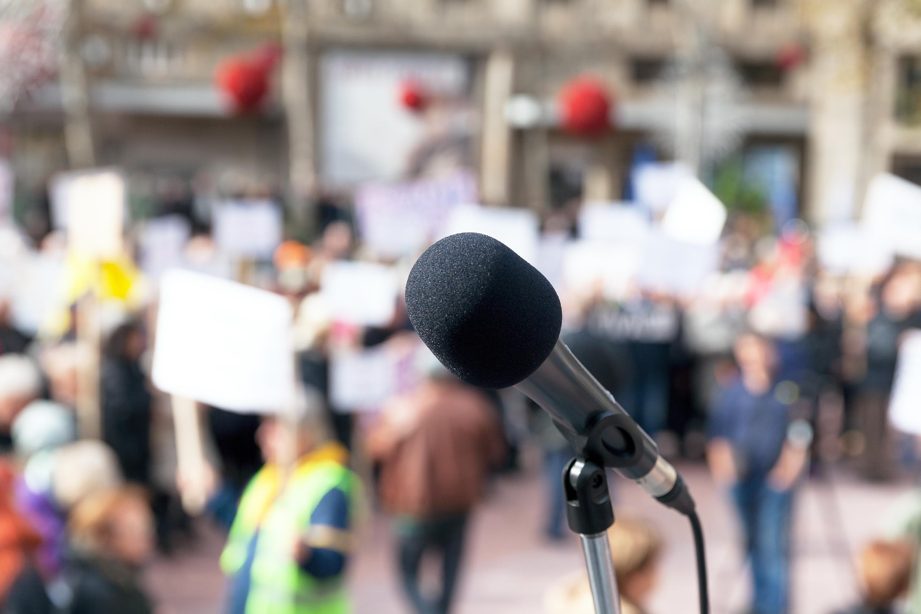

我們對選舉採取的具體作法
防止外力干涉選情和選民
我們會持續審查內容，確認是否違反我們的
《社群守則》。
我們的團隊要同時對抗外國勢力干涉和國內影響力作戰。
提供用戶可靠資訊，建立聯繫
我們會持續為用戶提供有關選民登記的官方資訊。
美國各州和地方選舉官員繼續使用我們的 Facebook 和 Instagram 投票快報。
我們與 90 名合作夥伴合作，使用的語言超過
60 種，攜手解決網路錯誤資訊的問題。
提供領先業界的廣告資訊透明度
針對社會議題、選舉或政治相關廣告，我們提供領先業界的資訊透明度。
我們在廣告檔案庫報告中採用我們的自訂花費
追蹤器。
Notes:
Let’s first discuss Meta’s approach to elections. We have a three-pronged approach for elections:
Preventing election and voter interference. We do this by continually reviewing content to determine if it violates our Community standards and our team fights both foreign interference and domestic influencer operations.
Connecting people with reliable information. We’re continuing to connect people with details about voter registration through our Voting Alerts on Facebook and Instagram. We work with 90 partners covering over 60 languages to address viral misinformation.
Providing industry-leading transparency for ads. Since 2018, we have provided industry-leading transparency for ads about social issues, elections or politics. Our Custom Spend Tracker is available as part of our Ad Library Report.

Slide 4

單元 1
開始使用 Meta 技術

Slide 5


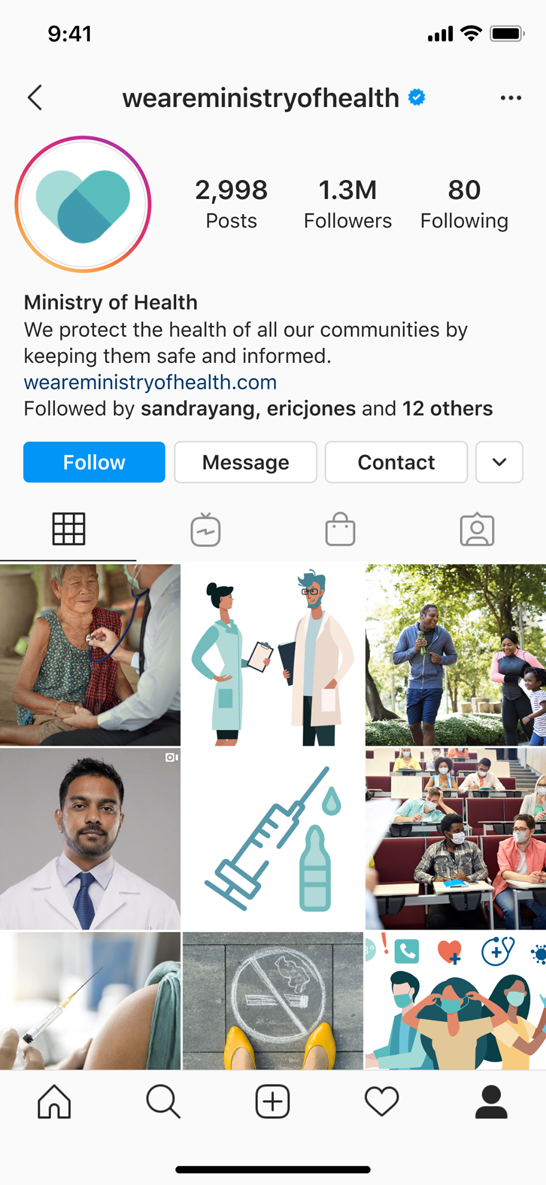
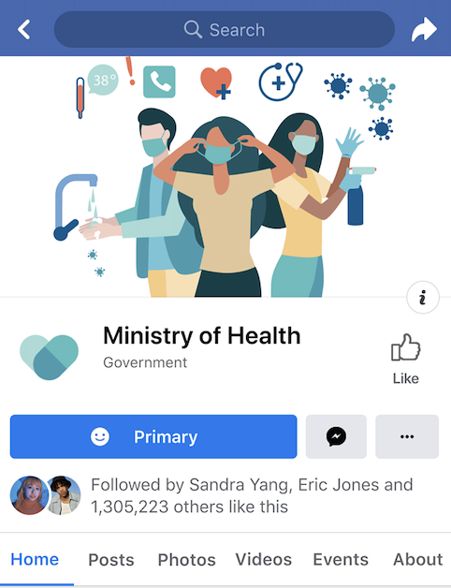
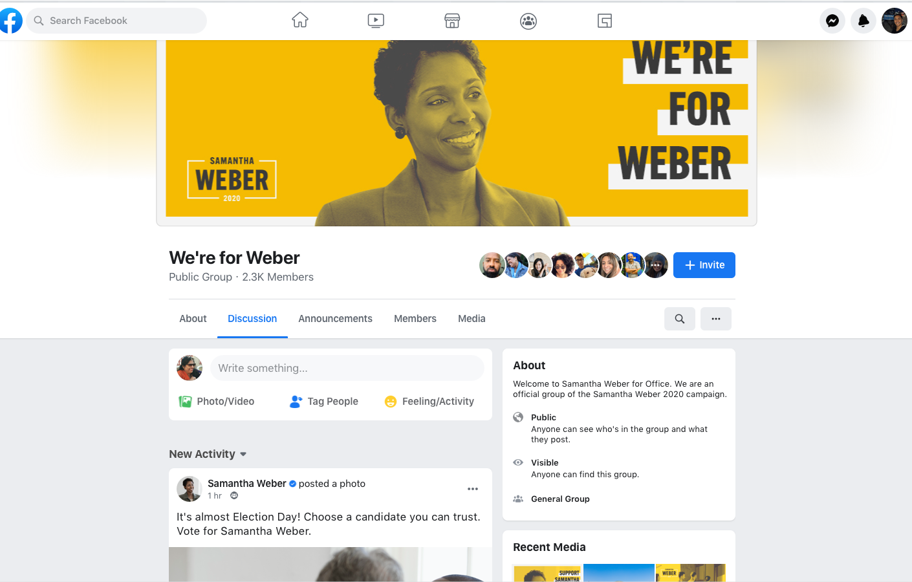
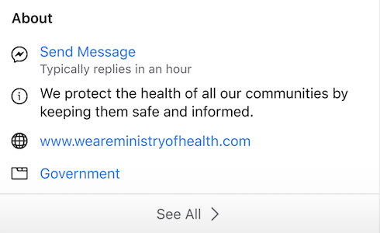
Facebook 粉絲專頁
用戶可透過 Facebook 粉絲專頁與您的組織建立聯繫並深入瞭解您的公益理念。您可以與選民和潛在選民分享更新資訊並進行互動交流。
個人檔案
粉絲專頁
Notes:
If you’re familiar with Facebook, chances are you already have a Facebook profile. This is your personal profile page. However, we recommend for individual electoral commissions involved in [government or politics] create a Facebook Page, rather than a profile. Your Page is a public presence designed for connecting with people at-large who you may or may not know personally. Your Page is managed by profiles and will have access to tools such as Page Insights and the ability to advertise. Be sure to add a profile Picture and Cover Photo like the example shown here.

Slide 6
粉絲專頁帳號安全
雙重驗證
隱私設定檢查
帳號安全檢查
Notes:
Once you have your Page, the most important thing you can do is turn on two-factor authentication.
Two-factor authentication is a security feature that helps protect your Facebook account in addition to your password.
When you set up two-factor authentication, you’ll be asked to enter a special login code or confirm your login attempt each time someone tries accessing Facebook from a browser or mobile device we don’t recognize.
Privacy checkup will help you control who can see what you share, how your information is used and how to secure your account.
Security checkup will help you log out of unused browsers and you will get alerts when someone tries logging into your account from an unrecognized computer or mobile device.
When you are conducting a security checkup, it’s also a good time to ensure that the email associated with your Facebook account is one that you currently have access to.

Slide 7
最佳化粉絲專頁
自訂網址
褻瀆詞語及關鍵字篩選功能*
留言排序
訊息功能
分享里程碑
*政府或官員在採取上述動作時，可能會因相關法律和規則而受到些許限制。如有疑問，請諮詢您的法律顧問。
Notes:
Once your Page is up and running, you will want to optimize your Page.
First, visit the “About” section and edit the “Create Page @Username” file under “General.” This will change the URL of your Facebook Page to facebook.com/[USERNAME]. We recommend that your Facebook Page URL/username match your other online accounts if at all possible - it will make them all that much easier for people to remember.
Second, click on “Settings” to adjust a number of options that will help you optimize your Page. For example, you can block certain words from appearing on your Page by using the Profanity Filter and Page moderation tools.
Comment ranking - Your can turn on comment ranking so that comments with the most likes or replies, as well as comments from verified Profiles and Pages, will appear first.
For Messaging, people increasingly want to communicate through private messaging because it is fast and convenient. Page admins can turn messaging on or off, set up welcome greetings, instant replies and more. If you do begin to utilize Page messaging, be sure you’re following our Messenger platform policies.
You can also share important milestones, which are a great way to give people more insight into the history and progress of your organization. Your Page is also the place to celebrate big moments, launches and anniversaries.

Slide 8

Facebook
驗證條件
遵循《社群守則》。
真實呈現：代表真實人物或實體。
獨一無二：成為特定人物或實體的唯一代表。
資訊完整：提供「關於」部分、粉絲專頁或大頭貼照和最新動態，包括至少一則貼文。
廣為人知：代表知名且搜尋率高的人物或實體，可以進行
付費驗證。
Notes:
The verified badge means Facebook has confirmed that the Page or profile is the authentic presence of the individual or entity it represents. You can apply for the verified badge if you are a public figure or entity and meet certain account and eligibility requirements. You can scan the QR code on the screen to fill out the form and verify your profile or Page. You must be logged in to view this form and request verification.
In addition to following our terms of service and the Facebook Community Standards, Pages and profiles need to be:
Authentic: Represent a real person or entity
Unique: Be the only presence of this person or entity. Only one Page or profile per person or entity may be verified, with exceptions for language-specific Pages and profiles.
Complete: Have an about section, Page or profile photo and recent activity, including at least one post.
Notable: Represent a well-known, often-searched person or entity for paid verification.
https://www.facebook.com/help/1288173394636262

Slide 9
運用工具管理粉絲專頁的貼文
審核小幫手
自動隱藏所有含有圖像或連結的新留言。
褻瀆詞語篩選器
封鎖不同等級的褻瀆詞語，
防止這類詞語顯示於粉絲專頁。
禁用詞語控制
封鎖含有您手動輸入之字詞、詞彙或表情符號的貼文或留言。
留言排序
依照系統預設，獲得最多讚和回覆次數的留言會優先置頂
顯示在粉絲專頁上。
*政府或官員在採取上述動作時，可能會因相關法律和規則而受到些許限制。如有疑問，請諮詢您的法律顧問。
Notes:
Meta has tools in place to help you manage what supporters and potential voters and post on your Page. One core tool we offer is Moderation Assist. This is a tool to manage comments for the new Pages experience where you can automatically hide all new comments that have images or links. You can review hidden comments in your Moderation Assist Activity Log to determine if you want them to be visible.
In addition to Moderation Assist, you can turn on additional tools such as:
Profanity filter to block different degrees of profanity from appearing on your Page. We determine what to block by using the most commonly reported words and phrases marked offensive by the community.
Page Moderation to block posts or comments containing the words, phrases or emojis you manually enter. When people include a word you've blocked in a post or comment on your Page, it won't appear on your Page.
Comment ranking so that comments with the most likes or replies as well as comments from friends or verified profiles and Pages will appear at the top by default. If you've turned off comment ranking for your Page, your Page will display comments chronologically by default.
After posting to your Facebook Page, you can manage comments by:
Limiting the people and Pages who can comment on each of your organic posts.
Hiding or deleting a comment from a post on your Facebook Page. When you hide a comment from a post on your Page, the comment will only be visible to the person who wrote it and their friends. When you delete a comment from a post on your Page, the comment will be permanently removed from the post.
Reporting a comment if it doesn't follow the Meta Community Standards.
Note: There may be restrictions on the ability of government or political officials to take these actions pursuant to applicable laws and regulations. Please consult with your legal counsel if you have questions.

Slide 10
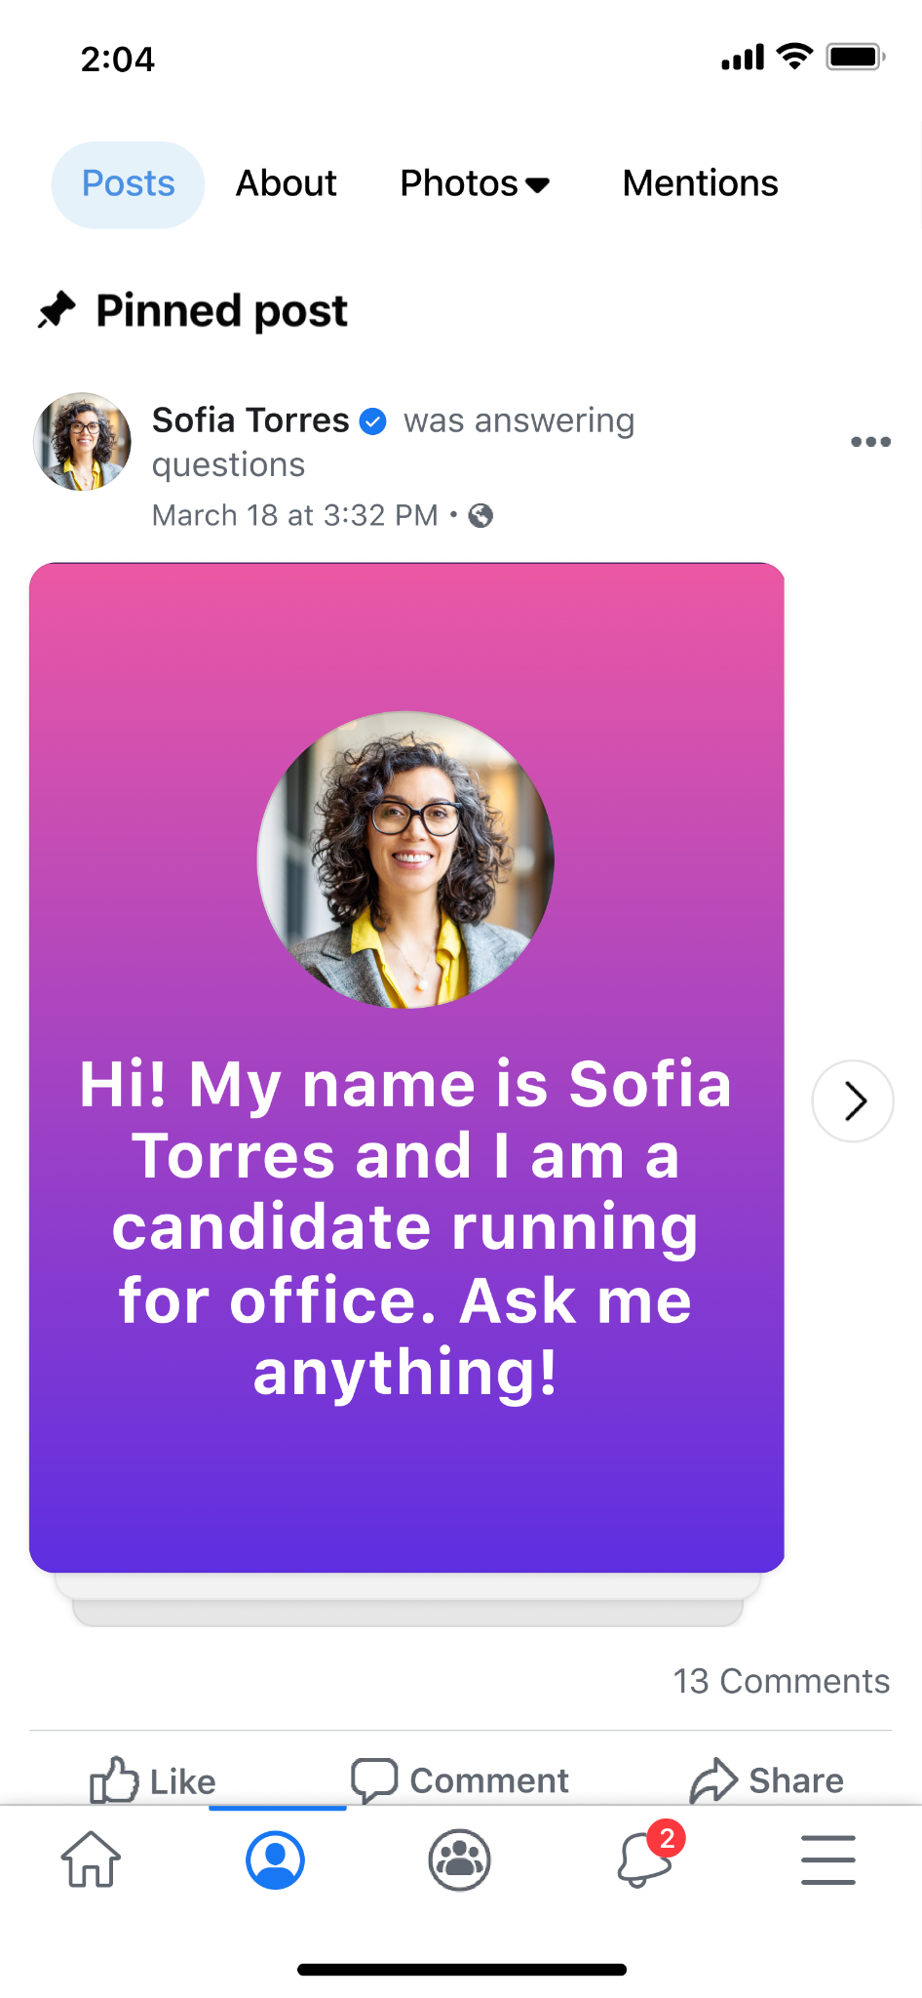
將貼文置頂於粉絲專頁
Notes:
You can set expectations about the type and tone of conversations you want to see on your Page, which can easily be done in a post pinned to your Page.
If you have Facebook access to a Page, you can pin posts, upcoming events and recent videos for display in the Featured section at the top of your page. As you pin items, the newest item appears at the front of the list, but you can change the order of any item. Pinned items remain in the Featured section until you remove them.
To pin a post, events or videos:
Log into Facebook, then click your profile photo in the top right
Click See all profiles, then select the Page you want to switch into
Click your Page’s profile picture in the top right to go to your Page.
Click your Page’s profile picture in the top right to go to your Page
Click Manage in the Featured section. If your Page already has pinned items, click the plus sign next to your pinned items
Click the pin icon next to Upcoming event, Recent videos, or a post below Recent posts you can pin to add these items to your Featured section.
You can also go to a post on your Page and click the three dots in the top right of a post and click the Pin post.
https://www.facebook.com/help/235598533193464

Slide 11
善用投票快報
注意：投票快報僅適用於美國地方政府、公共衛生單位和第一線處理單位所設定的粉絲專頁，以及澳洲的部分城市
就像本地快報一樣，投票快報應該只能用於緊急、實用且與選民廣泛相關的貼文。投票快報可用來傳達下列事項的特定司法管轄區變更資訊：
投票地點
投票方式和方法
誰符合選舉參加資格的相關規則
投票時間範圍（小時或日期）
Notes:
[Note: Voting alerts are only available to local government, public health agency and first responder Pages in the US and select cities in Australia. Before presenting this slide, please check with local policy and product to see if this is available in your country]
One tool I want to touch on before getting into Instagram and WhatsApp is voting alerts.
We know that it can be important for you and state and local governments to have the ability to communicate important and timely information. Voting alerts is an extension of local allows and allows state and local election authorities to reach their constituents with important updates about voting.
Like local alerts, voting alerts should only be used for posts that are urgent, actionable and broadly relevant to voters. Voting alerts can be used to communicate jurisdiction-specific changes to:
Voting locations
Means and methods of voting
Rules about who is eligible to participate in an election
Voting time frame (hours or dates)
There are separate guidelines for state election authorities and some local election authorities and county/municipal government agencies who are eligible to send Voting Alerts during a limited period of time around an election.
Pages eligible to send Voting alerts:
Must be an “Office” Page (i.e. Government Organization, Public and Government Service) and not a “People” Page (Named Government Official)
Have a Page thumbnail that does not identify as an elected official
Have a Page name that does not contain a person’s name
How voting alerts should be used: Like Local Alerts, Voting Alerts should only be used for posts that are urgent, actionable and broadly relevant to voters. Voting Alerts can be used to communicate jurisdiction-specific changes to:
Voting locations
Means and methods of voting
Rules about who is eligible to participate in an election
Voting time frame (hours or dates)
Voting Alerts must be targeted at all voters affected by the alert, not a subsection to the people to whom the alert is relevant.
Prohibited content: All use cases outside of those that we just mentioned are strictly prohibited, and may result in removal of the alert. Examples of prohibited content or targeting include:
Content identifying, referring to or advocating for candidates, political parties or organizations, elected officials, ballot measures or specific races
Content that isn’t broadly actionable for all voters i the alerted area
Content about a jurisdiction-wide change to means/methods of voting that is targeted to only part of the jurisdiction
Content about potential changes that are still the subject of ongoing litigation or other legal proceedings.
https://www.facebook.com/business/help/626587208260920?id=1549080658590154
https://www.facebook.com/gpa/blog/us-voting-alerts

Slide 12
前往您的 Facebook 粉絲專頁並開啟貼文撰寫工具，檢查可以使用的通知，然後將您的貼文設為投票快報。
從該處：
選擇通知地點。
選擇快報時間長度。
張貼內容前進行編輯。
傳送投票快報。
建立投票快報
Notes:
[Note: Voting alerts are only available to local government, public health agency and first responder Pages in the US and select cities in Australia]
There are separate guidelines for state election authorities and some local election authorities and county/municipal government agencies who are eligible to send Voting Alerts during a limited period of time around an election.
To get started creating a voting alert, go to your Facebook Page and open the post composer to check how many alerts you have available, and mark your post as a voting alert. From there,
Select alert location
Select alert duration
Edit before you post
Send your voting alert
Voting Alerts must be targeted at all voters affected by the alert, not a subsection to the people to whom the alert is relevant.
Prohibited content: All use cases outside of those that we just mentioned are strictly prohibited, and may result in removal of the alert. Examples of prohibited content or targeting include:
Content identifying, referring to or advocating for candidates, political parties or organizations, elected officials, ballot measures or specific races
Content that isn’t broadly actionable for all voters i the alerted area
Content about a jurisdiction-wide change to means/methods of voting that is targeted to only part of the jurisdiction
Content about potential changes that are still the subject of ongoing litigation or other legal proceedings.
https://www.facebook.com/business/help/626587208260920?id=1549080658590154
https://www.facebook.com/gpa/blog/us-voting-alerts

Slide 13

建立並最佳化 Instagram 帳號
Notes:
In addition to a Facebook Page, you might consider building an Instagram account. To get started, download the Instagram App in the app store. Enter your phone number or email address then the name of your organization.
Next, you’ll want to consider what type of account you want: A personal account, business account or creator account. We recommend for government, political and advocacy organizations to choose a business account
Complete your profile by:
Adding a profile picture: You can do this by navigating to your Instagram profile and tap Edit profile. Choose a profile picture that represents your organization and clearly communicates your brand. For example, a photo of your logo will help your community recognize you. Your profile picture will appear in the top left corner of each post you create.
Include a link to your website: With a business account, you can include a link to your website or blog in your profile.
Write a bio that describes your organization: Use your bio to tell people about your organization. Bios can’t exceed 150 characters, so keep it short and get attention early. Your bio can include what your organization does, what you stand for or language and emojis that reflect your personality.
Select a category: This helps people identify what you do and will appear in your profile under the name of your organization
Lastly, add contact details and an action button: Include your email address, phone number and location in Contact options to help people find and reach you.
https://www.facebook.com/business/learn/lessons/instagram-business-profile-setup
https://www.facebook.com/help/instagram/502981923235522

Slide 14
Instagram 商業帳號功能
您可加入組織的聯絡資料，鼓勵用戶與您聯繫。
整理訊息和使用快速回覆。
使用專業主控板。
Notes:
When you set up a free business account on Instagram, you can access features designed to help your organization. These tools can help you grow and manage your organization on Instagram. Here are some features of an Instagram business account:
Provide contact information: Include contact information about your organization and encourage people to get in touch. Add a link to your website, a phone number, location and email address so people can find your contact information. You can also add an action button (such as a contact button) to your profile. This enables people to take a direct action with you.
Organize your messages and use quick responses: With an Instagram business account, you’ll have access to an inbox that enables you to organize messages. The inbox has two tables: Primary and General. The Primary tab is for the messages you want to see first. All messages will appear in the Primary tab, but you can swipe them into the General tab. The General tab is for messages you want to get back to later.
Use the professional dashboard: Explore educational information and business tools all in one destination. Use the professional dashboard and Insights to learn about how your followers interact with your photos and videos. This knowledge can help you create posts that are relevant to your audience and increase opportunities for them to see your profile and take action.
https://www.facebook.com/business/learn/lessons/establish-instagram-business-account

Slide 15

Instagram 驗證標章
在 Instagram 帳號名稱旁顯示驗證標章，表示這個帳號
經 Instagram 認證為該名人員或實體的真實身分。
只要經過驗證，您就無法變更帳號的用戶名稱。驗證無法移轉至代表他人的不同帳號，即使該帳號是由合作夥伴
所擁有也不行。若要申請標章，您可以聯絡 Meta 支援專家，請前往 facebook.com/gpa/help。
Notes:
An Instagram account with a verified badge next to its name means that Instagram has confirmed that it is the authentic presence for that person or entity. Once verified, you will not be able to change your username on your account. Verification cannot be transferred to a different account that represents something else even if owned by the partner. To request a badge, you can reach out to Meta Support Pro by visiting facebook.com/gpa/help.
On Instagram, we follow the same requirements as Facebook including that you must follow our Community Standards and be authentic, unique, complete and notable.
At this time, requesting Instagram verification is not available on desktop.
If a partner asks about steps to request a badge:
To request a verified badge on iPhone or Android:
Make sure you’re logged in to the account you’re requesting a verified badge for.
Tap the person icon in the bottom of your profile
Tap the three lines in the top right, then tap settings
Tap account
Then tap request verification
Enter your full name and provide the required form of identification (e.g. government-issued photo ID)
Follow the on-screen instructions then tap Submit
To request a verified badge on android:
Keep in mind, even if your account is eligible for verification, submitting a request doesn’t guarantee that your account will be verified. Once we review your request, you’ll receive a notification in Activity up to 30 days after applying letting you know if your account has been verified or not. If your request is denied, you can submit a new request again in 30 days. Note that applying for a verified badge multiple times before receiving a decision will cancel your application.
https://www.facebook.com/help/854227311295302?helpref=faq_content
https://help.instagram.com/461238577687001?fbclid=IwAR1o2oDH1c6M9Qguhz37zCmIJPm71e5dfxnxK45Od4WCK-wNdXRALAbty8w https://help.instagram.com/312685272613322?fbclid=IwAR3t80yQ989SbESlhxD7oltyvmYs1s_iGnj80Jp6RhbbJd9dwrSwdl1lpvQ

Slide 16
留言審核
您可以開啟下列功能，選擇隱藏不想看到的留言和陌生訊息：
隱藏留言：系統會自動篩選或隱藏含有常見冒犯性文字、字詞或
表情符號的留言。此設定預設為開啟，但您可以隨時變更。
進階留言篩選功能：篩選更多可能含有冒犯性文字或字詞的留言。但不會隱藏您所追蹤的用戶和追蹤您的用戶所發佈的留言。此設定預設為關閉，但您可以隨時變更。
隱藏陌生訊息：系統會將可能含有詐欺或冒犯性文字、字詞或表情符號的陌生訊息傳送至隱藏的陌生訊息資料夾。此設定預設為關閉，但您可以隨時變更。
Notes:
Once you begin posting on Instagram, you might see potentially offensive comments and message requests. Content that doesn’t go against our Community Standards but may be inappropriate, disrespectful or offensive can be hidden using the Hidden Words setting. You can create a custom list of words, phrases, numbers and emojis you want to hide.
You can choose to hide comments and message requests you don’t want to see by turning on:
Hide comments: Comments with common offensive words, phrases or emojis are filtered out or hidden automatically. This setting is on by default, but you can change it any time.
Advanced comment filtering: Filter out even more comments that may contain offensive words or phrases. Comments from people you follow and who follow you will not be hidden. This setting is off by default, but you can change it at any time.
Hide message requests: Message requests that may contain scams or offensive words, phrases or emojis will appear in your hidden requests folder. This setting is off by default, but you can change it any time.
Note: There may be restrictions on the ability of government or political officials to take these actions pursuant to applicable laws and regulations. Please consult with your legal counsel if you have questions.
https://help.instagram.com/700284123459336

Slide 17

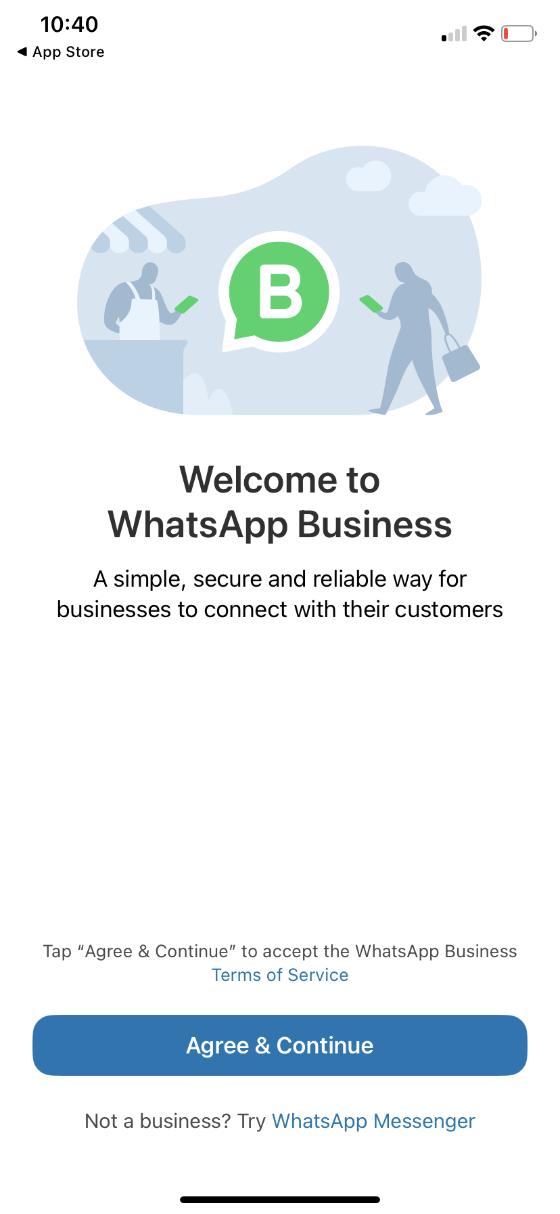
使用 WhatsApp 與社群互動交流
您可以使用 WhatsApp 高效管理與社群的溝通交流。WhatsApp 不受地點、裝置或網路連線品質等限制，向世界各地的用戶提供端對端
加密通話和聊天體驗。
Notes:
You can manage communication with your community more efficiently with WhatsApp. WhatsApp provides an end-to-end encrypted call and chat experience for people around the world, no matter the location, device or connection quality. This means that only the person you are communicating with is part of the conversation, no other entity or person will be able to view your conversations.
WhatsApp uses little data and battery life, so you can count on it to work reliably regardless of where you are.
Internal speaker note: Candidates for office and police departments cannot use the WhatsApp Business Platform (FKA WhatsApp API)
https://www.facebook.com/business/learn/lessons/whatsapp-for-business

Slide 18
在 WhatsApp Business
應用程式建立網路據點
下載和啟動 WhatsApp Business 應用程式：請前往應用程式商店並下載 WhatsApp。
註冊：從下拉清單選擇您的國家／地區並加入您的國碼，然後以國際電話號碼格式輸入您的電話號碼。點按「完成」或「下一步」，然後點按「確定」，透過簡訊或電話通話接收六位數註冊碼。若要完成註冊，請輸入您的六位數代碼。
注意：每組手機號碼只能註冊一個 WhatsApp 帳號，因此如果您使用和個人帳號相同的手機號碼登入 WhatsApp Business，您將會從 WhatsApp 登出。
允許存取聯絡人和相片：可以將您手機通訊錄中的聯絡人加入 WhatsApp Business
應用程式。您也可以允許存取您手機的相片、影片和檔案。
建立帳號：填寫您的組織名稱、選擇類別並選擇大頭貼照。
建立商業簡介：點按「探索」>「商業檔案」。您可以在此處新增組織地址、說明、
營業時間等重要資訊。
Notes:
WhatsApp Business can help your organization grow. It enables you to communicate with your community in a conversational, approachable and accessible manner.
To use WhatsApp to communicate on a local level, consider the following steps:
Download and launch the WhatsApp Business App by visiting the app store and downloading WhatsApp
Register: Select your country from the dropdown list and add your country code, then enter your phone number in international phone number format. Tap Done or Next, then tap OK to receive your six-digit registration code via SMS or phone call. To complete registration, enter your six-digit code.
Note: You can only have one WhatsApp account per phone number, so if you log into WhatsApp Business with the same mobile number that you use for your personal account, you’ll be logged out of WhatsApp.
Allow access to contacts and photos: Contacts can be added to the WhatsApp Business App from your phone’s address book. You can also allow access to your phone’s photos, videos and files.
Create an account: Fill out your organization name, select your category and choose a profile picture.
Build your profile: Tap Explore > Business profile. Here, you can add important information like your organization’s address, description, hours and more.
https://www.facebook.com/business/learn/lessons/whatsapp-for-business
Internal speaker note:
Candidates for office and police departments cannot use the WhatsApp Business Platform (FKA WhatsApp API).
WhatsApp business verification is limited to a small number of businesses participating in a closed pilot program. At this time, there is no verified badge for the business app.

Slide 19
使用 WhatsApp 申請官方商業帳號
注意：只有在顧客對 Business 平台和驗證有疑問時顯示這張投影片。
官方商業帳號的申請步驟
從您的企業管理平台存取 WhatsApp 管理工具。在「總覽」部分點擊您要申請官方商業帳號的手機號碼。
開啟雙步驟驗證。
點擊「提出申請」並填寫必要資訊。
Notes:
Note: Only present this slide if you get questions about the Business Platform and verification.
There are two types of WhatsApp Business accounts:
Business Account: By default, any account using the WhatsApp Business Platform or Business App is a business account. WhatsApp verifies authenticity of an organization for every account. If the account has completed Business Verification, the name of the organization is visible even if the user hasn’t added the organization to their address book.
Official Business Account: An official business account has a green checkmark badge in its profile and chat thread headers.
If your WhatsApp account is an official business account, there will bea green checkmark beside the displayed name in the contacts view. How it works:
Follow WhatsApp Business Policies
Be notable: Represent a well-known organization
Verified: Has gone through Business Verification, and
Has set up two-step verification
To request an Official Business Account:
Access WhatsApp Manager from your Business Manager. Click on the phone number for which you want to request OBA within the Overview section
Turn on two-step verification for this phone number to apply for OBA
Click on Submit Request Button and fill out the required information. You can submit up to 5 supporting links to show that the business is notable.
Once we’ve reviewed your request, you will receive a notification letting you know if your account has been granted OBA or not. If your request is rejected, you can submit a new request after 30 days. Note: We do not grant OBA to employees, test accounts and Business App accounts.
https://developers.facebook.com/docs/whatsapp/overview/business-accounts/#official-business-account
https://www.facebook.com/business/help/2058515294227817?id=180505742745347
https://www.facebook.com/business/help/604726921052590?ref=search_new_837

Slide 20

單元 2
廣告刊登最佳作法

Slide 21
加強推廣與刊登廣告
加強推廣
迅速又簡單
直接從粉絲專頁發佈
使用的目標設定和最佳化選項較少
刊登廣告
廣告管理員
完整的廣告刊登工具
提供觸及受眾的進階選項
Notes:
We know that paid advertising might seem overwhelming but all Facebook ads are self-serve and easy to run. There a few different ways to create a Facebook ad, including boosting a post and creating an ad in Ads Manager.
If you’re new to Facebook Ads, digital advertising in general, or your needs are simple, Facebook can do more of the work for you.
Let’s start with boosting. ​Boosting posts is the easiest form of advertising on Facebook. With boosting posts, you can quickly run ads directly from your Facebook Page by promoting one of your Page posts. While boosting a post is still considered an ad, Facebook ads are created through Ads Manager and offer more advanced customization solutions. Keep in mind that because a boosted post is considered an ad, you’ll need to get authorized and create a disclaimer if your ad is considered a social issue ad according to the policies we mentioned earlier.
​To advance your strategies and take your advertising to the next level, you might consider running ads in Ads Manager and benefiting from the full suite of advertising solutions. By running an ad, you can leverage advanced options to reach an audience and maximize investment.
A boosted post may initially optimize for Page likes, comments, and shares or overall brand awareness whereas Facebook ads can optimize for website conversions, video views, donations and more.

Slide 22
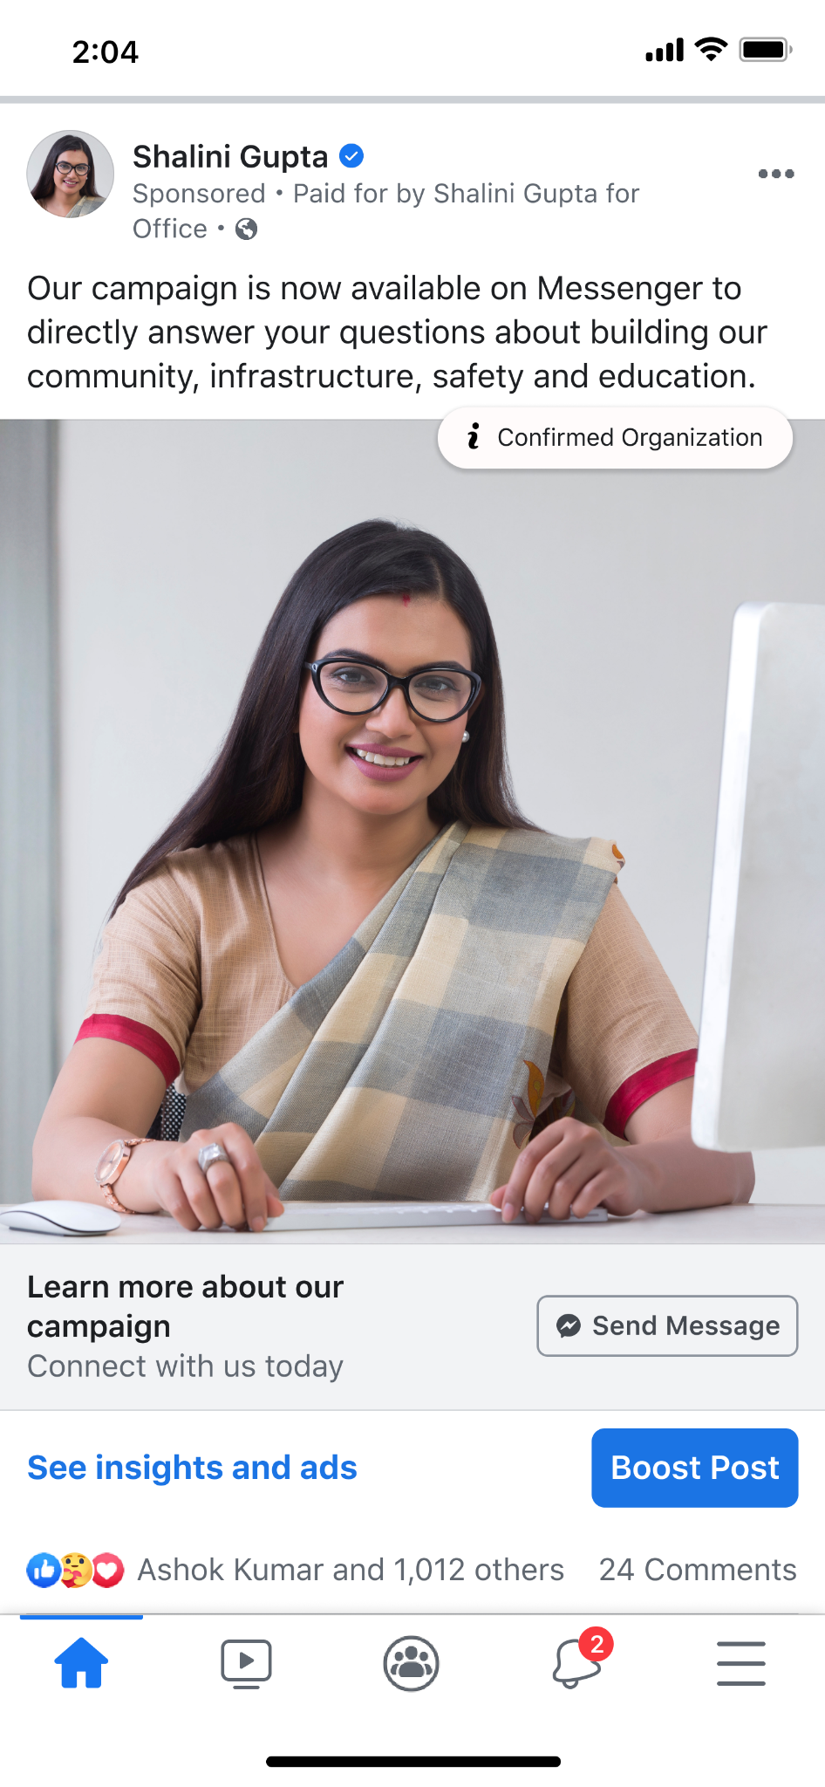
加強推廣貼文時，
請完成以下三項設定：
您想觸及的對象
您的預算上限
廣告的刊登期間
Notes:
Before diving deeper into running ads, let’s walk through how to boost a post. When you boost a post, you tell us three things:
Who you want to reach: You pick the audience you want to connect with and who you want to see this specific post
Your maximum budget: This is how much you want to spend over the course of your entire campaign
How long you want to run your ad: Once you click Boost and your ad is approved, people in your target audience will see your ad in their News Feed for the duration you’ve set.

Slide 23
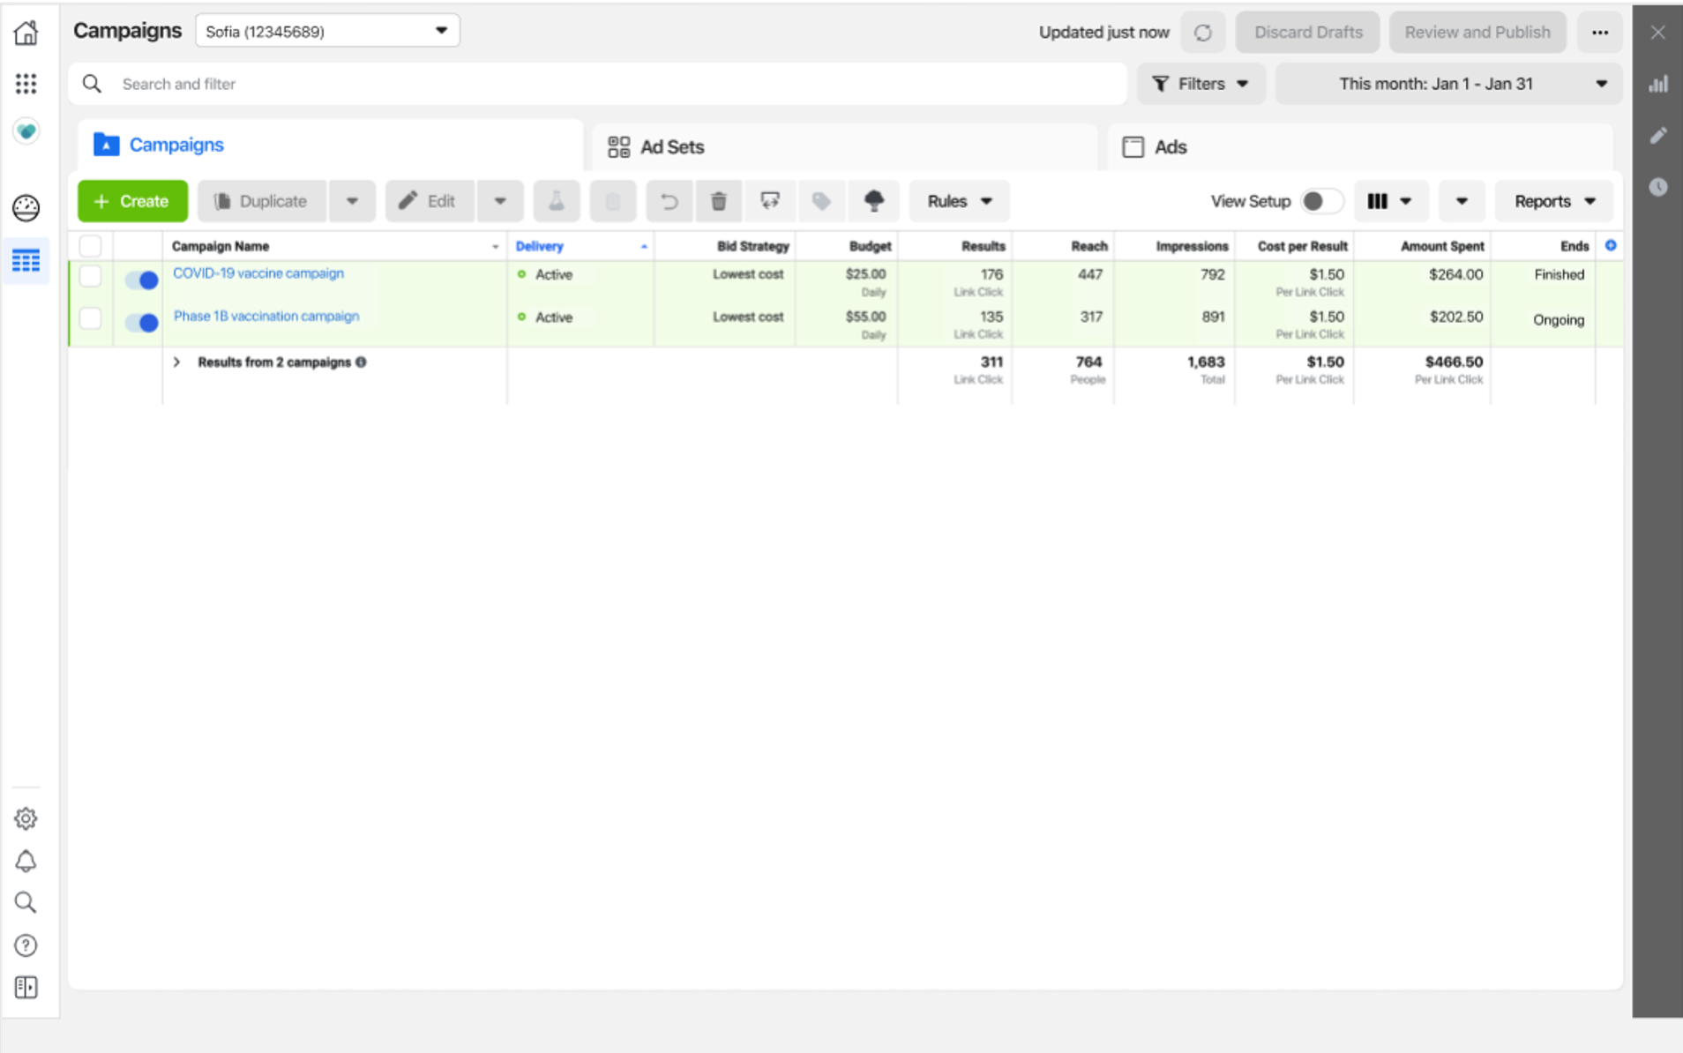
廣告管理員
檢視、變更廣告行銷活動並查看
廣告成果。
透過逐步程序擬定廣告行銷活動。
編輯廣告設定，藉此同時管理、
控制及自訂多則廣告。
評估廣告成效。
Notes:
Now that you have your Page up and running and your accounts are secure, let’s talk about how you can create an Ads Manager account.
Ads Manager offers a full suite of advertising solutions. Ads Manager is typically suitable for advertisers who wish to leverage advanced options to reach an audience and maximize investment.
With Ads Manager you can:
- View, make changes, and see results for all of your Facebook ad campaigns.
- Utilize a step-by-step process to develop ad campaigns by using ad creation to design your ads.
- Manage, control, and customize multiple ads at once by editing settings such as audience and a budget.
- Evaluate your ad’s performance by viewing up-to-date data on the quality of your ads and schedule reports

Slide 24

Meta Business Suite
Notes:
Meta Business Suite is distinct from Business Manager in that it offers several unique tools that facilitate cross-Meta engagement (posting, messaging, advertising) planning and insights. Meta Business Suite centralizes the following:
Desktop and mobile experience: Manage your business presence wherever you go with Meta Business Suite desktop or Meta Business Suite mobile app.
Scheduling and calendar tools: Publish or schedule new posts and stories for your Facebook Page and Instagram account. Plan content across Facebook and Instagram months in advance.
Unified Inbox:Read new messages and comments from your Facebook Page, Messenger and Instagram accounts. You can also create automated responses to help save time when responding to questions people commonly ask.
View insights: See how your organic and paid posts are performing with data on trends, activity on the content you share. You’ll also find more information about your audience here.
View activity: See who’s liked or commented on your posts, updates on your ads, and other activity on your Page and Instagram account.
Ads creation: Create new ads, boost posts, and promote your Page and see metrics for ads you create directly in Meta Business Suite. You’ll still have access to Ads Manager to see more details on your campaigns.
New home view: See new notifications for your Facebook Page and Instagram account in Home. You’ll also see an overview of recent ads and insights from your posts here.

Slide 25

企業管理平台
管理資產，例如您的粉絲專頁和廣告帳號。
新增代理商或行銷合作夥伴，協助管理
您的行銷活動。
深入瞭解並鎖定您的廣告受眾。
Notes:
Business Manager is a central place to manage your organization’s advertising separate from your personal account. It helps advertisers integrate Facebook marketing efforts across their organization and with external partners.
With Business Manager, you can:
Manage assets such as your Pages and ad accounts
Add an agency or marketing partner to help manage your organization
Better understand and target your audience
https://www.facebook.com/gpa/resources/advertising/business-manager
https://www.facebook.com/gpa/blog/business-manager-for-government-politics-or-advocacy-organizations

Slide 26
行銷活動架構
行銷活動
廣告組合
廣告組合
廣告
廣告
廣告
廣告
Notes:
Let’s start by digging deeper into the campaign structure - In order to run ads, you will need to set up a campaign within your ad account. Each campaign has a specific structure where you will make decisions at each level:
1) The first level is the campaign where you will choose an objective. Your objective should match your real-world goal. You also have the option to set a budget at this level. This is a new recommended feature called “Campaign Budget Optimization” (or CBO) that makes it easier and more efficient for you to allocate budget across audiences.
2) The next level is the ad set. You can have multiple ad sets within a single campaign. If you do have multiple ad sets within a single campaign, each ad set should have a different, non-overlapping audience. You will also choose your placements and set bids at this level. If you are not using CBO, then you will also set your budget at this level. If you are using CBO, you have the option to control budget minimums and maximums at the ad set level.
3) The final level is the ad. The ad is where you will customize your creative. You can have multiple ads within a single ad set where you can test various formats -- like video versus images.
Source: https://www.facebook.com/business/help/613846972027099

Slide 27
廣泛目標設定
包含性別、年齡和地點的廣泛目標設定。
自訂廣告受眾
您可以透過自訂廣告受眾找到在 Facebook 上的既有顧客。
您可以使用瀏覽過您網站或曾在 Facebook 上互動過的用戶等
資料來源，來建立對您有所瞭解的自訂廣告受眾。
類似廣告受眾
類似廣告受眾可協助您觸及新的用戶，該用戶可能會對您的組織感興趣，因為該用戶與現有自訂廣告受眾具備相同特質。
目標設定
廣告主利用目標設定來設定廣告想要觸及的受眾條件。
Notes:
Let’s discuss targeting. Targeting is where advertisers set the criteria for the audiences they’re trying to reach with their ads. You have three options for targeting including:
Broad targeting: Broad targeting includes gender, age and location
Custom audiences: Custom Audiences let you find your existing audiences among people who are on Facebook. You can use sources like people who have visited your website or engaged on Facebook to create custom audiences of people who already know you.
Lookalike audiences: A lookalike audience is a way your ads can reach new people who are likely to be interested in your organization because they share similar characteristics to an existing custom audience.

Slide 28
運用廣泛目標設定來觸及目標社群
最佳作法：
將廣告受眾設定為觸及 100–1000 萬名用戶。
啟用「高效速成詳細目標設定」。
使用廣告管理員的廣告受眾測定儀，檢查受眾規模是否合適。
設定廣泛目標受眾意即您要讓 Meta 投遞系統找出最理想的廣告受眾。
Notes:
Targeting broadly means that you’re letting Meta’s delivery system find the best people to show your ad to. Remember the following best practices for using broad targeting:
Set your audience to reach 1-10 million: Our ad delivery system works best when your audience size is between 1 million to 10 million people, so set up your ad to target the widest audience possible that makes sense for your organization.
Turn on Advantage detailed targeting: While Meta recommends broad targeting to drive the best performance for your ads, if you'd prefer to use detailed targeting, you should enable Advantage detailed targeting in Meta Ads Manager. This is automatically enabled on campaigns that optimize for web conversions. For those objectives that do not have Advantage detailed targeting automatically enabled, we recommend you turn it on. Note: Advantaged detailed targeting is automatically enabled when using the conversions objective and optimizing for conversions, value or app events and message objectives. However it is not automatically enabled with the traffic, engagement, video views and lead generation catalog.
After setting your objectives at the campaign level in Ads Manager, enabling broad targeting is easy.
Confirm your Audience settings: In the ad set level, scroll down to the Audience section. Broad targeting is shown ad default. You can make adjustments to location, age and gender, but avoid narrowing down your audience by interests or behaviors.
Check your Audience Insights: If you target broadly and then check Audience Insights or ads reporting, you can learn more about the types of people we found for you and how they reacted to your ads. This can help inform your future ad strategies.
https://www.facebook.com/business/small-business/performance-five-advertising/broad-targeting

Slide 29
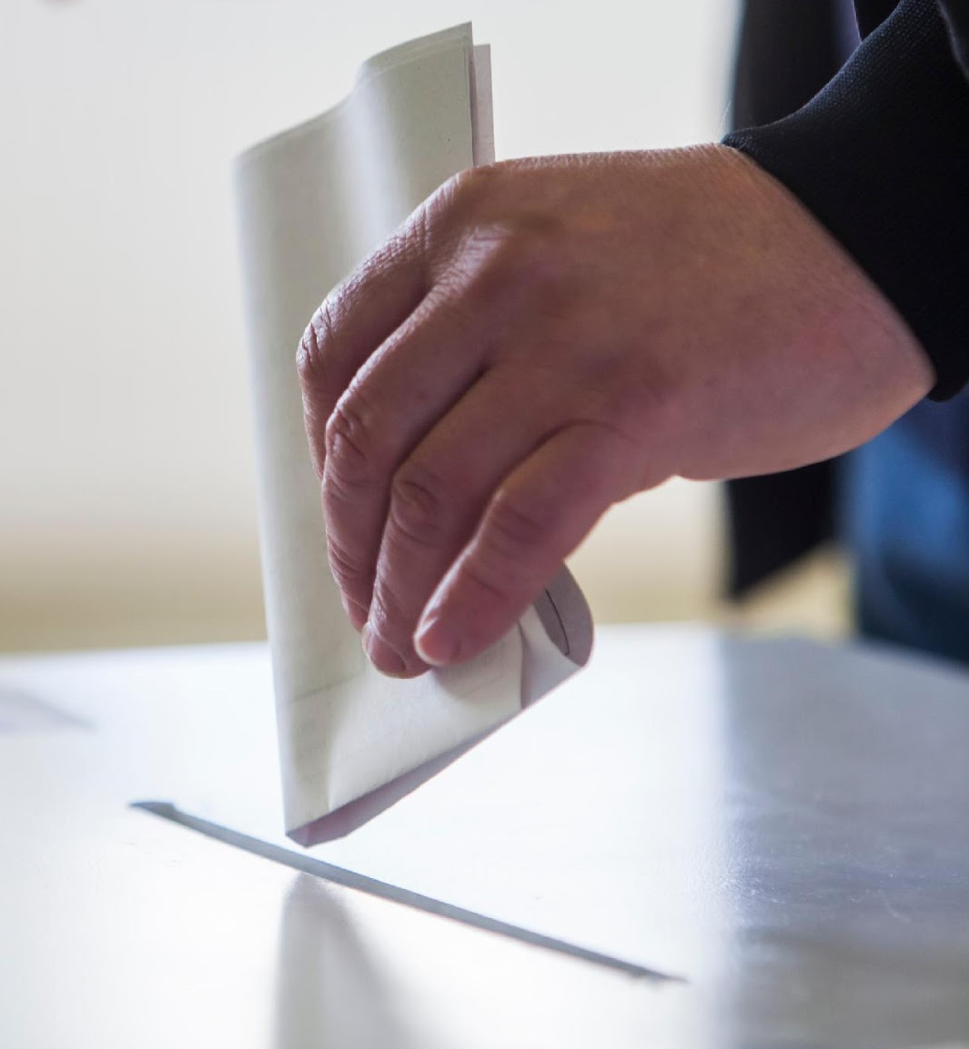
如果您是在沒有社會議題廣告政策執行的司法管轄區進行簡報，請移除提及的社會議題後編輯
這張投影片
單元 3
社會議題、選舉或政治相關廣告

Slide 30
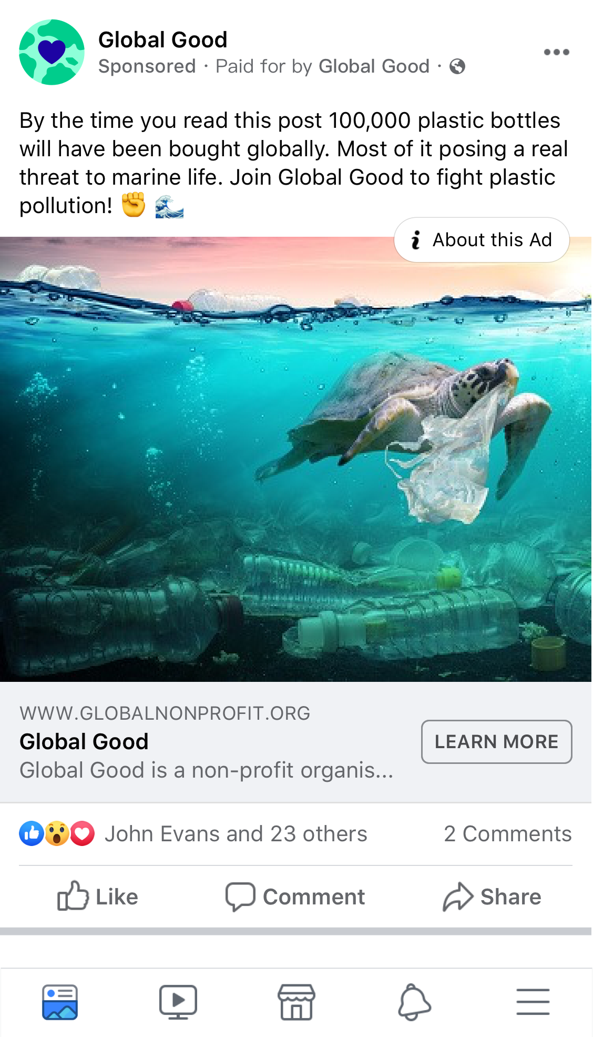
如果您的國家／地區沒有適用的社會議題，請略過這張投影片。
社會議題、選舉或政治相關廣告
基本上，我們相信技術平台用戶需要擁有表達自由。為了促進公眾對具影響力的話題進行安全、健康的討論，我們的《廣告刊登準則》要求廣告主須完成額外步驟，以真實身分為社會議題、選舉或政治相關廣告背書，並願意面對相關問責；方便大眾更加瞭解試圖用廣告影響他們決定的人士。
凡是引起大眾激辯、可能影響選舉結果，或可能促成現行法令或提案立法／與之相關的敏感
話題，皆屬於「社會議題」。我們要求提高社會議題廣告的真實性和資訊透明度，因為這些
廣告試圖透過贊成或反對健康、公民和社會權利等重要相關話題的討論、辯論或倡議來影響
公眾輿論。
此類廣告的來源可能包括各類型的廣告主，例如政治組織、倡議人士、品牌或非營利組織，
若他們刊登的廣告所支持的議題在我們政策的規定範圍內，或是該廣告與選舉或政治相關，
則皆須取得授權，並在廣告中使用「出資者」免責聲明。
如需瀏覽社會議題文案範例，並瞭解您所在國家／地區是否規定此類廣告須取得授權和
免責聲明，請前往使用說明。
Notes:
First, let’s define what we mean by social issues. In many countries, social issues become heavily debated, highly politicized topics over which the public is deeply divided.
They are sensitive topics that can influence many people within a society – especially if amplified by many – may impact the outcome of an election or result in or relate to existing or proposed legislation.
In most countries globally, there aren’t laws or agencies that list specific social issues that are subject to regulation. In the absence of this, we have worked closely with in-region regulators, policy and advocacy groups to define a set of social issues for our platform, which include civil and social rights, immigration, education, environmental politics, and so forth. The list is meant to be fluid to reflect the public discourse around social issues on and off Meta technologies that seek to influence public opinion through advocacy, debate or discussion.
---
Source: https://www.facebook.com/business/help/214754279118974?id=288762101909005

Slide 31

如果您的國家／地區有適用的社會議題，請略過這張投影片。
選舉或政治相關廣告
基本上，我們相信技術平台用戶需要擁有表達自由。為了促進公眾對具影響力的話題進行安全、健康的討論，我們的《廣告刊登準則》要求廣告主須完成額外步驟，以真實身分為選舉或政治
相關廣告背書，並願意面對相關問責；方便大眾更加瞭解試圖用廣告影響他們決定的人士。
選舉或政治相關廣告為：
由公職候選人、政治人物、政黨、政治行動委員會或公職選舉結果支持者所刊登或代表刊登，或內容與上述人士或機關相關；
有關任何選舉、公民投票或投票倡議，包括「動員投票」或選舉競選活動；
受到政治廣告法規管制的任何廣告。
Notes:
We're constantly working to increase ad transparency and election integrity on Facebook and Instagram. Therefore, we've established measures to promote authenticity and legitimacy for anyone wishing to run ads about social issues, elections or politics.
Ads about social issues, elections or politics are:
Made by, on behalf of, or about a candidate for public office, a political figure, a political party, a political action committee or advocates for the outcome of an election to public office; or
About any election, referendum, or ballot initiative, including "go out and vote" or election campaigns; or
About social issues in any place where the ad is being placed; or
Regulated as political advertising.
Advertisers interested in placing these ads should complete the ad authorization process. The process is available for advertisers that reside and are located in the targeted country at the time they run ads.
---
Source: https://www.facebook.com/business/help/214754279118974?id=288762101909005

Slide 32
注意：如果您的國家／地區沒有社會議題政策執行，請移除這張投影片。
民眾使用多種方法來解決社會議題
民眾投票選舉領導人以推進
他們的理想。民眾大聲疾呼，
呼籲在重要議題上進行改革。
領導人透過制定重要議題的議程，激勵選民投票並推動改革。
品牌、倡議團體和組織在影響
民眾觀感和塑造文化的議題上
分享他們的觀點。
Notes:
There are a variety of methods that people use to address social issues.
In a democracy, people vote for leaders that they believe will advance their ideals. Even globally, in repressive societies that restrict speech, when people can speak they often call for change on important issues.
In turn, leaders build their agendas around the social issues they believe are most important, in hopes of inspiring voters and driving meaningful impact.
At the same time, activists, brands, entertainment companies, and political organizations may try to use paid advertising to broaden their voice or influence the sentiment of people because they feel a responsibility to shape culture and inspire change.
Corporate social good can be a big differentiator for an organization, so many brands see value in taking a stand on issues that align with what their customers want and expect from them.

Slide 33
基本上，我們相信用戶和廣告主應擁有言論自由
我們的決策根植於：
+
=
真實性
資訊透明化
負起隱私保護責任
Notes:
We still fundamentally believe in freedom of expression for people and advertisers.
Our decisions and investments are rooted in this belief… but in addition, we committed to taking down coordinated networks of accounts, Pages and Groups that seek to manipulate public debate, and we’ve built smarter tools and introduced policies that provide an unprecedented level of transparency and authenticity for ads about social issues, elections, and politics.
But now, with our commitment to greater authenticity and transparency, people around the world can now see who’s behind the ads they see and better understand who’s trying to influence them with sensitive ads and why. Over time, this leads to increased accountability – for both Meta and advertisers.
Democracy depends on the idea that we value everyone’s right to be heard above our own desire to get the outcomes we want. Giving everyone a voice empowers the powerless. Building an inclusive society depends upon people being able to share their diverse perspectives. So, our policy is based on the idea that advertisers can still discuss sensitive topics, but in order to promote safe and healthy public debate on influential topics, advertisers need to complete more steps to confirm their identity so people can see who’s trying to influence them.

Slide 34
如果您是在沒有社會議題廣告政策執行的司法管轄區進行簡報，請移除本投影片提及的社會議題和最後一個項目符號，然後編輯這張投影片。
社會議題、選舉或政治相關廣告為：
由公職候選人、政治人物、政黨或公職選舉結果支持者所刊登或代表刊登，或內容與上述人士或機關相關
有關任何選舉、公民投票或投票倡議，包括「動員投票」或選舉競選活動
受到政治廣告法規管制的任何廣告
與社會議題相關；包含在特定國家／地區討論、辯論、倡導或
反對某些議題的內容
為了制定有效政策，
我們必須依據更高標準將廣告分類
Notes:
Inspired by our core beliefs, to build an effective policy, we needed to begin by categorizing which ads are required to meet a higher standard. We realize that our universal policy will impact how you manage and operate your advertising, requiring more workflow, but we believe it’s the balanced and fair thing to do to enable a safe and transparent platform for all people.
Ads about social issues, elections or politics are:
•Made by, on behalf of or about a candidate for public office, a political figure, a political party or advocates for the outcome of an election to public office; or
•About any election, referendum or ballot initiative, including "get out the vote" or election information campaigns; this includes all ads coming from election regulators about how, when and where to vote. or
•Regulated as political advertising
•About social issues in any place where the ad is being run
---
More info:
-- To enforce on a social issues policy, we had to specifically define what those topics are. In most countries globally, there aren’t laws or agencies that list specific social issues that are subject to regulation. In the absence of this, we have worked closely with in-region regulators, policy and advocacy groups to develop country-specific categories -- like health, civil and social rights, immigration -- that reflect the public discourse around social issues that seek to influence public opinion with ad content that includes advocacy, debate or discussion. Learn more about social issues in certain countries [Help Center]

Slide 35
如果您是在沒有社會議題廣告政策執行的司法管轄區進行簡報，請移除提及的社會議題後編輯
這張投影片。
若要刊登與社會議題、選舉或政治相關的廣告，廣告主需要：
授權
在想要刊登廣告的國家／地區完成授權程序。
身分
證明自己的身分及所在地。
免責聲明
在廣告中包含經過驗證的「出資者」免責聲明，以協助我們確認組織的合法性，並向用戶顯示這些有
影響力的廣告幕後是誰在操盤。
資訊透明化
若廣告遭標示為「社會議題、選舉或政治相關廣告」，
將會在廣告檔案庫保留七年。
Notes:
To allow people to run ads about issues, elections, and politics, we have taken actions that are rooted in three principles: Authenticity, Transparency, and Accountability.
To meet these principles, we’ve introduced an unprecedented level of transparency and authenticity around these ads to ensure people can see who’s trying to influence them so they can make informed decisions.
To enable healthy discourse and help prevent interference in elections, our policy for ads about social issues, elections or politics requires that advertisers must complete the authorization process in the country they want to run ads in. To do this, advertisers that want to run these ads must prove who they are and where they are located, include verified “Paid for by” disclaimers to help us confirm the legitimacy of an organization and show who’s behind the ad, and these ads will be entered into our public Ad Library for seven years.

Slide 36
粉絲專頁資訊透明度
我們採取許多措施來確保粉絲專頁資訊的真實性和
公開透明，包括向用戶顯示粉絲專頁管理人員所在的主要國家／地區，以及粉絲專頁是否與其他專頁合併。這讓用戶能夠更清楚地瞭解該粉絲專頁的背景資料，以及隱身在幕後的人。
資訊透明化和帳號安全
對用戶的意義
我們發現有越來越多人刻意隱藏粉絲專頁背後的經營組織，
讓用戶認為粉絲專頁的運作獨立於組織之外。為了解決這個問題，
我們加入更多有關粉絲專頁經營組織的資訊，包括新的「粉絲
專頁的管理組織」頁籤，它會顯示粉絲專頁經過確認的「粉絲
專頁擁有者」，包括組織的法定名稱、經過查證的城市、電話
號碼或網站。
Notes:
We want to make sure people are using our products and solutions authentically, and that they understand who is speaking to them. We’ve taken steps to ensure Pages are authentic and are more transparent by showing people the Page’s primary country location and whether the Page has merged with other Pages. This gives people more context on the Page and makes it easier to understand who’s behind it.
Increasingly, we’ve seen people failing to disclose the organization behind their Page as a way to make people think that Page is run independently. To address this, we’ve added more information about who is behind a Page, including a new “Organizations That Manage This Page” tab that shows the Page’s confirmed “Page Owner,” including the organization’s legal name and verified city, phone number or website.

Slide 37
資訊透明化和帳號安全
美國廣告授權程序
步驟 1
在美國確認用戶身分和地點
設定雙重驗證。
提交美國身分證件進行驗證。
透過郵件接收字母代碼後輸入，驗證您在美國的地點。
步驟 2
管理免責聲明和連結廣告帳號
設定「出資者」免責聲明：凡是想要刊登
社會議題、選舉或政治相關廣告的廣告主，皆須提供更多關於其組織的資訊。
將免責聲明連結到廣告帳號。
步驟 3
辨別議題、選舉或政治相關廣告
若廣告遭標示為「社會議題、選舉或政治
相關廣告」，將會在廣告檔案庫保留七年。
如果廣告與此類主題相關，Meta 會主動
偵測內容，並在收到通報時進行審查。即便廣告缺少免責聲明，也會在廣告檔案庫中
供大眾瀏覽。

Slide 38
資訊透明化和帳號安全
全球廣告授權程序
步驟 1
在所在國家／地區確認身分
設定雙重驗證。
提交身分證件進行驗證。
步驟 2
管理免責聲明和連結廣告帳號
設定「出資者」免責聲明：凡是想要刊登
社會議題、選舉或政治相關廣告的廣告主，皆須提供更多關於其組織的資訊。
將免責聲明連結到廣告帳號。
步驟 3
辨別議題、選舉或政治相關廣告
若廣告遭標示為「社會議題、選舉或政治
相關廣告」，將會在廣告檔案庫保留七年。
如果廣告與此類主題相關，Meta 會主動
偵測內容，並在收到通報時進行審查。即便廣告缺少免責聲明，也會在廣告檔案庫中
供大眾瀏覽。
時間：最多需要 48 小時
時間：最多需要 24 小時
時間：最多需要 72 小時

Slide 39
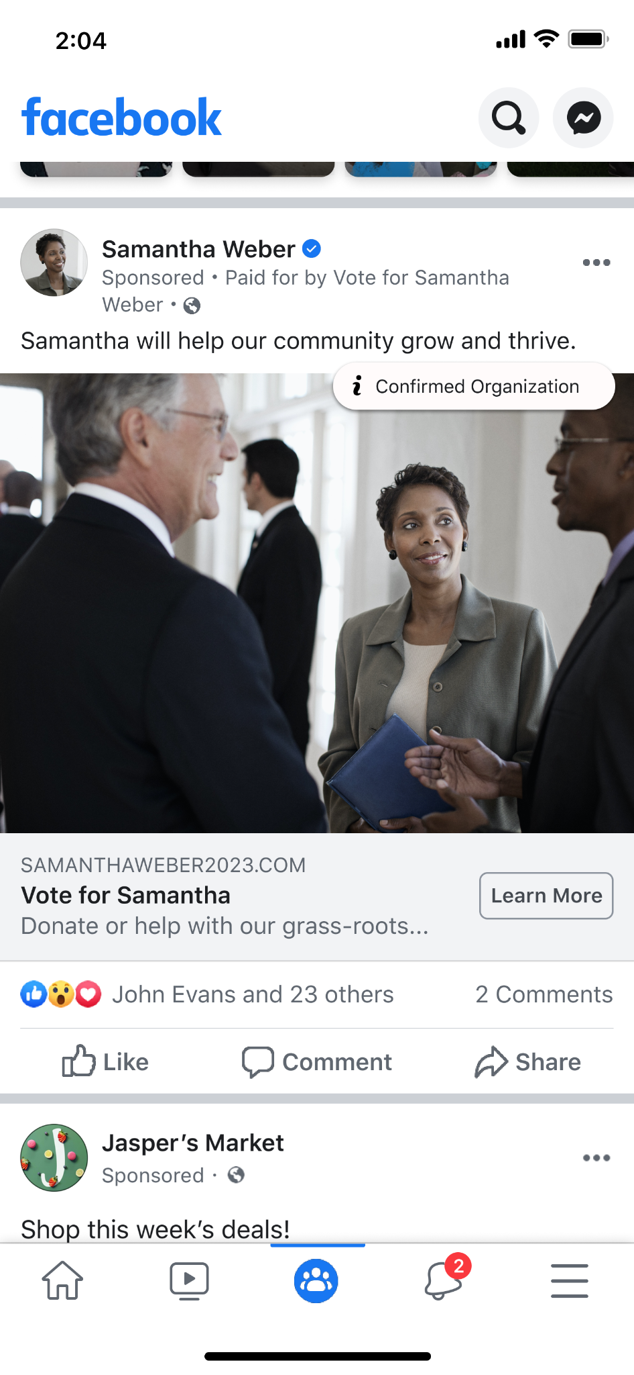
如果您是在沒有社會議題廣告政策執行的司法管轄區進行簡報，請移除提及的社會議題後編輯
這張投影片
資訊透明化和帳號安全
「出資者」免責聲明
廣告主必須在社會議題、選舉或政治相關廣告中
清楚標示「出資者」免責聲明，告知該廣告的出資組織或實體。
對用戶的意義
用戶將能看到是誰替任何企業商家或組織機構支付廣告費用，
廣告主必須提供更多資訊供 Meta 確認及公開。您可以選擇以不同的方式呈現您的免責聲明，包括：
粉絲專頁名稱
其他組織
Notes:
To increase transparency, all ads about social issues, elections or politics must be clearly labeled with a “Paid for by” disclaimer from the advertiser to communicate the organization or person behind the ad. This means that people can see who is paying for the ad and, for any business or organization, they must provide more information to Meta for confirmation, some of which is then made available publicly for transparency purposes.
US advertisers must now provide additional information, like a Federal Election Commission ID or Tax-ID number. This allows people to confidently gauge the legitimacy of an organization and quickly raise questions or concerns if they find anything out of the ordinary.

Slide 40
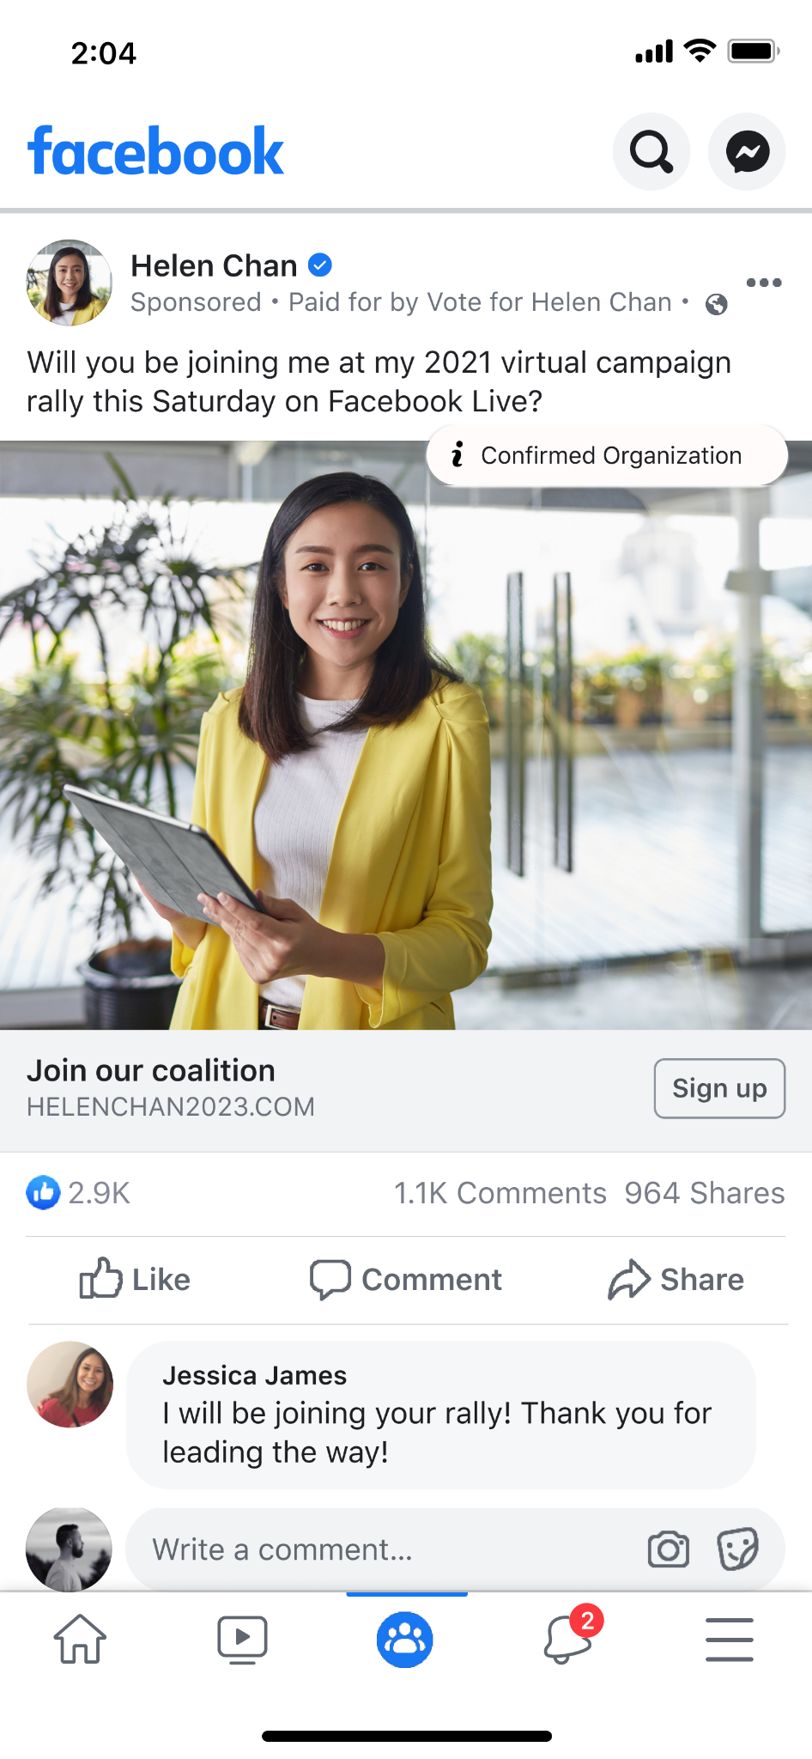
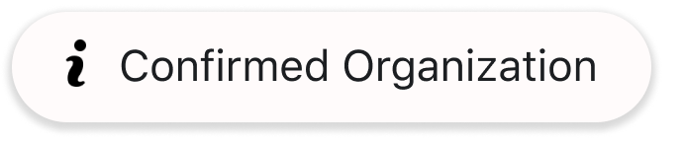
注意：如果是美國以外國家／地區，請移除這張投影片
資訊透明化和帳號安全
確認
在美國有關社會議題、選取或政治的廣告中顯示
「認可組織」圖示，讓用戶知道我們已經查證過刊登廣告的組織機構是向美國政府登記在案的組織。
對用戶的意義
只要點按一下，用戶就能看到廣告主的聯絡詳細資料，以及在 Facebook 之外經過查證的資訊，包括他們是否提交 FEC ID
（聯邦選舉委員會編號）、稅籍登記或美國政府國書，藉此迅速
督促廣告主負起責任。
美國的「認可組織」圖示
Notes:
NOTE: This slide is for the US only
Ad “i” icon in the US: Ads about social issues, elections or politics in the US with a “Confirmed Organization” icon will give people confidence in knowing that the advertiser has verified the organization behind the ad is registered with the US government. Now, with one tap, people will not only see information about the ad, but they’ll be able to quickly hold advertisers accountable by seeing their contact details and the information verified off-Facebook, including if they submitted an FEC ID, Tax-Registered Organization, or US government credentials.

Slide 41
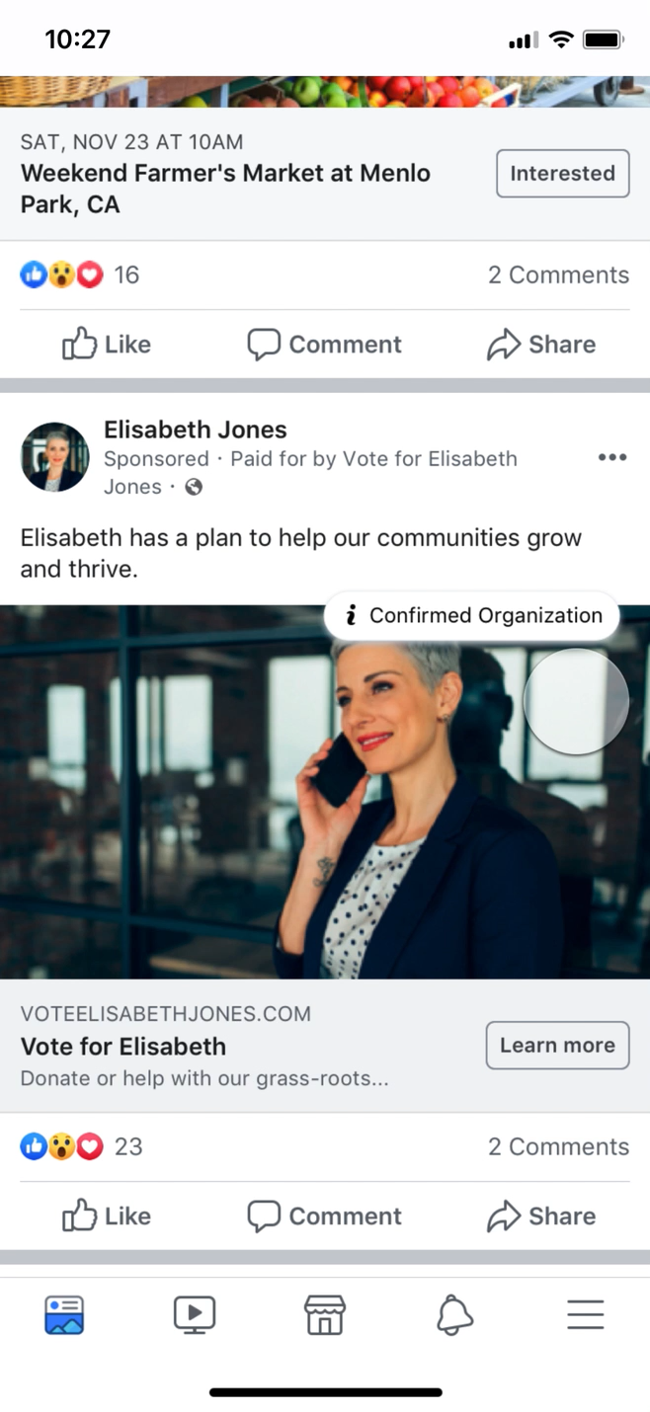
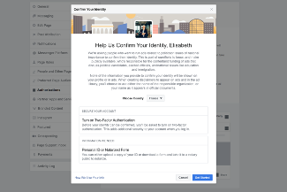
資訊透明化和帳號安全
真實性
提升資訊透明度
Notes:
Elections are happening all over the world and we are committed to requiring authorizations and "Paid for by" disclaimers in more places, to help prevent interference in elections globally. We know that protecting the integrity of elections is never finished and we can’t do this alone — that’s why we continue to work with policymakers and experts to make sure we are constantly improving

Slide 42
您應熟悉我們的廣告刊登準則，避免日後未獲准
刊登。
威嚇選民或讓選民打消投票念頭的廣告，以及
違反《社群守則》中有關選民舞弊和干預選民投票的廣告
社會議題、選舉或政治相關廣告須通過驗證程序
並使用免責聲明
瞭解《廣告刊登準則》
如果您是在沒有社會議題廣告政策執行的司法管轄區進行簡報，請移除提及的社會議題後編輯
這張投影片
資訊透明化和帳號安全
Notes:
Moving to our policies. I want to remind you of our Advertising Standards.
Our ad policies provide guidance on the types of content that is allowed on our platforms. Familiarizing yourself with the policies can help you adhere to them and avoid disapproval later.
Also, it’s important to note that you cannot post organic content or run ads that intimidate or discourage people from voting and also you cannot run ads that violate our Community Standards on voter fraud and voter interference.
For you and your organizations, it’s especially important to be aware and familiar with our ads about social issues, elections or politics. We will have a deep dive about our policies here in a bit but in the meantime, I want to flag that all ads about social issues, elections or politics will need a disclaimer and the process can take up to 72 hours to complete so we recommend that all relevant advertisers get started as soon as possible.

Slide 43
反對選舉暴力和不當行為的政策
背景說明：鼓吹謀劃干預行為，妨礙他人參加選舉
結合情境：號召前往選舉／投票／計票地點時採取軍事或恐嚇行為，藉此監視或觀看選民或選務人員的活動
結合情境：威脅選務人員
資訊透明化和帳號安全
意圖購買或出售選票
在陳述中鼓吹、提供指引或明確表達以非法手段參與投票的意圖
鼓吹針對投票、選民登記、選務或選舉結果採取暴力行動
呼籲攜帶武器前往投票所、計票地點或選務機關

Slide 44
資訊透明化和帳號安全
我們不允許以下情況的不實陳述：
投票或登記的日期、地點、時間和方法
可投票身分及投票資格
是否計票、投票時必須提供哪些資訊和/或資料
候選人是否參加競選
選民干預的相關政策

Slide 45

廣告審查方式
文案
刊登在 Facebook 或 Instagram 的所有廣告
都須先通過自動化審查（人工智慧）搭配人工
審查的程序。我們會依據《社群守則》以及
《廣告刊登準則》檢查廣告的圖像、文字、立場以及廣告連結頁面的內容。
在某些情況下，已經刊登的廣告會被 AI 特別
標示或被我們的社群檢舉。如果發生此情況，
我們可能會再次審查該廣告，如發現其違反了
我們的政策及／或缺少免責聲明，我們將不予以刊登，並會要求廣告主先行取得授權並在廣告中加入「出資者」免責聲明，才能繼續予以刊登。
廣告圖像
連結頁面
行動呼籲
Notes:
We hold advertisers to even stricter standard to protect people – in part because they receive paid distribution, as opposed to something organically surfacing in people's feed.
•All ads are subject to our ad review system before they're shown on Facebook or Instagram, which relies primarily on automated review (artificial intelligence) to check ads against our Advertising Policies.
•During ad review, we'll check your ad's images, text, and positioning, in addition to the content on your ad's landing page.
•We use manual review to improve and train our automated systems, and in some cases, have trained global teams review specific ads.
•Ads are also required to follow our Community Standards.
FLAGGED BY AI OR REPORTS BY PEOPLE
In certain cases, a post or ad that's already running can be flagged by AI or reported by our community. If this happens, the content may be reviewed again, and if found to be in violation of our policies and/or the ad is missing a “Paid for by” disclaimer, we disapprove it.
---
Source: https://www.facebook.com/business/help/313752069181919?id=288762101909005&helpref=uf_permalink

Slide 46
移除違反政策的內容
我們對錯誤資訊採取的具體作法
減少傳播查證機構評為不實的內容
與其他主要網路平台及大多數媒體一樣，Meta 不會對政治人物的直接言論進行查證。
告知用戶有關錯誤資訊的更多背景資訊和標籤
Notes:
On Facebook and Instagram, we follow a three-part framework to help prevent the spread of misinformation and give people more context to make informed decisions:
•Remove accounts and content violating Community Standards or ad policies​
•Reduce the distribution of false news and inauthentic content, like clickbait, when independent third-party fact-checkers rate content as false
•Inform people by giving them more context and labels on false posts they see​
But like the other major internet platforms and most media, Meta doesn’t fact-check direct speech from politicians.
---
ADDITIONAL CONTEXT
Fighting misinformation and our approach to politicians
We've cut the amount of engagement with fake news on Facebook by more than half according to multiple independent studies so we know people are seeing much less of it. But misinformation is a complex and evolving problem, and we have much more work to do. On Facebook and Instagram, we follow a three-part framework to help prevent the spread of misinformation and provide additional context so people can make informed decisions.
•Remove: We especially focus on removing content that violates our Community Standards, including fake accounts and misinformation that may contribute to the risk of imminent violence or harm.
•Reduce: Since 2016, we have partnered with 80 organizations independent third-party fact-checkers around the world, to fact-check potentially false news and content in more than 60 languages. When third-party fact-checkers label content as false, we significantly reduce its distribution on Facebook and Instagram so fewer people see it.
•Inform: The answer to misinformation isn’t always less information - it’s more context. So, we have introduced more prominent warning labels on Facebook and Instagram which provide more context and information from fact-checkers on false or partly false content. We believe it’s important to inform people who have encountered false news or content, so they can decide for themselves what to read, trust, and share.
Protecting Your Vote: We’re committed to fighting harmful attempts to interfere with or suppress voting which undermine elections. That’s why our policies prohibit and remove content that includes incorrect voting information as well as ads that advise people not to vote.
---
Source:
https://about.fb.com/actions/preventing-election-interference/
https://about.fb.com/news/2019/04/protecting-eu-elections-from-misinformation/
https://about.fb.com/news/2018/05/hard-questions-false-news/

Slide 47
自由表達與責任承擔
我們認為，在擁有新聞自由的高度民主化國家／地區，政治言論往往是審查最為嚴謹的言論。
用戶應該要能夠聽到那些有望成為領導人的聲音。限制言論，會導致用戶不太能理解他們的民選官員到底想表達什麼。
只有當我們能夠看清那些尋求選票的候選人在說什麼，並且在公開場合對其進行嚴格審視和
辯論時，談論責任歸屬才有意義，即使我們發自內心不同意他們所說的話也是如此。
豁免直接的政治言論
如果政治人物直接在粉絲專頁、廣告或網站上發佈聲明，第三方查證計畫便會將該聲明視為直接陳述且不適用本計畫。
政治人物不能說的內容？
政治人物不能違反我們的《廣告刊登政策》或《社群守則》，包括煽動或涉及仇恨言論；不得
散播有關投票地點、時間或方法的錯誤資訊。
廣告必須遵守更嚴格的資訊透明標準，必須加入免責聲明並在廣告檔案庫存放七年，開放大眾
查詢。這同樣有助於政治人物對其在選舉活動中的言論負責。
我們面對政治人物的作法
我們認為在民主國家，內容是否可信應該是由
用戶自行決定，而不是由科技公司來決定；我們不認為私人公司有權審查政治人物或新聞內容。
我們的作法奠定於我們對言論自由的基本信念。
Notes:
We believe that in a democracy, people should decide what is credible, not technology companies. We don’t believe a private company should make decisions about political ads or censor politicians or the news, which is why we welcome regulation that would apply across the industry. In the absence of regulation, Meta and other companies are left to design their own policies.
As we stated earlier, our approach is grounded in our fundamental belief in free expression. We believe that, in mature democracies with a free press, political speech is the most scrutinized speech there is, and by limiting it, we would leave people less informed about what their elected officials are saying. People should be able to hear from those who wish to lead them, because ultimately, accountability only works if we can see what those in power seeking our votes are saying and it’s scrutinized and debated in public. Even if we viscerally disagree with what they say.
Exempting direct political speech
Per our policy, if a claim is made directly by a politician on their Page, in an ad or on their website, it is considered direct speech and ineligible for our third-party fact checking program.
What political entities are fact-checked?
Former candidates for office or former officials continue to be covered by our third-party fact-checking program. That remains true for organizations like Super PACs or advocacy organizations that are unaffiliated with candidates.
What can’t politicians say?
•Our policies don’t mean that politicians can say whatever they want on Facebook and Instagram.
•They can’t violate our Advertising Policies or Community Standards by posting content that may incite violence or is considered hate speech.
•They still can’t, for example, spread misinformation about where, when, or how to vote.
•There will be some instances where a false or partly false rating from our fact-checking partners will affect politicians. When anyone shares a specific piece of content that has been otherwise debunked, we will demote that content, display a warning and reject the ad. This is different from a politician’s own claim or statement.
---
Source:
https://www.facebook.com/business/help/182222309230722

Slide 48

單元 4
Meta 廣告檔案庫

Slide 49
廣告檔案庫
廣告檔案庫是 Meta 最詳盡的廣告資訊透明度查詢中心，可針對 Meta 技術上的廣告提供完整相關資料。用戶
可以透過廣告檔案庫深入瞭解自己所看到的廣告，對於提升廣告資訊透明度來說大有幫助。
對用戶的意義
廣告檔案庫可顯示所有在 Meta 產品刊登中的廣告。為了協助
防範選舉受到干涉，我們將廣告資訊透明度列為優先改進事項，並因此推出廣告檔案庫，為有關社會議題、選舉或政治的廣告
提供廣告支出金額範圍、觸及人數、出資單位／出資人的名稱／姓名等其他資訊。這些類型的廣告（不論是刊登中或暫停刊登）會在首次曝光後保存七年。
Notes:
The Ad Library is Meta’s comprehensive ads transparency hub, providing a searchable view of ads across Meta’s products.
It provides unprecedented transparency into advertising globally and gives people more information about the ads they see which especially helps journalists, regulators and researchers conduct analysis. The Ad Library constraints all active ads running across Meta’s platforms. To preserve the integrity of elections, the Ad Library offers more insights about ads about social issues, elections or politics including spend range, reach breakdown and more details about the organization or person responsible for funding the ad. We store these ads for seven years. Ads that run with disclaimers are made public in the Ad Library as soon as they receive their first impression. In countries with proactive and reactive enforcement, ads that we take down without disclaimers as also added to the Ad Library.
[Speaker note: If you get questions about the ad library, you can view the ad library deck for more in-depth information: https://docs.google.com/presentation/d/1RLw3p8MkMVPtjuIHshpH9VDOvyFd_6UVlKAG0_AdRzY/edit?usp=sharing

Slide 50
廣告檔案庫總覽
廣告檔案庫可顯示所有在 Meta 產品刊登中的廣告。為了協助防範選舉
受到干擾，我們將廣告資訊透明度列為優先改進事項，並因此推出廣告
檔案庫，針對社會議題、選舉或政治相關廣告，提供以下資訊：
廣告花費範圍
觸及人數
負責廣告的實體名稱
我們會儲存所有議題、選舉或政治相關廣告（無論是否標示為正在刊登），並且從廣告首次曝光日期起算保存七年。如果刊登中的廣告遭系統標示或社群成員回報為與上述主題相關且缺少免責聲明，該廣告將遭拒絕刊登，同時也會納入廣告檔案庫中。廣告檔案庫中標示為「暫停」的廣告一定是曾在 Facebook 和 Instagram 刊登過的廣告。

Slide 51
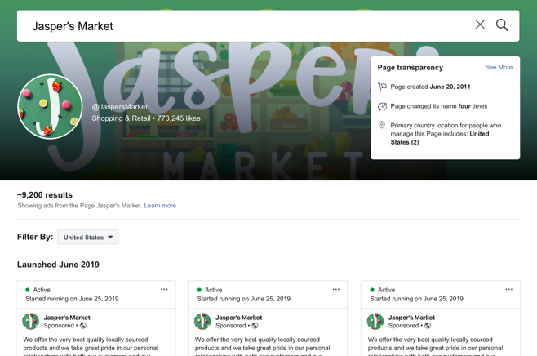
搜尋廣告檔案庫
廣告檔案庫會顯示粉絲專頁刊登中的所有廣告。您只要搜尋廣告主，就能查看該粉絲專頁刊登中的廣告。
您查看粉絲專頁刊登中的廣告時，系統會一併顯示廣告創意與文案。點擊「查看廣告詳情」便能查看其他資訊，例如粉絲專頁「關於」區塊的內容。
如果您認為某則刊登中的廣告與政治或重大國家議題有關，但該廣告
並未標示「出資者」免責聲明，或是廣告違反其他 Meta 廣告刊登政策，您可以提出檢舉。

Slide 52
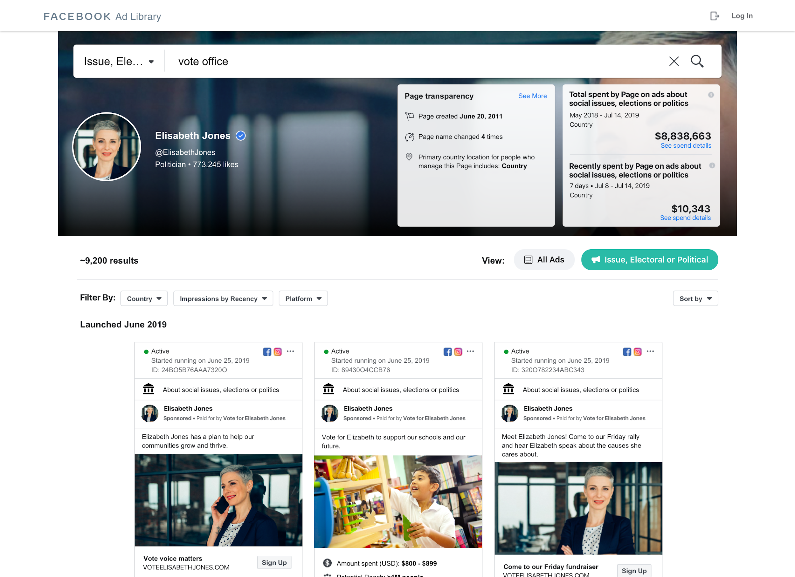
廣告檔案庫：具搜尋功能的資料庫
除了所有刊登中的廣告外，我們也會針對所有粉絲專頁顯示以下粉絲專頁透明度資訊：
粉絲專頁建立日期
粉絲專頁名稱變更次數
粉絲專頁管理人員所在的主要國家／地區
若要尋找社會議題、選舉或政治相關的廣告，您可以利用下列方式，搜尋粉絲專頁名稱或關鍵字來篩選廣告：
國家／地區
粉絲專頁名稱
狀態（「刊登中」及／或「暫停」）
針對這些廣告，我們會顯示七年內的搜尋結果（包括狀態為「刊登中」和「暫停」的廣告）。這些廣告都包含免責聲明，因此您可以從中瞭解廣告的負責人是誰。
在頁面頂端，您還會看到這些廣告主在議題、選舉或政治廣告的總支出和上週花費金額等額外資訊。

Slide 53
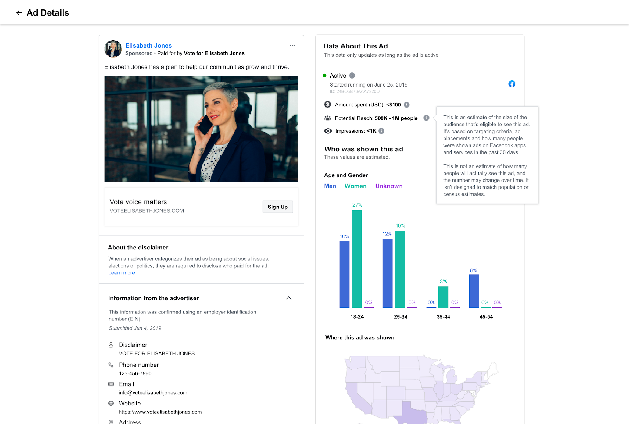
檢視廣告詳細資料
若要深入瞭解某則社會議題、選舉或政治相關廣告，請點擊「查看廣告詳情」查看以下資訊：
廣告狀態（「刊登中」或「暫停」）
曝光次數範圍
支出金額範圍
已觸及用戶的人口統計資料分析
已觸及用戶的所在地點
潛在觸及人數
如果提交免責聲明時使用粉絲專頁名稱或其他名稱，我們會要求檢查
平台外的資訊，例如電話號碼、電子郵件地址、網站和商家地址。這些資訊會在廣告檔案庫中存放七年，並開放大眾查詢。您可以點擊廣告
詳情中的「廣告主提供的資訊」下拉式區塊，查看這些詳細資料。
Notes:
Ads that run without a disclaimer and are later deemed to be political will also appear in the Ad Library. Page spend information is available for ads about social issues, elections or politics where the Ad Library Report is currently available.

Slide 54
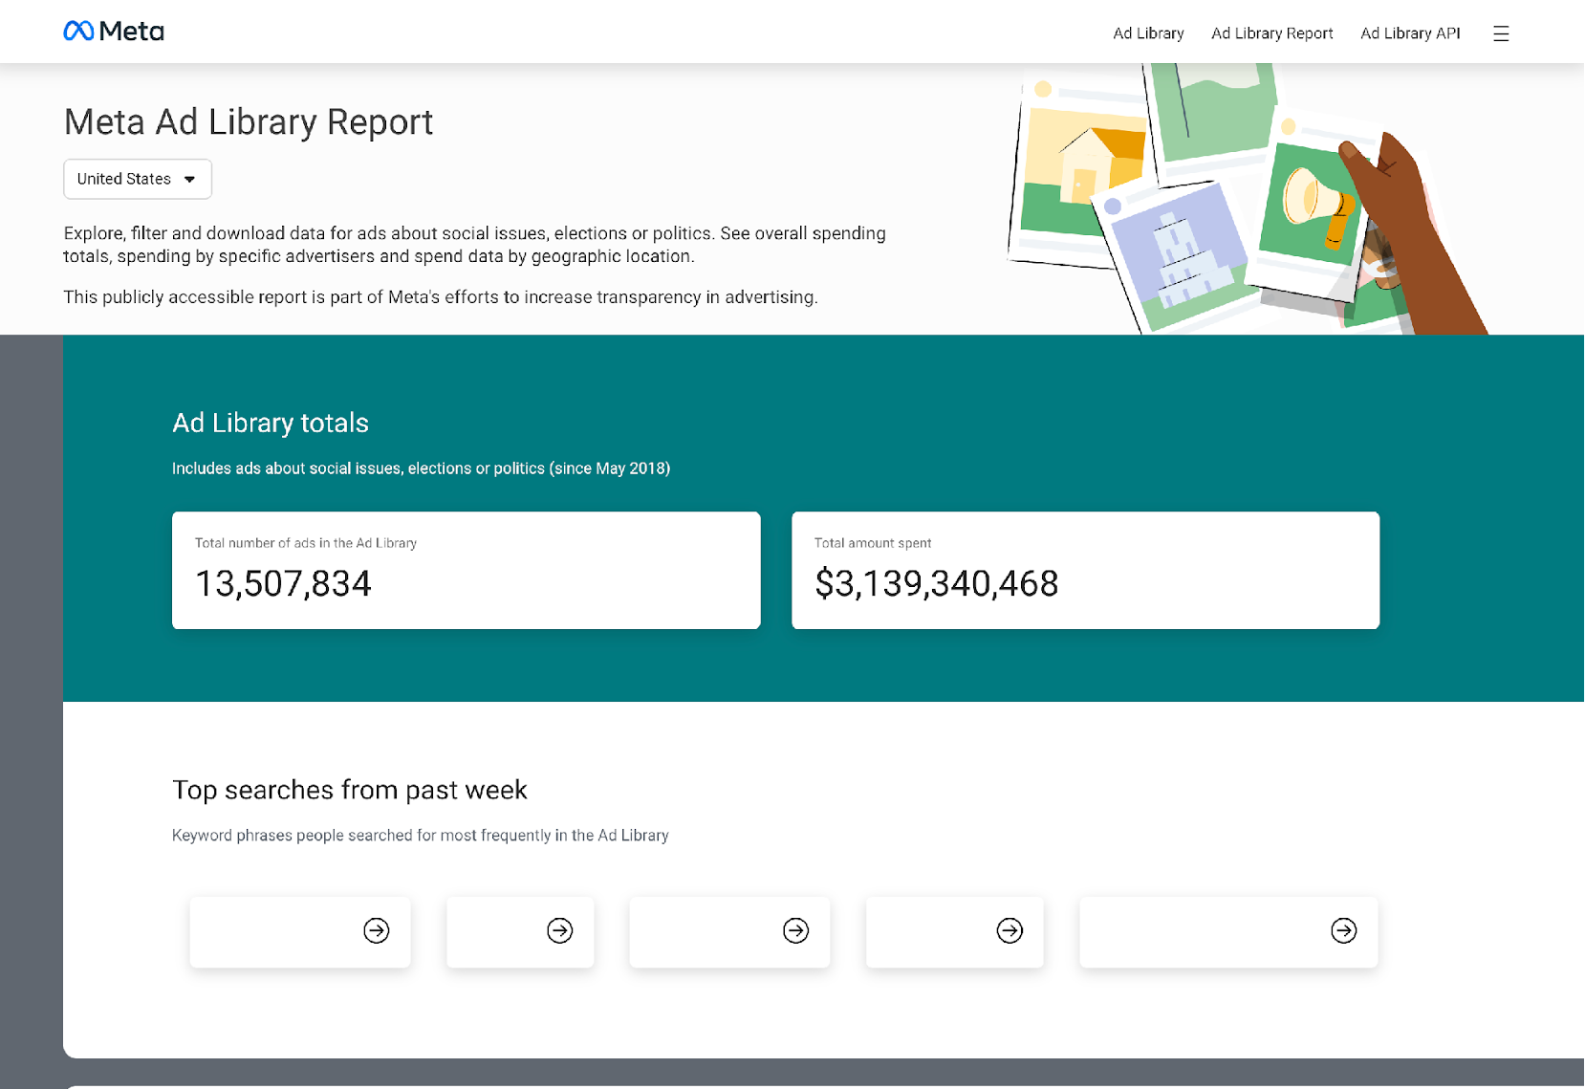
廣告檔案庫報告
廣告檔案庫報告可讓您找出特定國家／地區和時間範圍內的社會議題、
選舉或政治相關廣告，並查看這些廣告的完整彙總資料。您將能查看
廣告主花費金額、熱門搜尋詞語及其他資料。我們還提供自訂花費追蹤器，以比較廣告主刊登社會議題、選舉或政治相關廣告的花費。
Notes:
The Ad Library report allows you to get an aggregated, comprehensive view of ads about social issues, elections or politics in a given country, for a given time period. You’ll see how much advertisers are spending, popular search terms and more. We also offer a custom spend tracker to compare the spending of advertisers running ads about social issues, elections or politics.
Currently, the report is available in the EU, United Kingdom, Canada, Ukraine, Israel, US, India, SIngapore, Taiwan, Argentina and more.

Slide 55

廣告檔案庫 API
我們已在全球推出廣告檔案庫 API，讓主管機關、新聞工作者、監察機構以及一般大眾都能分析社會議題、選舉或政治相關廣告，協助確保廣告主和 Meta 負起應負責任。
廣告檔案庫 API 能讓您以有效率的方式分析廣告檔案庫中的議題、選舉或政治廣告，進而深入瞭解廣告主在我們平台上所採取的動作。
若要使用 API：
完成身分確認程序。
建立開發人員帳號。
同意我們的《開放平台政策》。
Notes:
The Ad Library application programming interface (API) allows you to perform customized keyword searches of ads stored in the Ad Library. You can search data for all active and inactive ads about social issues, elections or politics.
https://www.facebook.com/id/hub/
https://developers.facebook.com/terms/
https://www.facebook.com/ads/library/api

Slide 56
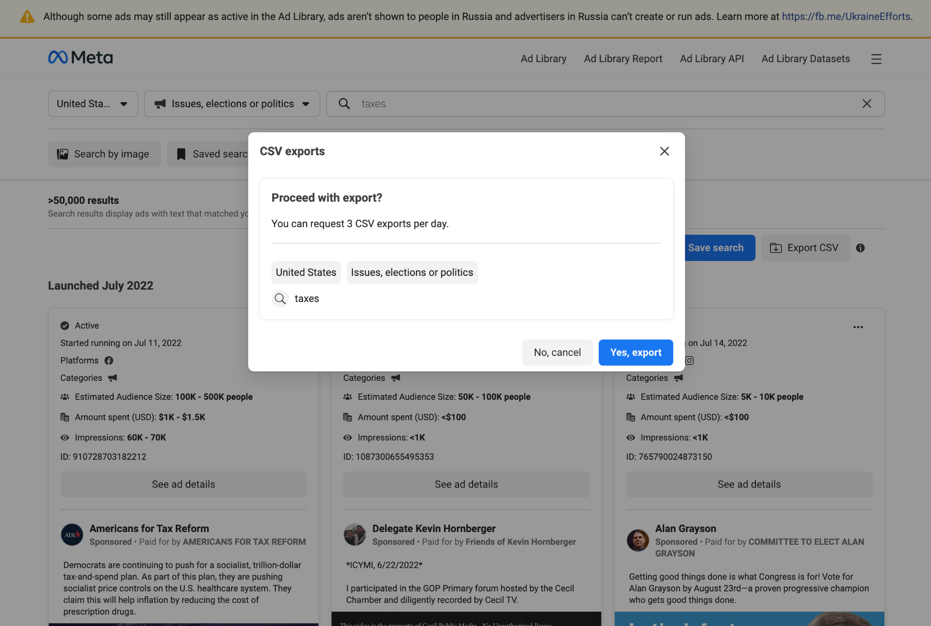
匯出 CSV
雖然此資料已可透過廣告檔案庫 API 取得和下載，但以 CSV 格式匯出是一種更簡單的新存取方式，而且不需要任何 API 技術知識條件，可以讓用戶更輕鬆地分析趨勢和特定時間範圍。

Slide 57
訂閱廣告主摘要
若要訂閱每日或每週摘要，請前往廣告檔案庫並編輯您的訂閱。
廣告檔案庫目前提供電子郵件訂閱和更新，您只要註冊就能接收功能
更新資訊或取得產品的系統狀態通知。
您可以立即訂閱，接收最多 10 名廣告主的廣告花費金額和廣告數量，或是有關議題、選舉或政治相關廣告的更新資訊。
Notes:
https://fb.workplace.com/groups/transparencyfyi/posts/2915275445440806/

Slide 58
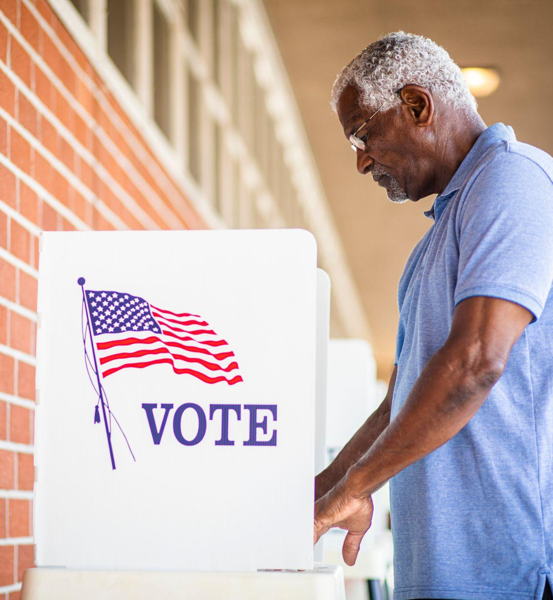
資源
如需更多資訊和資源，請瀏覽 facebook.com/gpa

