Slide 1



Outils et solutions pour les organismes de contrôle des élections
En savoir plus
Comprendre les politiques et les produits de Meta en matière d’intégrité des élections

Slide 2
Sommaire
Premiers pas avec les technologies Meta
Vue d’ensemble sur la publicité
Publicités portant sur un enjeu social, électoral ou politique
Bibliothèque publicitaire Meta
Ressources

Slide 3



Notre approche en matière d’élections
Éviter toute interférence dans les élections et le processus de vote
Nous examinons en permanence les contenus afin de déterminer s’ils enfreignent nos Standards de la communauté.
Nos équipes luttent à la fois contre l’ingérence étrangère et les opérations d’influence nationales.
Orienter les personnes vers des informations fiables
Nous continuons à fournir des informations officielles concernant l’inscription sur les listes électorales.
Les agents électoraux locaux et ceux des États américains continuent d’utiliser nos alertes sur le vote sur Facebook et Instagram.
Nous travaillons avec 90 partenaires couvrant plus de 60 langues pour lutter contre la désinformation virale.
Fournir une transparence sans équivalent en matière de publicités
Nous fournissons une transparence sans équivalent pour les publicités portant sur un enjeu social, électoral ou politique.
Notre suivi personnalisé des dépenses est disponible dans le cadre de notre rapport de la bibliothèque publicitaire.
Notes:
Let’s first discuss Meta’s approach to elections. We have a three-pronged approach for elections:
Preventing election and voter interference. We do this by continually reviewing content to determine if it violates our Community standards and our team fights both foreign interference and domestic influencer operations.
Connecting people with reliable information. We’re continuing to connect people with details about voter registration through our Voting Alerts on Facebook and Instagram. We work with 90 partners covering over 60 languages to address viral misinformation.
Providing industry-leading transparency for ads. Since 2018, we have provided industry-leading transparency for ads about social issues, elections or politics. Our Custom Spend Tracker is available as part of our Ad Library Report.

Slide 4

SECTION 01
Premiers pas avec les technologies Meta

Slide 5


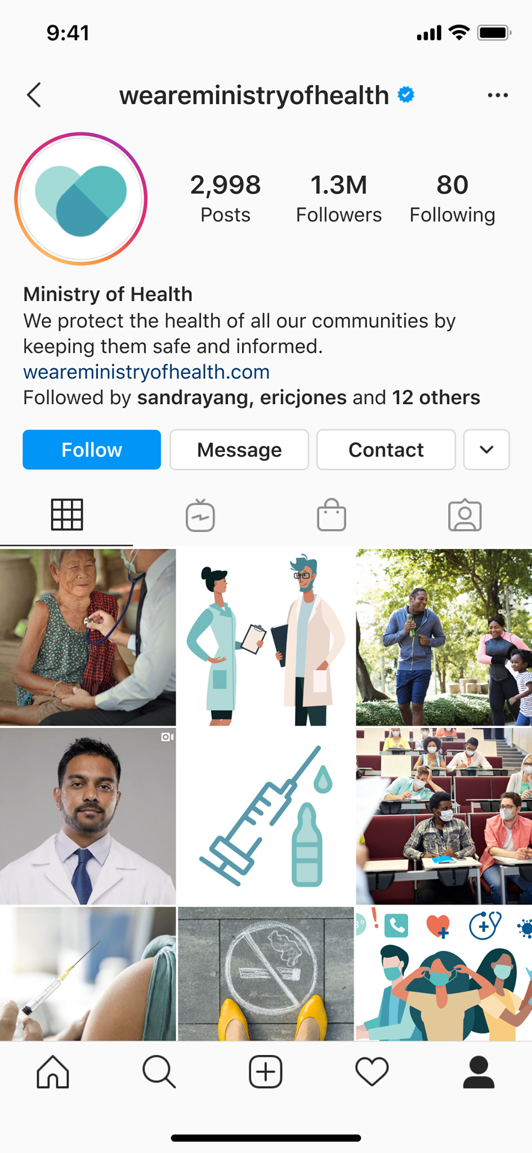
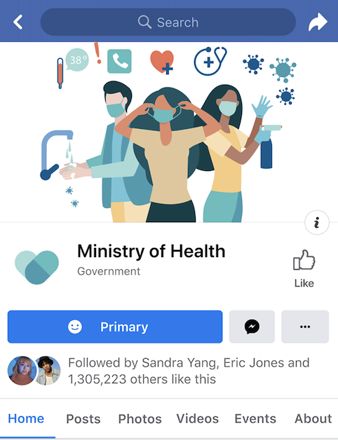
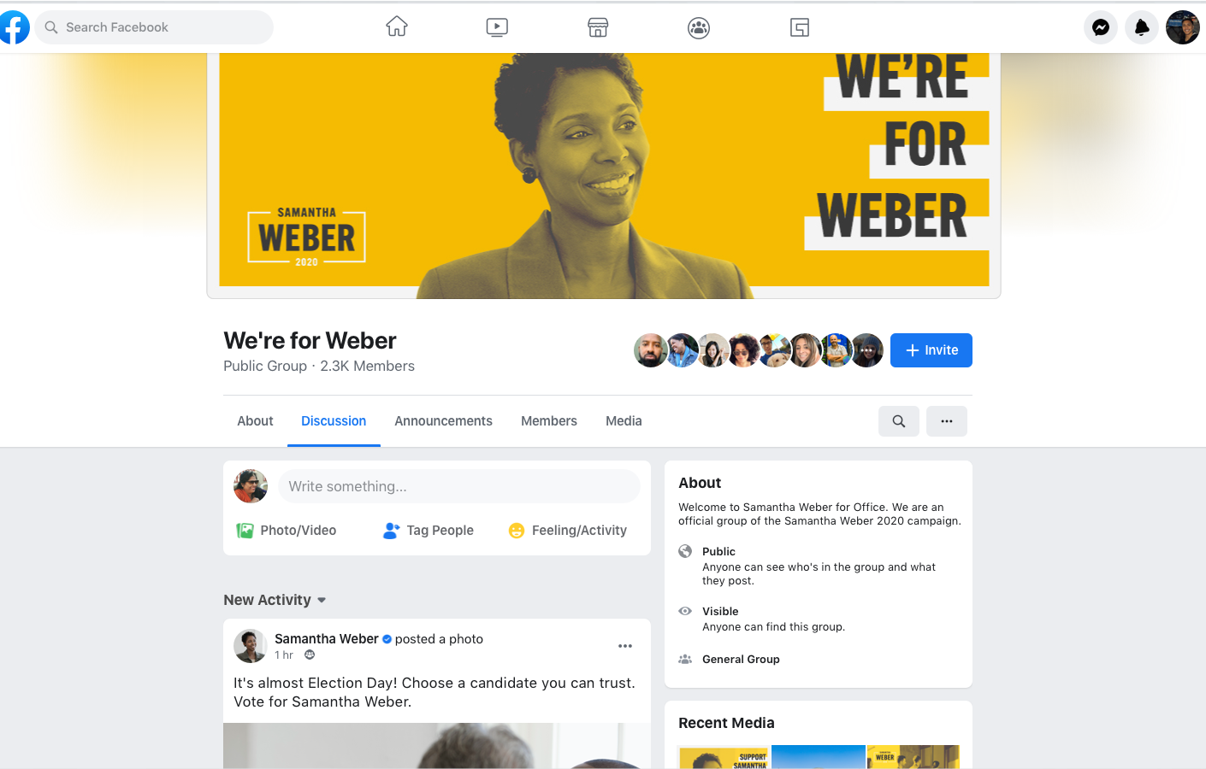
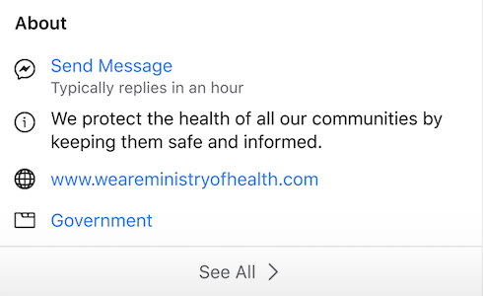
Page Facebook
Une Page Facebook permet au public d’entrer en contact avec votre organisation et d’en apprendre davantage sur votre cause. Vous pouvez partager des mises à jour et dialoguer avec vos soutiens et potientiel·les électeur·ices.
PROFIL
STATISTIQUES
Notes:
If you’re familiar with Facebook, chances are you already have a Facebook profile. This is your personal profile page. However, we recommend for individual electoral commissions involved in [government or politics] create a Facebook Page, rather than a profile. Your Page is a public presence designed for connecting with people at-large who you may or may not know personally. Your Page is managed by profiles and will have access to tools such as Page Insights and the ability to advertise. Be sure to add a profile Picture and Cover Photo like the example shown here.

Slide 6
Sécurité de la Page
Authentification à deux facteurs
Assistance confidentialité
Contrôle de sécurité
Notes:
Once you have your Page, the most important thing you can do is turn on two-factor authentication.
Two-factor authentication is a security feature that helps protect your Facebook account in addition to your password.
When you set up two-factor authentication, you’ll be asked to enter a special login code or confirm your login attempt each time someone tries accessing Facebook from a browser or mobile device we don’t recognize.
Privacy checkup will help you control who can see what you share, how your information is used and how to secure your account.
Security checkup will help you log out of unused browsers and you will get alerts when someone tries logging into your account from an unrecognized computer or mobile device.
When you are conducting a security checkup, it’s also a good time to ensure that the email associated with your Facebook account is one that you currently have access to.

Slide 7
Optimisez votre Page
Personnalisez votre URL
Filtres à injures et mots-clés*
Classement des commentaires
Messages
Partage des moments clés
* Dans certains pays, la capacité du gouvernement ou des responsables politiques à prendre ces mesures peut être limitée en raison des lois et réglementations applicables. Si vous avez des doutes, n’hésitez pas à consulter votre conseiller ou conseillère sur les questions juridiques.
Notes:
Once your Page is up and running, you will want to optimize your Page.
First, visit the “About” section and edit the “Create Page @Username” file under “General.” This will change the URL of your Facebook Page to facebook.com/[USERNAME]. We recommend that your Facebook Page URL/username match your other online accounts if at all possible - it will make them all that much easier for people to remember.
Second, click on “Settings” to adjust a number of options that will help you optimize your Page. For example, you can block certain words from appearing on your Page by using the Profanity Filter and Page moderation tools.
Comment ranking - Your can turn on comment ranking so that comments with the most likes or replies, as well as comments from verified Profiles and Pages, will appear first.
For Messaging, people increasingly want to communicate through private messaging because it is fast and convenient. Page admins can turn messaging on or off, set up welcome greetings, instant replies and more. If you do begin to utilize Page messaging, be sure you’re following our Messenger platform policies.
You can also share important milestones, which are a great way to give people more insight into the history and progress of your organization. Your Page is also the place to celebrate big moments, launches and anniversaries.

Slide 8

Critères de vérification sur Facebook
Respecter les Standards de la communauté.
Authentique : Représenter une personne ou une entité réelle.
Unique : Être la seule présence de la personne ou entité.
Complet : Avoir une section À propos, une Page ou une photo de profil et une activité récente, en incluant au moins un message.
Remarquable : Représenter une personne ou une entité bien connue et souvent recherchée pour une vérification payante.
Notes:
The verified badge means Facebook has confirmed that the Page or profile is the authentic presence of the individual or entity it represents. You can apply for the verified badge if you are a public figure or entity and meet certain account and eligibility requirements. You can scan the QR code on the screen to fill out the form and verify your profile or Page. You must be logged in to view this form and request verification.
In addition to following our terms of service and the Facebook Community Standards, Pages and profiles need to be:
Authentic: Represent a real person or entity
Unique: Be the only presence of this person or entity. Only one Page or profile per person or entity may be verified, with exceptions for language-specific Pages and profiles.
Complete: Have an about section, Page or profile photo and recent activity, including at least one post.
Notable: Represent a well-known, often-searched person or entity for paid verification.
https://www.facebook.com/help/1288173394636262

Slide 9
Outils pour vous aider à gérer les publications sur votre Page
Assistance modération
Masquer automatiquement tous les nouveaux commentaires contenant des images ou des liens.
Filtre à injures
Bloquer l’apparition de différents degrés d’injure sur votre Page.
Modération des Pages
Bloquer les publications ou les commentaires contenant les mots, les phrases ou les emojis que vous saisissez manuellement.
Classement des commentaires
Les commentaires ayant le plus grand nombre de mentions J’aime ou de réponses apparaîtront par défaut en haut de votre Page.
*Dans certains pays, la capacité du gouvernement ou des responsables politiques à prendre ces mesures peut être limitée en raison des lois et réglementations applicables. Si vous avez des doutes, n’hésitez pas à consulter votre conseiller ou conseillère sur les questions juridiques.
Notes:
Meta has tools in place to help you manage what supporters and potential voters and post on your Page. One core tool we offer is Moderation Assist. This is a tool to manage comments for the new Pages experience where you can automatically hide all new comments that have images or links. You can review hidden comments in your Moderation Assist Activity Log to determine if you want them to be visible.
In addition to Moderation Assist, you can turn on additional tools such as:
Profanity filter to block different degrees of profanity from appearing on your Page. We determine what to block by using the most commonly reported words and phrases marked offensive by the community.
Page Moderation to block posts or comments containing the words, phrases or emojis you manually enter. When people include a word you've blocked in a post or comment on your Page, it won't appear on your Page.
Comment ranking so that comments with the most likes or replies as well as comments from friends or verified profiles and Pages will appear at the top by default. If you've turned off comment ranking for your Page, your Page will display comments chronologically by default.
After posting to your Facebook Page, you can manage comments by:
Limiting the people and Pages who can comment on each of your organic posts.
Hiding or deleting a comment from a post on your Facebook Page. When you hide a comment from a post on your Page, the comment will only be visible to the person who wrote it and their friends. When you delete a comment from a post on your Page, the comment will be permanently removed from the post.
Reporting a comment if it doesn't follow the Meta Community Standards.
Note: There may be restrictions on the ability of government or political officials to take these actions pursuant to applicable laws and regulations. Please consult with your legal counsel if you have questions.

Slide 10
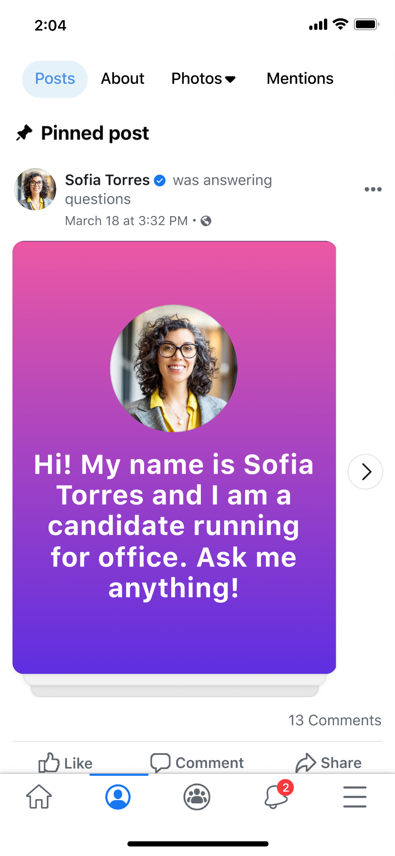
Épingler un article sur votre Page
Notes:
You can set expectations about the type and tone of conversations you want to see on your Page, which can easily be done in a post pinned to your Page.
If you have Facebook access to a Page, you can pin posts, upcoming events and recent videos for display in the Featured section at the top of your page. As you pin items, the newest item appears at the front of the list, but you can change the order of any item. Pinned items remain in the Featured section until you remove them.
To pin a post, events or videos:
Log into Facebook, then click your profile photo in the top right
Click See all profiles, then select the Page you want to switch into
Click your Page’s profile picture in the top right to go to your Page.
Click your Page’s profile picture in the top right to go to your Page
Click Manage in the Featured section. If your Page already has pinned items, click the plus sign next to your pinned items
Click the pin icon next to Upcoming event, Recent videos, or a post below Recent posts you can pin to add these items to your Featured section.
You can also go to a post on your Page and click the three dots in the top right of a post and click the Pin post.
https://www.facebook.com/help/235598533193464

Slide 11
Comment utiliser les alertes sur le vote
Remarque : Les alertes sur le vote ne sont disponibles que pour les Pages des collectivités locales, des organismes de santé publique et des premiers intervenants aux États-Unis et dans certaines villes d’Australie.
Tout comme les alertes locales, celles sur le vote ne doivent être utilisées que pour les messages urgents, pouvant faire l’objet d’une action et présentant un intérêt général pour les électeur·ices. Les alertes sur le vote peuvent être utilisées pour communiquer des changements spécifiques à une juridiction et concernant :
Les lieux de vote
Les moyens et méthodes de vote
Les règles concernant les personnes éligibles pour participer à une élection
La période de vote (heures ou dates)
Notes:
[Note: Voting alerts are only available to local government, public health agency and first responder Pages in the US and select cities in Australia. Before presenting this slide, please check with local policy and product to see if this is available in your country]
One tool I want to touch on before getting into Instagram and WhatsApp is voting alerts.
We know that it can be important for you and state and local governments to have the ability to communicate important and timely information. Voting alerts is an extension of local allows and allows state and local election authorities to reach their constituents with important updates about voting.
Like local alerts, voting alerts should only be used for posts that are urgent, actionable and broadly relevant to voters. Voting alerts can be used to communicate jurisdiction-specific changes to:
Voting locations
Means and methods of voting
Rules about who is eligible to participate in an election
Voting time frame (hours or dates)
There are separate guidelines for state election authorities and some local election authorities and county/municipal government agencies who are eligible to send Voting Alerts during a limited period of time around an election.
Pages eligible to send Voting alerts:
Must be an “Office” Page (i.e. Government Organization, Public and Government Service) and not a “People” Page (Named Government Official)
Have a Page thumbnail that does not identify as an elected official
Have a Page name that does not contain a person’s name
How voting alerts should be used: Like Local Alerts, Voting Alerts should only be used for posts that are urgent, actionable and broadly relevant to voters. Voting Alerts can be used to communicate jurisdiction-specific changes to:
Voting locations
Means and methods of voting
Rules about who is eligible to participate in an election
Voting time frame (hours or dates)
Voting Alerts must be targeted at all voters affected by the alert, not a subsection to the people to whom the alert is relevant.
Prohibited content: All use cases outside of those that we just mentioned are strictly prohibited, and may result in removal of the alert. Examples of prohibited content or targeting include:
Content identifying, referring to or advocating for candidates, political parties or organizations, elected officials, ballot measures or specific races
Content that isn’t broadly actionable for all voters i the alerted area
Content about a jurisdiction-wide change to means/methods of voting that is targeted to only part of the jurisdiction
Content about potential changes that are still the subject of ongoing litigation or other legal proceedings.
https://www.facebook.com/business/help/626587208260920?id=1549080658590154
https://www.facebook.com/gpa/blog/us-voting-alerts

Slide 12
Allez sur votre page Facebook et ouvrez l’éditeur de publication pour vérifier le nombre d’alertes disponibles, puis faites de votre publication une alerte sur le vote.
Ensuite :
Sélectionnez le lieu de l’alerte.
Sélectionnez la durée de l’alerte.
Modifiez avant de publier.
Envoyez votre alerte sur le vote.
Créez une alerte sur le vote
Notes:
[Note: Voting alerts are only available to local government, public health agency and first responder Pages in the US and select cities in Australia]
There are separate guidelines for state election authorities and some local election authorities and county/municipal government agencies who are eligible to send Voting Alerts during a limited period of time around an election.
To get started creating a voting alert, go to your Facebook Page and open the post composer to check how many alerts you have available, and mark your post as a voting alert. From there,
Select alert location
Select alert duration
Edit before you post
Send your voting alert
Voting Alerts must be targeted at all voters affected by the alert, not a subsection to the people to whom the alert is relevant.
Prohibited content: All use cases outside of those that we just mentioned are strictly prohibited, and may result in removal of the alert. Examples of prohibited content or targeting include:
Content identifying, referring to or advocating for candidates, political parties or organizations, elected officials, ballot measures or specific races
Content that isn’t broadly actionable for all voters i the alerted area
Content about a jurisdiction-wide change to means/methods of voting that is targeted to only part of the jurisdiction
Content about potential changes that are still the subject of ongoing litigation or other legal proceedings.
https://www.facebook.com/business/help/626587208260920?id=1549080658590154
https://www.facebook.com/gpa/blog/us-voting-alerts

Slide 13

Créez et optimisez votre compte Instagram
Notes:
In addition to a Facebook Page, you might consider building an Instagram account. To get started, download the Instagram App in the app store. Enter your phone number or email address then the name of your organization.
Next, you’ll want to consider what type of account you want: A personal account, business account or creator account. We recommend for government, political and advocacy organizations to choose a business account
Complete your profile by:
Adding a profile picture: You can do this by navigating to your Instagram profile and tap Edit profile. Choose a profile picture that represents your organization and clearly communicates your brand. For example, a photo of your logo will help your community recognize you. Your profile picture will appear in the top left corner of each post you create.
Include a link to your website: With a business account, you can include a link to your website or blog in your profile.
Write a bio that describes your organization: Use your bio to tell people about your organization. Bios can’t exceed 150 characters, so keep it short and get attention early. Your bio can include what your organization does, what you stand for or language and emojis that reflect your personality.
Select a category: This helps people identify what you do and will appear in your profile under the name of your organization
Lastly, add contact details and an action button: Include your email address, phone number and location in Contact options to help people find and reach you.
https://www.facebook.com/business/learn/lessons/instagram-business-profile-setup
https://www.facebook.com/help/instagram/502981923235522

Slide 14
Fonctionnalités des comptes Instagram Business
Indiquez les coordonnées de votre organisation et encouragez les personnes à vous contacter.
Organisez vos messages et utilisez les réponses rapides
Utilisez le tableau de bord professionnel
Notes:
When you set up a free business account on Instagram, you can access features designed to help your organization. These tools can help you grow and manage your organization on Instagram. Here are some features of an Instagram business account:
Provide contact information: Include contact information about your organization and encourage people to get in touch. Add a link to your website, a phone number, location and email address so people can find your contact information. You can also add an action button (such as a contact button) to your profile. This enables people to take a direct action with you.
Organize your messages and use quick responses: With an Instagram business account, you’ll have access to an inbox that enables you to organize messages. The inbox has two tables: Primary and General. The Primary tab is for the messages you want to see first. All messages will appear in the Primary tab, but you can swipe them into the General tab. The General tab is for messages you want to get back to later.
Use the professional dashboard: Explore educational information and business tools all in one destination. Use the professional dashboard and Insights to learn about how your followers interact with your photos and videos. This knowledge can help you create posts that are relevant to your audience and increase opportunities for them to see your profile and take action.
https://www.facebook.com/business/learn/lessons/establish-instagram-business-account

Slide 15

Badge Vérifié sur Instagram
Un compte Instagram avec un badge Vérifié à côté de son nom signifie qu’Instagram a confirmé qu’il s’agit de la présence authentique de cette personne ou entité. Une fois vérifié, vous ne pourrez pas changer votre nom d’utilisateur sur votre compte. La vérification ne peut pas être transférée à un compte différent qui représente quelque chose d’autre, même s’il appartient au partenaire. Pour demander un badge, vous pouvez contacter le spécialiste assistance Meta en visitant facebook.com/gpa/help.
Notes:
An Instagram account with a verified badge next to its name means that Instagram has confirmed that it is the authentic presence for that person or entity. Once verified, you will not be able to change your username on your account. Verification cannot be transferred to a different account that represents something else even if owned by the partner. To request a badge, you can reach out to Meta Support Pro by visiting facebook.com/gpa/help.
On Instagram, we follow the same requirements as Facebook including that you must follow our Community Standards and be authentic, unique, complete and notable.
At this time, requesting Instagram verification is not available on desktop.
If a partner asks about steps to request a badge:
To request a verified badge on iPhone or Android:
Make sure you’re logged in to the account you’re requesting a verified badge for.
Tap the person icon in the bottom of your profile
Tap the three lines in the top right, then tap settings
Tap account
Then tap request verification
Enter your full name and provide the required form of identification (e.g. government-issued photo ID)
Follow the on-screen instructions then tap Submit
To request a verified badge on android:
Keep in mind, even if your account is eligible for verification, submitting a request doesn’t guarantee that your account will be verified. Once we review your request, you’ll receive a notification in Activity up to 30 days after applying letting you know if your account has been verified or not. If your request is denied, you can submit a new request again in 30 days. Note that applying for a verified badge multiple times before receiving a decision will cancel your application.
https://www.facebook.com/help/854227311295302?helpref=faq_content
https://help.instagram.com/461238577687001?fbclid=IwAR1o2oDH1c6M9Qguhz37zCmIJPm71e5dfxnxK45Od4WCK-wNdXRALAbty8w https://help.instagram.com/312685272613322?fbclid=IwAR3t80yQ989SbESlhxD7oltyvmYs1s_iGnj80Jp6RhbbJd9dwrSwdl1lpvQ

Slide 16
Modération des commentaires
Vous pouvez choisir de masquer les commentaires et les invitations par message que vous ne souhaitez pas voir en activant l’option :
Masquer les commentaires : les commentaires contenant des mots, des phrases ou des emojis offensants sont automatiquement filtrés ou masqués. Ce paramètre est activé par défaut, mais vous pouvez le modifier à tout moment.
Filtrage avancé des commentaires : filtrez encore plus de commentaires susceptibles de contenir des mots ou des phrases offensants. Les commentaires des personnes que vous suivez et qui vous suivent ne seront pas masqués. Ce paramètre est désactivé par défaut, mais vous pouvez le modifier à tout moment.
Masquer les invitations par message : les demandes de messages susceptibles de contenir des escroqueries ou des mots, phrases ou emojis offensants apparaîtront dans votre dossier d’invitations masquées. Ce paramètre est désactivé par défaut, mais vous pouvez le modifier à tout moment.
Notes:
Once you begin posting on Instagram, you might see potentially offensive comments and message requests. Content that doesn’t go against our Community Standards but may be inappropriate, disrespectful or offensive can be hidden using the Hidden Words setting. You can create a custom list of words, phrases, numbers and emojis you want to hide.
You can choose to hide comments and message requests you don’t want to see by turning on:
Hide comments: Comments with common offensive words, phrases or emojis are filtered out or hidden automatically. This setting is on by default, but you can change it any time.
Advanced comment filtering: Filter out even more comments that may contain offensive words or phrases. Comments from people you follow and who follow you will not be hidden. This setting is off by default, but you can change it at any time.
Hide message requests: Message requests that may contain scams or offensive words, phrases or emojis will appear in your hidden requests folder. This setting is off by default, but you can change it any time.
Note: There may be restrictions on the ability of government or political officials to take these actions pursuant to applicable laws and regulations. Please consult with your legal counsel if you have questions.
https://help.instagram.com/700284123459336

Slide 17

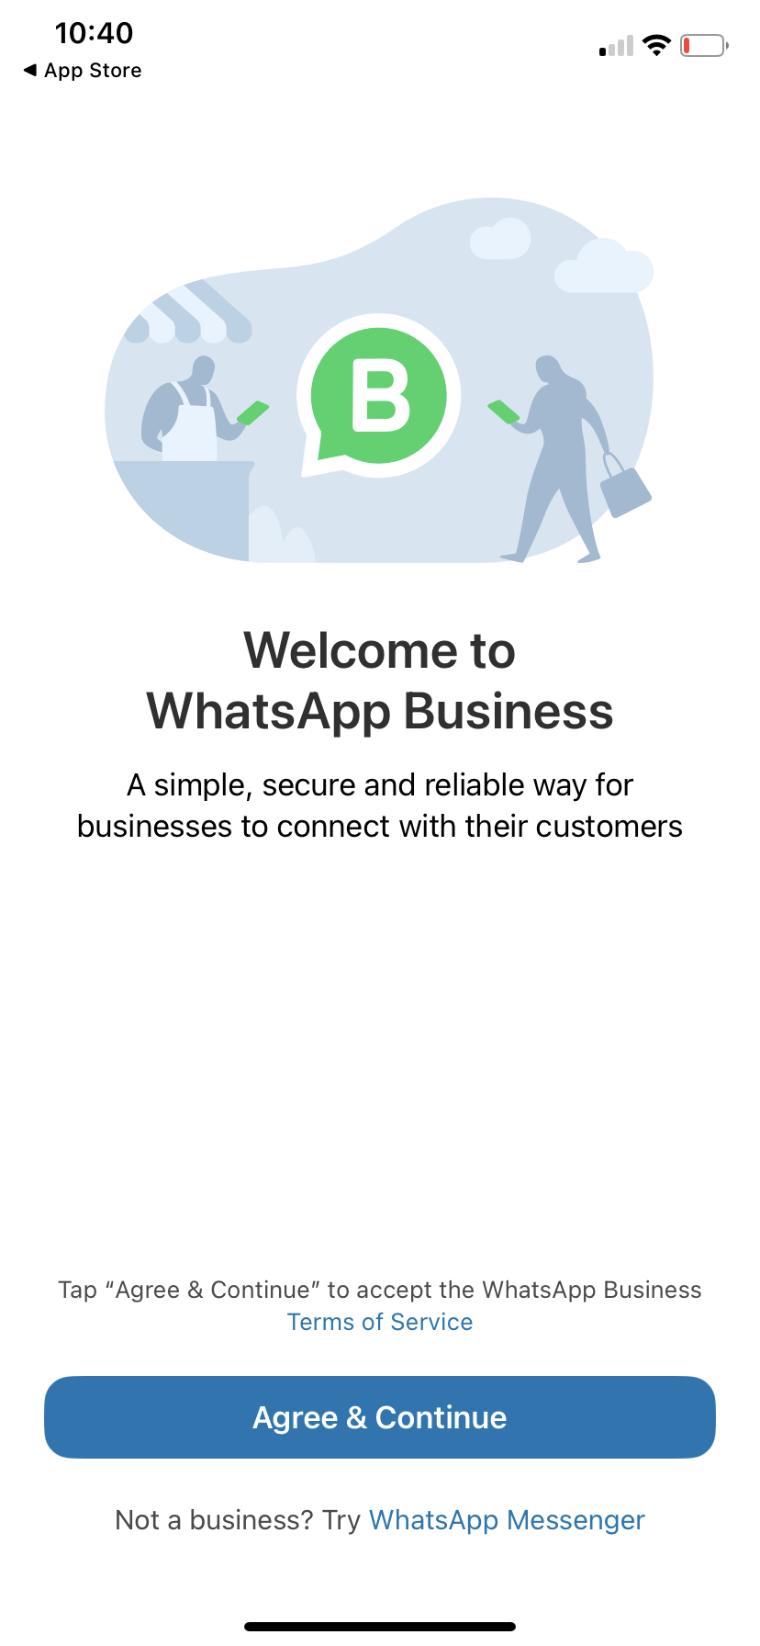
Communiquez avec votre audience sur WhatsApp
WhatsApp vous permet de gérer plus efficacement la communication avec votre audience. WhatsApp offre une expérience d’appel et de discussion chiffrée de bout en bout à des personnes du monde entier, indépendamment de l’appareil qu’elles utilisent et de la qualité de leur connexion.
Notes:
You can manage communication with your community more efficiently with WhatsApp. WhatsApp provides an end-to-end encrypted call and chat experience for people around the world, no matter the location, device or connection quality. This means that only the person you are communicating with is part of the conversation, no other entity or person will be able to view your conversations.
WhatsApp uses little data and battery life, so you can count on it to work reliably regardless of where you are.
Internal speaker note: Candidates for office and police departments cannot use the WhatsApp Business Platform (FKA WhatsApp API)
https://www.facebook.com/business/learn/lessons/whatsapp-for-business

Slide 18
Établissez une présence sur
l’application WhatsApp Business
Téléchargez et lancez l’application WhatsApp Business en vous rendant sur l’App Store et en téléchargeant WhatsApp.
Inscrivez-vous : sélectionnez votre pays dans la liste déroulante pour ajouter votre indicatif pays, puis saisissez votre numéro de téléphone au format international. Appuyez sur Terminé ou Suivant, puis sur OK pour recevoir votre code d’enregistrement à 6 chiffres par SMS ou appel téléphonique. Pour terminer l’inscription, saisissez votre code à 6 chiffres.
Remarque : Vous ne pouvez avoir qu’un seul compte WhatsApp par numéro de téléphone. Si vous vous connectez à WhatsApp Business avec le numéro de mobile que vous utilisez pour votre compte personnel, vous serez déconnecté·e de WhatsApp.
Autorisez l’accès aux contacts et aux photos : vous pouvez ajouter des contacts à l’application WhatsApp Business à partir du carnet d’adresses de votre téléphone. Vous pouvez également autoriser l’accès aux photos, vidéos et fichiers de votre téléphone.
Créez un compte : indiquez le nom de votre organisation, sélectionnez votre catégorie et choisissez une photo de profil.
Créez votre profil : appuyez sur Explorer > Profil professionnel. Vous pouvez ajouter des informations importantes telles que l’adresse, la description et les horaires de votre organisation ici.
Notes:
WhatsApp Business can help your organization grow. It enables you to communicate with your community in a conversational, approachable and accessible manner.
To use WhatsApp to communicate on a local level, consider the following steps:
Download and launch the WhatsApp Business App by visiting the app store and downloading WhatsApp
Register: Select your country from the dropdown list and add your country code, then enter your phone number in international phone number format. Tap Done or Next, then tap OK to receive your six-digit registration code via SMS or phone call. To complete registration, enter your six-digit code.
Note: You can only have one WhatsApp account per phone number, so if you log into WhatsApp Business with the same mobile number that you use for your personal account, you’ll be logged out of WhatsApp.
Allow access to contacts and photos: Contacts can be added to the WhatsApp Business App from your phone’s address book. You can also allow access to your phone’s photos, videos and files.
Create an account: Fill out your organization name, select your category and choose a profile picture.
Build your profile: Tap Explore > Business profile. Here, you can add important information like your organization’s address, description, hours and more.
https://www.facebook.com/business/learn/lessons/whatsapp-for-business
Internal speaker note:
Candidates for office and police departments cannot use the WhatsApp Business Platform (FKA WhatsApp API).
WhatsApp business verification is limited to a small number of businesses participating in a closed pilot program. At this time, there is no verified badge for the business app.

Slide 19
Demander un compte business officiel sur WhatsApp
Remarque : Ne présentez cette diapositive que si vous avez des questions sur la plateforme d’entreprise et la vérification.
Étapes à suivre pour demander un compte business officiel
Accédez au Gestionnaire WhatsApp à partir de votre Business Manager. Dans la section Vue d’ensemble, cliquez sur le numéro de téléphone pour lequel vous souhaitez demander un OBA.
Activez la vérification en 2 étapes.
Cliquez sur Envoyer la demande et remplissez les informations requises.
Notes:
Note: Only present this slide if you get questions about the Business Platform and verification.
There are two types of WhatsApp Business accounts:
Business Account: By default, any account using the WhatsApp Business Platform or Business App is a business account. WhatsApp verifies authenticity of an organization for every account. If the account has completed Business Verification, the name of the organization is visible even if the user hasn’t added the organization to their address book.
Official Business Account: An official business account has a green checkmark badge in its profile and chat thread headers.
If your WhatsApp account is an official business account, there will bea green checkmark beside the displayed name in the contacts view. How it works:
Follow WhatsApp Business Policies
Be notable: Represent a well-known organization
Verified: Has gone through Business Verification, and
Has set up two-step verification
To request an Official Business Account:
Access WhatsApp Manager from your Business Manager. Click on the phone number for which you want to request OBA within the Overview section
Turn on two-step verification for this phone number to apply for OBA
Click on Submit Request Button and fill out the required information. You can submit up to 5 supporting links to show that the business is notable.
Once we’ve reviewed your request, you will receive a notification letting you know if your account has been granted OBA or not. If your request is rejected, you can submit a new request after 30 days. Note: We do not grant OBA to employees, test accounts and Business App accounts.
https://developers.facebook.com/docs/whatsapp/overview/business-accounts/#official-business-account
https://www.facebook.com/business/help/2058515294227817?id=180505742745347
https://www.facebook.com/business/help/604726921052590?ref=search_new_837

Slide 20

SECTION 02
Recommandations publicitaires

Slide 21
Booster vs diffuser une publicité
Booster
Simple et rapide
Directement depuis votre Page
Moins d’options de ciblage et d’optimisation
Diffusion de publicités
Gestionnaire de publicités
Suite complète d’outils publicitaires
Options avancées pour toucher une audience
Notes:
We know that paid advertising might seem overwhelming but all Facebook ads are self-serve and easy to run. There a few different ways to create a Facebook ad, including boosting a post and creating an ad in Ads Manager.
If you’re new to Facebook Ads, digital advertising in general, or your needs are simple, Facebook can do more of the work for you.
Let’s start with boosting. ​Boosting posts is the easiest form of advertising on Facebook. With boosting posts, you can quickly run ads directly from your Facebook Page by promoting one of your Page posts. While boosting a post is still considered an ad, Facebook ads are created through Ads Manager and offer more advanced customization solutions. Keep in mind that because a boosted post is considered an ad, you’ll need to get authorized and create a disclaimer if your ad is considered a social issue ad according to the policies we mentioned earlier.
​To advance your strategies and take your advertising to the next level, you might consider running ads in Ads Manager and benefiting from the full suite of advertising solutions. By running an ad, you can leverage advanced options to reach an audience and maximize investment.
A boosted post may initially optimize for Page likes, comments, and shares or overall brand awareness whereas Facebook ads can optimize for website conversions, video views, donations and more.

Slide 22
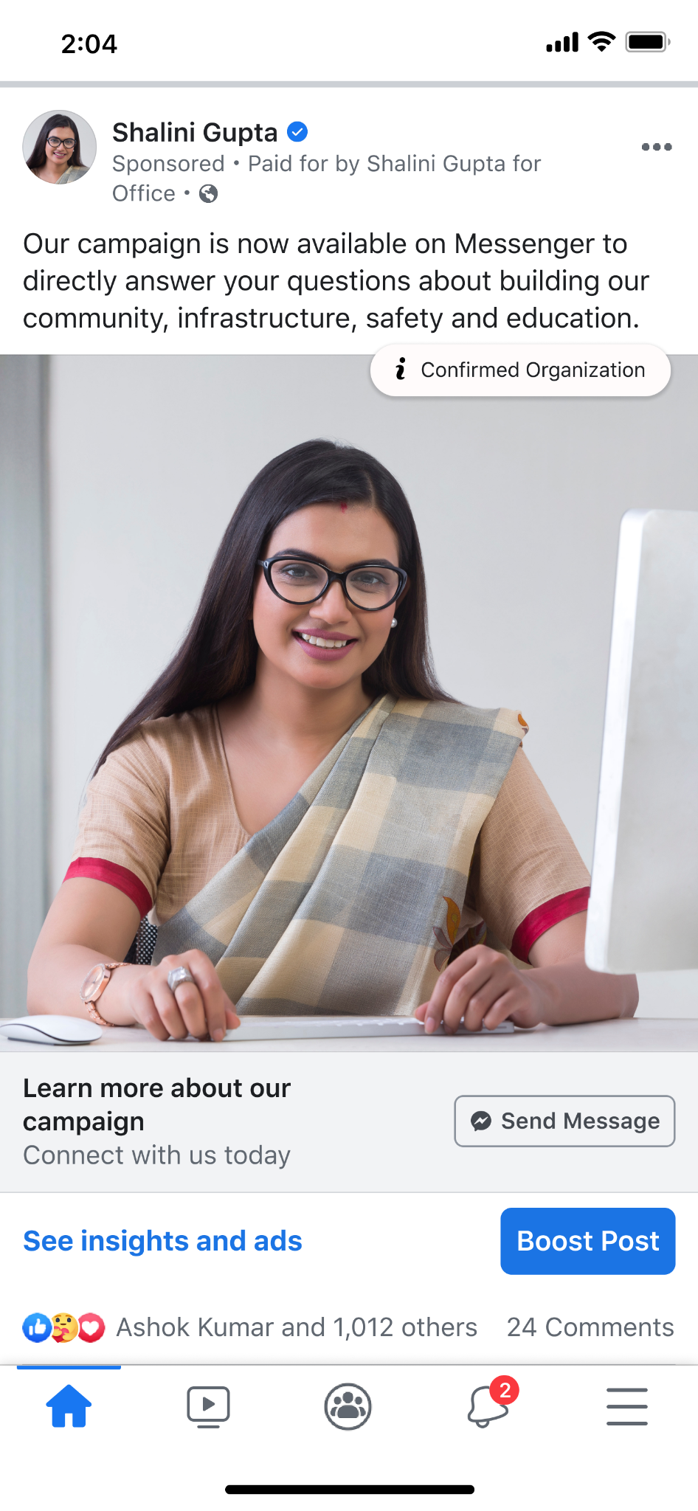
Lorsque vous boostez une publication, trois éléments sont importants :
les personnes que vous voulez couvrir
votre budget maximum
la durée de diffusion souhaitée de votre publicité
Notes:
Before diving deeper into running ads, let’s walk through how to boost a post. When you boost a post, you tell us three things:
Who you want to reach: You pick the audience you want to connect with and who you want to see this specific post
Your maximum budget: This is how much you want to spend over the course of your entire campaign
How long you want to run your ad: Once you click Boost and your ad is approved, people in your target audience will see your ad in their News Feed for the duration you’ve set.

Slide 23
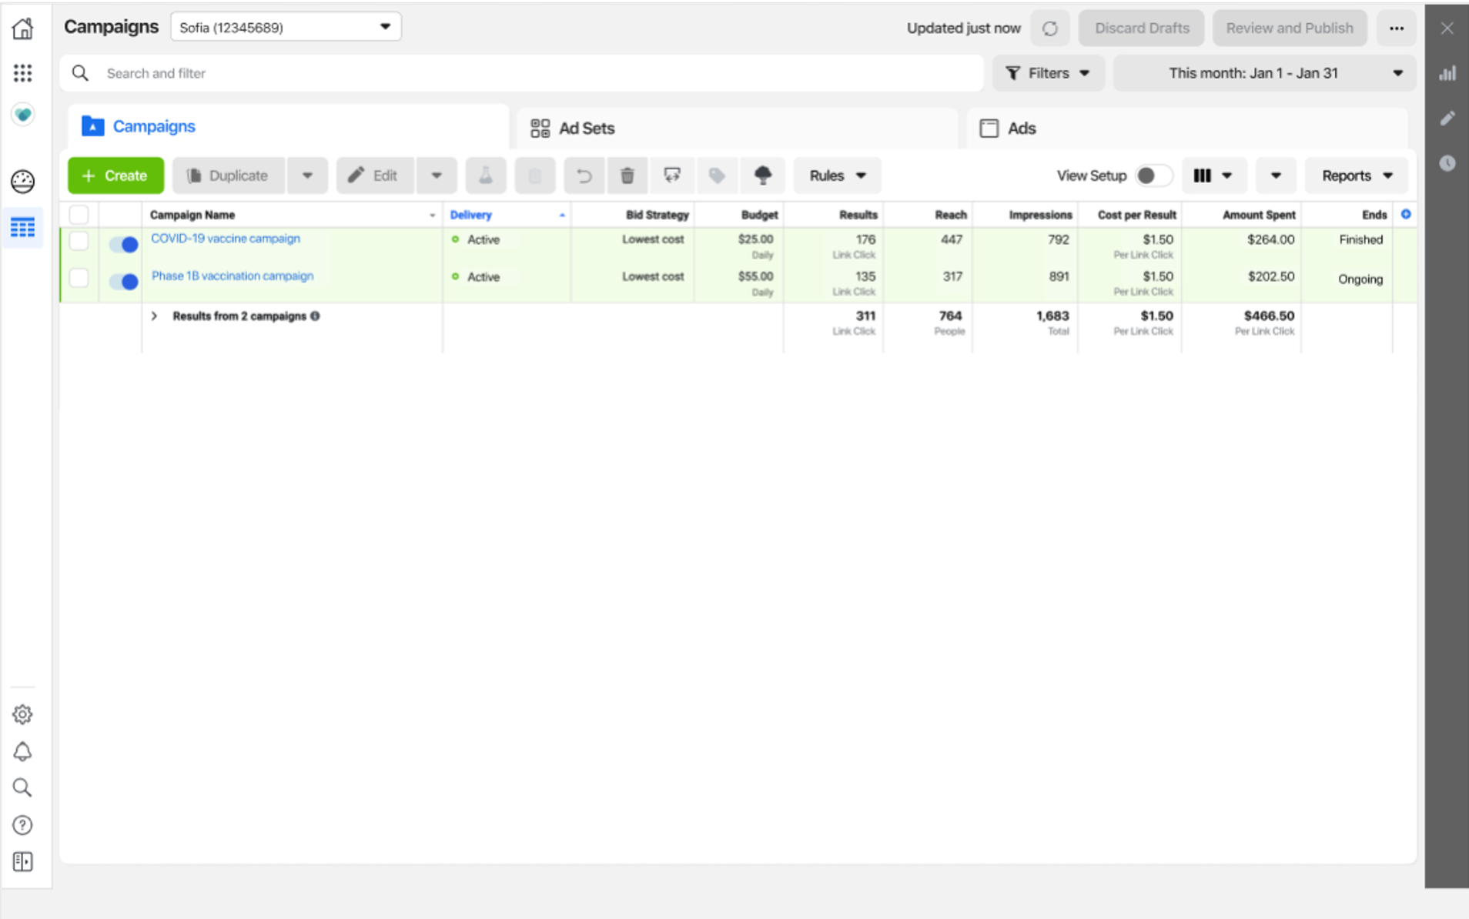
Gestionnaire de publicités
Voir, modifier et consulter les résultats de vos campagnes publicitaires.
Utiliser un processus étape par étape pour développer des campagnes publicitaires.
Gérer, contrôler et personnaliser plusieurs publicités à la fois en modifiant les paramètres.
Évaluez les performances publicitaires.
Notes:
Now that you have your Page up and running and your accounts are secure, let’s talk about how you can create an Ads Manager account.
Ads Manager offers a full suite of advertising solutions. Ads Manager is typically suitable for advertisers who wish to leverage advanced options to reach an audience and maximize investment.
With Ads Manager you can:
- View, make changes, and see results for all of your Facebook ad campaigns.
- Utilize a step-by-step process to develop ad campaigns by using ad creation to design your ads.
- Manage, control, and customize multiple ads at once by editing settings such as audience and a budget.
- Evaluate your ad’s performance by viewing up-to-date data on the quality of your ads and schedule reports

Slide 24

Meta Business Suite
Notes:
Meta Business Suite is distinct from Business Manager in that it offers several unique tools that facilitate cross-Meta engagement (posting, messaging, advertising) planning and insights. Meta Business Suite centralizes the following:
Desktop and mobile experience: Manage your business presence wherever you go with Meta Business Suite desktop or Meta Business Suite mobile app.
Scheduling and calendar tools: Publish or schedule new posts and stories for your Facebook Page and Instagram account. Plan content across Facebook and Instagram months in advance.
Unified Inbox:Read new messages and comments from your Facebook Page, Messenger and Instagram accounts. You can also create automated responses to help save time when responding to questions people commonly ask.
View insights: See how your organic and paid posts are performing with data on trends, activity on the content you share. You’ll also find more information about your audience here.
View activity: See who’s liked or commented on your posts, updates on your ads, and other activity on your Page and Instagram account.
Ads creation: Create new ads, boost posts, and promote your Page and see metrics for ads you create directly in Meta Business Suite. You’ll still have access to Ads Manager to see more details on your campaigns.
New home view: See new notifications for your Facebook Page and Instagram account in Home. You’ll also see an overview of recent ads and insights from your posts here.

Slide 25

Business Manager
Gérer des ressources telles que vos Pages et vos comptes publicitaires.
Ajouter une agence ou un partenaire marketing pour vous aider à gérer votre campagne.
Mieux comprendre et cibler votre audience.
Notes:
Business Manager is a central place to manage your organization’s advertising separate from your personal account. It helps advertisers integrate Facebook marketing efforts across their organization and with external partners.
With Business Manager, you can:
Manage assets such as your Pages and ad accounts
Add an agency or marketing partner to help manage your organization
Better understand and target your audience
https://www.facebook.com/gpa/resources/advertising/business-manager
https://www.facebook.com/gpa/blog/business-manager-for-government-politics-or-advocacy-organizations

Slide 26
Structure de campagne
Campagne
Ensemble de publicités
Ensemble de publicités
Publicité
Publicité
Publicité
Publicité
Notes:
Let’s start by digging deeper into the campaign structure - In order to run ads, you will need to set up a campaign within your ad account. Each campaign has a specific structure where you will make decisions at each level:
1) The first level is the campaign where you will choose an objective. Your objective should match your real-world goal. You also have the option to set a budget at this level. This is a new recommended feature called “Campaign Budget Optimization” (or CBO) that makes it easier and more efficient for you to allocate budget across audiences.
2) The next level is the ad set. You can have multiple ad sets within a single campaign. If you do have multiple ad sets within a single campaign, each ad set should have a different, non-overlapping audience. You will also choose your placements and set bids at this level. If you are not using CBO, then you will also set your budget at this level. If you are using CBO, you have the option to control budget minimums and maximums at the ad set level.
3) The final level is the ad. The ad is where you will customize your creative. You can have multiple ads within a single ad set where you can test various formats -- like video versus images.
Source: https://www.facebook.com/business/help/613846972027099

Slide 27
Ciblage large
Le ciblage élargi inclut le genre, l’âge et la localisation.
Audiences personnalisées
Les audiences personnalisées vous permettent de trouver vos audiences existantes parmi les personnes actives sur Facebook. Vous pouvez utiliser des sources comme les personnes qui ont visité votre site web ou qui sont interagi sur Facebook pour créer des audiences personnalisées composées de personnes qui vous connaissent déjà.
Audiences similaires
Une audience similaire permet à vos publicités de couvrir une nouvelle audience susceptible d’être intéressée par votre organisation car elle partage des caractéristiques similaires à une audience personnalisée existante.
Ciblage
Le ciblage permet aux annonceurs de définir les critères pour les audiences qu’ils essaient d’atteindre avec leurs publicités.
Notes:
Let’s discuss targeting. Targeting is where advertisers set the criteria for the audiences they’re trying to reach with their ads. You have three options for targeting including:
Broad targeting: Broad targeting includes gender, age and location
Custom audiences: Custom Audiences let you find your existing audiences among people who are on Facebook. You can use sources like people who have visited your website or engaged on Facebook to create custom audiences of people who already know you.
Lookalike audiences: A lookalike audience is a way your ads can reach new people who are likely to be interested in your organization because they share similar characteristics to an existing custom audience.

Slide 28
Touchez votre audience avec le ciblage large.
Recommandations :
Définissez votre audience pour toucher entre 1 et 10 millions de personnes.
Activez le ciblage avancé Advantage.
Utilisez l’indicateur d’audience dans le Gestionnaire de publicités pour vérifier que votre audience a la bonne taille.
Le ciblage large signifie que vous laissez le système de diffusion de Meta trouver les meilleures personnes à qui montrer votre publicité.
Notes:
Targeting broadly means that you’re letting Meta’s delivery system find the best people to show your ad to. Remember the following best practices for using broad targeting:
Set your audience to reach 1-10 million: Our ad delivery system works best when your audience size is between 1 million to 10 million people, so set up your ad to target the widest audience possible that makes sense for your organization.
Turn on Advantage detailed targeting: While Meta recommends broad targeting to drive the best performance for your ads, if you'd prefer to use detailed targeting, you should enable Advantage detailed targeting in Meta Ads Manager. This is automatically enabled on campaigns that optimize for web conversions. For those objectives that do not have Advantage detailed targeting automatically enabled, we recommend you turn it on. Note: Advantaged detailed targeting is automatically enabled when using the conversions objective and optimizing for conversions, value or app events and message objectives. However it is not automatically enabled with the traffic, engagement, video views and lead generation catalog.
After setting your objectives at the campaign level in Ads Manager, enabling broad targeting is easy.
Confirm your Audience settings: In the ad set level, scroll down to the Audience section. Broad targeting is shown ad default. You can make adjustments to location, age and gender, but avoid narrowing down your audience by interests or behaviors.
Check your Audience Insights: If you target broadly and then check Audience Insights or ads reporting, you can learn more about the types of people we found for you and how they reacted to your ads. This can help inform your future ad strategies.
https://www.facebook.com/business/small-business/performance-five-advertising/broad-targeting

Slide 29
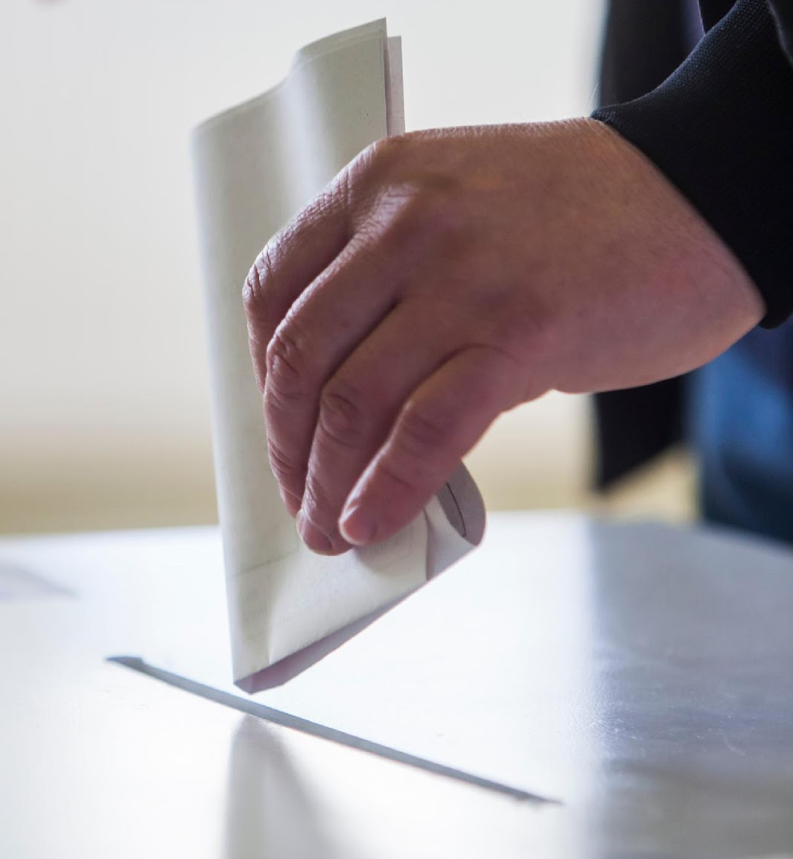
Si vous faites une présentation dans une juridiction où il n’y a pas de règles relatives aux publicités portant sur un enjeu social, modifiez cette diapositive en supprimant les mentions relatives aux enjeux sociaux
SECTION 03
Publicités portant sur un enjeu social, électoral ou politique

Slide 30
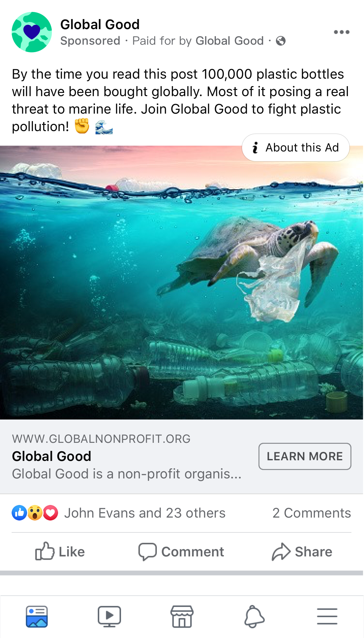
Passez cette diapositive si les enjeux sociaux ne sont pas connus dans votre pays.
Publicités portant sur un enjeu social, électoral ou politique
Nous sommes profondément attaché·es à la liberté d’expression sur nos technologies. Pour promouvoir un débat public sûr et sain sur des sujets influents, nos Standards publicitaires exigent des annonceurs qu’ils suivent des étapes supplémentaires, qu’ils soutiennent leurs publicités portant sur un enjeu social, électoral ou politique sous leur vraie identité et qu’ils assument une responsabilité, de sorte que les personnes puissent mieux comprendre qui essaie de les influencer avec des publicités.
Ces enjeux sociaux sont des sujets sensibles qui font l’objet de débats intenses, qui sont susceptibles d’avoir une incidence sur les résultats d’une élection ou de concerner une législation existante ou proposée. Nous exigeons une plus grande authenticité et une transparence accrue pour diffuser des publicités portant sur un enjeu social qui cherchent à influencer l’opinion publique via des discussions, des débats ou des actions pour ou contre des sujets importants, comme la santé ou les droits civiques et sociaux.
Ces publicités peuvent provenir de nombreux annonceurs, y compris des organisations politiques, des activistes, des marques et des groupes à but non lucratif, qui doivent tous être autorisés et utiliser des avertissements de type « Financé par » dans les publicités qui prennent position sur des thèmes mentionnés dans nos règles ou qui ont une portée électorale ou politique.
Consultez les Pages d’aide pour prendre connaissance d’exemples de textes sur les enjeux sociaux et voir si ces publicités nécessitent des autorisations et des limitations de responsabilité dans votre pays.
Notes:
First, let’s define what we mean by social issues. In many countries, social issues become heavily debated, highly politicized topics over which the public is deeply divided.
They are sensitive topics that can influence many people within a society – especially if amplified by many – may impact the outcome of an election or result in or relate to existing or proposed legislation.
In most countries globally, there aren’t laws or agencies that list specific social issues that are subject to regulation. In the absence of this, we have worked closely with in-region regulators, policy and advocacy groups to define a set of social issues for our platform, which include civil and social rights, immigration, education, environmental politics, and so forth. The list is meant to be fluid to reflect the public discourse around social issues on and off Meta technologies that seek to influence public opinion through advocacy, debate or discussion.
---
Source: https://www.facebook.com/business/help/214754279118974?id=288762101909005

Slide 31

Passez cette diapositive si les enjeux sociaux sont connus dans votre pays.
Publicités portant sur un enjeu électoral ou politique
Nous sommes profondément attaché·es à la liberté d’expression sur nos technologies. Pour promouvoir un débat public sûr et sain sur des sujets influents, nos Standards publicitaires exigent des annonceurs qu’ils suivent des étapes supplémentaires, qu’ils soutiennent leurs publicités portant sur un enjeu électoral ou politique sous leur vraie identité et qu’ils assument une responsabilité, de sorte que les personnes puissent mieux comprendre qui essaie de les influencer avec des publicités.
Les publicités portant sur un enjeu électoral ou politique sont :
faites par, au nom ou à propos d’un·e candidat·e à une fonction publique, d’une personnalité politique, d’un parti politique, d’un comité d’action politique ou de défenseur·ses pour les résultats d’une élection à une fonction publique ; ou
liées à toute élection, tout référendum ou tout scrutin, y compris les campagnes électorales ou les celles d’incitation au vote ; ou
celles réglementées en tant que publicités politiques.
Notes:
We're constantly working to increase ad transparency and election integrity on Facebook and Instagram. Therefore, we've established measures to promote authenticity and legitimacy for anyone wishing to run ads about social issues, elections or politics.
Ads about social issues, elections or politics are:
Made by, on behalf of, or about a candidate for public office, a political figure, a political party, a political action committee or advocates for the outcome of an election to public office; or
About any election, referendum, or ballot initiative, including "go out and vote" or election campaigns; or
About social issues in any place where the ad is being placed; or
Regulated as political advertising.
Advertisers interested in placing these ads should complete the ad authorization process. The process is available for advertisers that reside and are located in the targeted country at the time they run ads.
---
Source: https://www.facebook.com/business/help/214754279118974?id=288762101909005

Slide 32
Remarque : Supprimez cette diapositive si votre pays ne dispose pas de règles relatives aux enjeux sociaux.
Il existe une variété de méthodes que les personnes utilisent pour aborder la question des enjeux sociaux
La population vote pour des dirigeant·es qui font avancer leurs idéaux. Le peuple s’exprime et appelle au changement sur des enjeux importants.
Les dirigeant·es élaborent leur programme à partir d’enjeux importants afin d’inspirer les électeurs et les électrices et favoriser ainsi le changement.
Les marques, les groupes de sensibilisation et les organisations s’expriment sur ces enjeux pour influencer le sentiment des populations et façonner la culture.
Notes:
There are a variety of methods that people use to address social issues.
In a democracy, people vote for leaders that they believe will advance their ideals. Even globally, in repressive societies that restrict speech, when people can speak they often call for change on important issues.
In turn, leaders build their agendas around the social issues they believe are most important, in hopes of inspiring voters and driving meaningful impact.
At the same time, activists, brands, entertainment companies, and political organizations may try to use paid advertising to broaden their voice or influence the sentiment of people because they feel a responsibility to shape culture and inspire change.
Corporate social good can be a big differentiator for an organization, so many brands see value in taking a stand on issues that align with what their customers want and expect from them.

Slide 33
Nous croyons profondément en la liberté d’expression des personnes et des annonceurs
Voici la base de toutes nos décisions :
+
=
Authenticité
Transparence
Responsabilité
Notes:
We still fundamentally believe in freedom of expression for people and advertisers.
Our decisions and investments are rooted in this belief… but in addition, we committed to taking down coordinated networks of accounts, Pages and Groups that seek to manipulate public debate, and we’ve built smarter tools and introduced policies that provide an unprecedented level of transparency and authenticity for ads about social issues, elections, and politics.
But now, with our commitment to greater authenticity and transparency, people around the world can now see who’s behind the ads they see and better understand who’s trying to influence them with sensitive ads and why. Over time, this leads to increased accountability – for both Meta and advertisers.
Democracy depends on the idea that we value everyone’s right to be heard above our own desire to get the outcomes we want. Giving everyone a voice empowers the powerless. Building an inclusive society depends upon people being able to share their diverse perspectives. So, our policy is based on the idea that advertisers can still discuss sensitive topics, but in order to promote safe and healthy public debate on influential topics, advertisers need to complete more steps to confirm their identity so people can see who’s trying to influence them.

Slide 34
Si vous faites une présentation dans une juridiction où il n’y a pas de règles relatives aux publicités portant sur un enjeu social, modifiez cette diapositive et son dernier point en supprimant les mentions relatives aux enjeux sociaux.
Les publicités portant sur un enjeu social, électoral ou politique sont :
Celles faites par, au nom de ou à propos d’un candidat ou d’une candidate à une fonction publique, une personnalité politique ou un parti politique, ou qui cherchent à influencer les résultats d’une élection à une fonction publique
Celles liées à une élection, un référendum ou une initiative de vote, y compris les campagnes d’incitation au vote ou d’information autour des élections
Réglementées en tant que publicités politiques
Celles qui abordent un enjeu social et peuvent inclure une discussion, un débat ou un argument pour ou contre cet enjeu dans certains pays
Pour établir une politique efficace, nous devons déterminer quelles publicités doivent répondre à un standard supérieur
Notes:
Inspired by our core beliefs, to build an effective policy, we needed to begin by categorizing which ads are required to meet a higher standard. We realize that our universal policy will impact how you manage and operate your advertising, requiring more workflow, but we believe it’s the balanced and fair thing to do to enable a safe and transparent platform for all people.
Ads about social issues, elections or politics are:
•Made by, on behalf of or about a candidate for public office, a political figure, a political party or advocates for the outcome of an election to public office; or
•About any election, referendum or ballot initiative, including "get out the vote" or election information campaigns; this includes all ads coming from election regulators about how, when and where to vote. or
•Regulated as political advertising
•About social issues in any place where the ad is being run
---
More info:
-- To enforce on a social issues policy, we had to specifically define what those topics are. In most countries globally, there aren’t laws or agencies that list specific social issues that are subject to regulation. In the absence of this, we have worked closely with in-region regulators, policy and advocacy groups to develop country-specific categories -- like health, civil and social rights, immigration -- that reflect the public discourse around social issues that seek to influence public opinion with ad content that includes advocacy, debate or discussion. Learn more about social issues in certain countries [Help Center]

Slide 35
Modifiez cette diapositive si vous faites une présentation dans un pays où la publicité sur les enjeux sociaux n’est pas appliquée en supprimant les mentions relatives aux enjeux sociaux
Exigences pour les annonceurs qui diffusent des publicités portant sur un enjeu social, électoral ou politique :
Autorisation
Terminer le processus d’autorisation pour le pays dans lequel les publicités seront diffusées.
Identité
Justifier de l’identité et de la localisation géographique.
Limitation de responsabilité
Inclure l’avertissement vérifié « Financé par » nous permettant de confirmer la légitimité d’une organisation et de montrer au public qui est à l’origine de chaque publicité d’influence.
Transparence
Les publicités signalées comme « Portant sur un enjeu social, électoral ou politique » sont ajoutées à la bibliothèque publicitaire pour une durée de 7 ans.
Notes:
To allow people to run ads about issues, elections, and politics, we have taken actions that are rooted in three principles: Authenticity, Transparency, and Accountability.
To meet these principles, we’ve introduced an unprecedented level of transparency and authenticity around these ads to ensure people can see who’s trying to influence them so they can make informed decisions.
To enable healthy discourse and help prevent interference in elections, our policy for ads about social issues, elections or politics requires that advertisers must complete the authorization process in the country they want to run ads in. To do this, advertisers that want to run these ads must prove who they are and where they are located, include verified “Paid for by” disclaimers to help us confirm the legitimacy of an organization and show who’s behind the ad, and these ads will be entered into our public Ad Library for seven years.

Slide 36
Transparence de la Page
En indiquant le pays de résidence principale de la Page et son éventuelle fusion avec d’autres Pages, nous avons pris des mesures pour garantir l’intégrité et la transparence des Pages. Cela offre davantage de contexte sur la Page et permet de comprendre plus facilement qui se cache derrière elle.
Transparence et sécurité des comptes
Ce que cela signifie
De plus en plus, certaines personnes cachent l’organisation à l’origine de leur Page, afin de faire croire au public que la Page est gérée de manière indépendante. Pour lutter contre cette tendance, nous avons ajouté davantage d’informations sur les responsables des Pages. Nous avons notamment créé un nouvel onglet « Organisations gérant cette Page » dans lequel se trouve le « Propriétaire de la Page » confirmé, ainsi que le nom légal de l’organisation, sa ville, son numéro de téléphone ou son site web.
Notes:
We want to make sure people are using our products and solutions authentically, and that they understand who is speaking to them. We’ve taken steps to ensure Pages are authentic and are more transparent by showing people the Page’s primary country location and whether the Page has merged with other Pages. This gives people more context on the Page and makes it easier to understand who’s behind it.
Increasingly, we’ve seen people failing to disclose the organization behind their Page as a way to make people think that Page is run independently. To address this, we’ve added more information about who is behind a Page, including a new “Organizations That Manage This Page” tab that shows the Page’s confirmed “Page Owner,” including the organization’s legal name and verified city, phone number or website.

Slide 37
Transparence et sécurité des comptes
Procédure d’autorisation des publicités aux États-Unis
ÉTAPE 1
Confirmer l’identité et la localisation aux États-Unis
Configurer l’authentification à 2 facteurs.
Envoyer une pièce d’identité américaine à des fins de vérification.
Recevoir la lettre par la poste et saisir le code pour vérifier votre localisation aux États-Unis.
ÉTAPE 2
Gérer les avertissements et associer des comptes publicitaires
Configurer un avertissement de type « Financé par » : Tous les annonceurs doivent fournir plus d’informations sur leur organisation pour pouvoir diffuser des publicités portant sur un enjeu social, électoral ou politique.
Associez les avertissements à un compte publicitaire.
ÉTAPE 3
Identifier les publicités de nature sociale, électorale ou politique
Les publicités signalées comme « Portant sur un enjeu social, électoral ou politique » sont ajoutées à la bibliothèque publicitaire pour une durée de 7 ans.
Meta détecte et examine les publicités de cette nature de manière proactive. Même les publicités qui ne contiennent pas d’avertissement sont rendues publiques dans la bibliothèque publicitaire.

Slide 38
Transparence et sécurité des comptes
Processus d’autorisation des publicités
ÉTAPE 1
Confirmation d’identité dans votre pays
Configurer l’authentification à 2 facteurs.
Envoyez une pièce d’identité à des fins de vérification.
ÉTAPE 2
Gérer les avertissements et associer des comptes publicitaires
Configurer un avertissement de type « Financé par » : Tous les annonceurs doivent fournir plus d’informations sur leur organisation pour pouvoir diffuser des publicités portant sur un enjeu social, électoral ou politique.
Associer les avertissements à des comptes publicitaires.
ÉTAPE 3
Identifier les publicités de nature sociale, électorale ou politique
Les publicités signalées comme « Portant sur un enjeu social, électoral ou politique » sont ajoutées à la bibliothèque publicitaire pour une durée de 7 ans.
Meta détecte et examine les publicités de cette nature de manière proactive. Même les publicités qui ne contiennent pas d’avertissement sont rendues publiques dans la bibliothèque publicitaire.
Durée : 48 heures maximum
Durée : 24 heures maximum
Durée : 72 heures au maximum

Slide 39
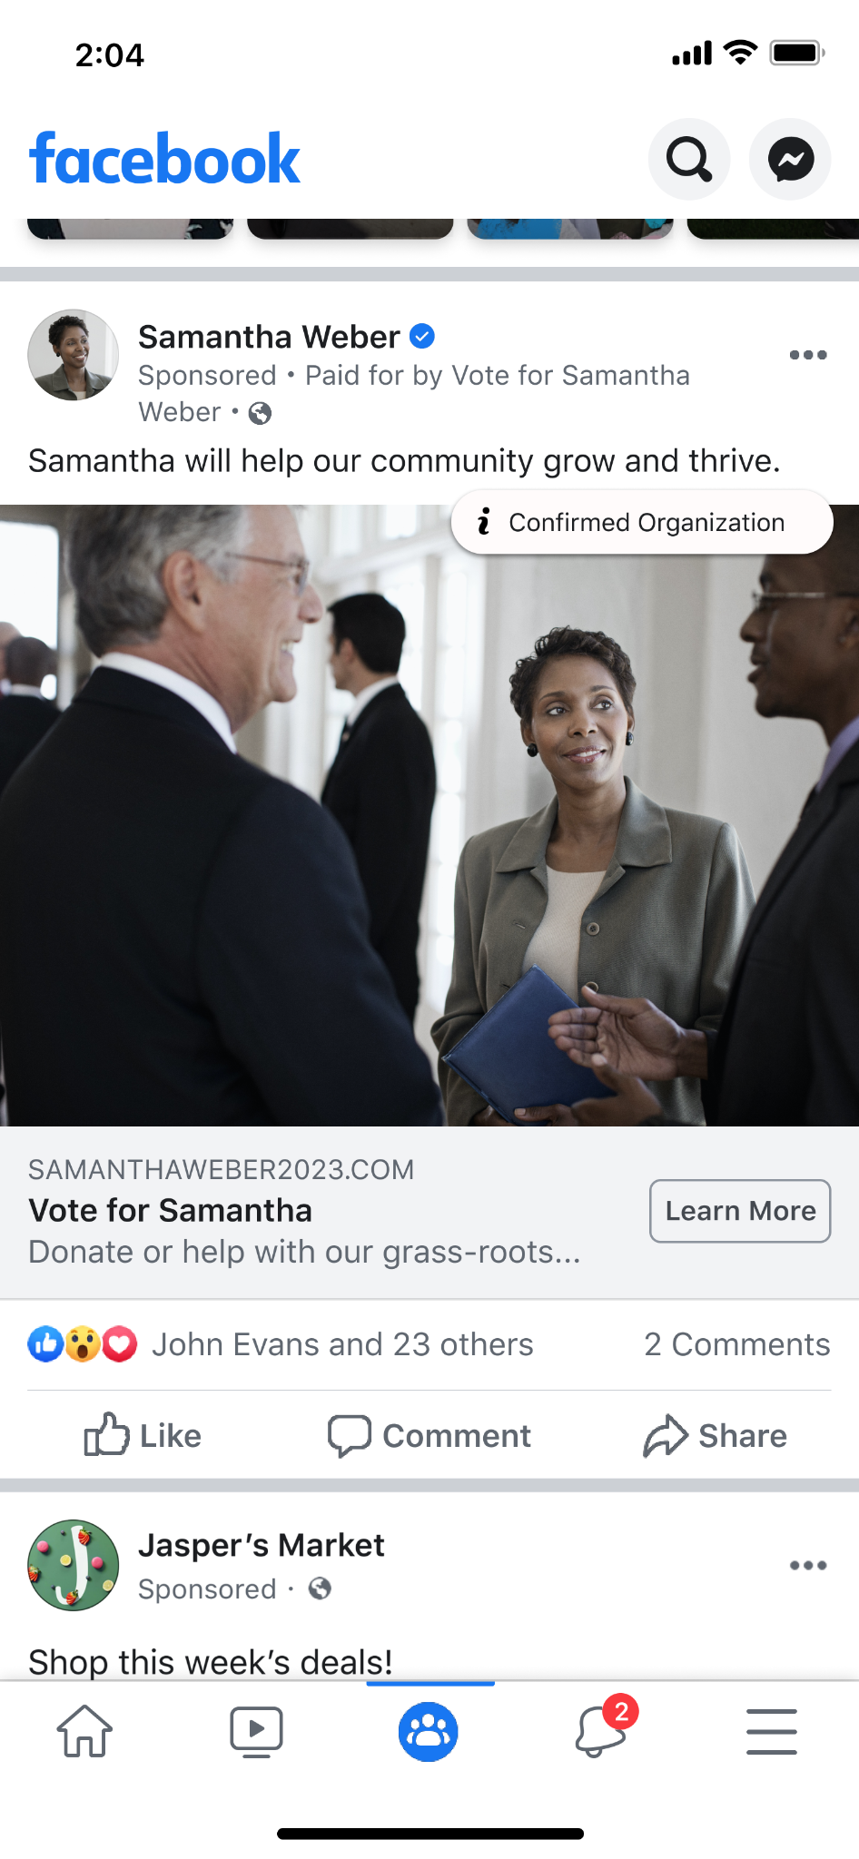
Si vous faites une présentation dans une juridiction où il n’y a pas de règles relatives aux publicités portant sur un enjeu social, modifiez cette diapositive en supprimant les mentions relatives aux enjeux sociaux
Transparence et sécurité des comptes
Avertissements « Financé par »
Les publicités portant sur un enjeu social, électoral ou politique doivent clairement comporter l’avertissement « Financé par » de l’annonceur, afin que le public sache quelle organisation ou quelle entité a payé la publicité.
Ce que cela signifie
Le public peut voir qui finance la publicité et, toute entreprise ou organisation doit fournir davantage d’informations à Meta, qui les vérifie et les rend publiques. Diverses options sont possibles pour votre avertissement. Vous pouvez notamment utiliser :
Nom de la Page
Une organisation différente
Notes:
To increase transparency, all ads about social issues, elections or politics must be clearly labeled with a “Paid for by” disclaimer from the advertiser to communicate the organization or person behind the ad. This means that people can see who is paying for the ad and, for any business or organization, they must provide more information to Meta for confirmation, some of which is then made available publicly for transparency purposes.
US advertisers must now provide additional information, like a Federal Election Commission ID or Tax-ID number. This allows people to confidently gauge the legitimacy of an organization and quickly raise questions or concerns if they find anything out of the ordinary.

Slide 40
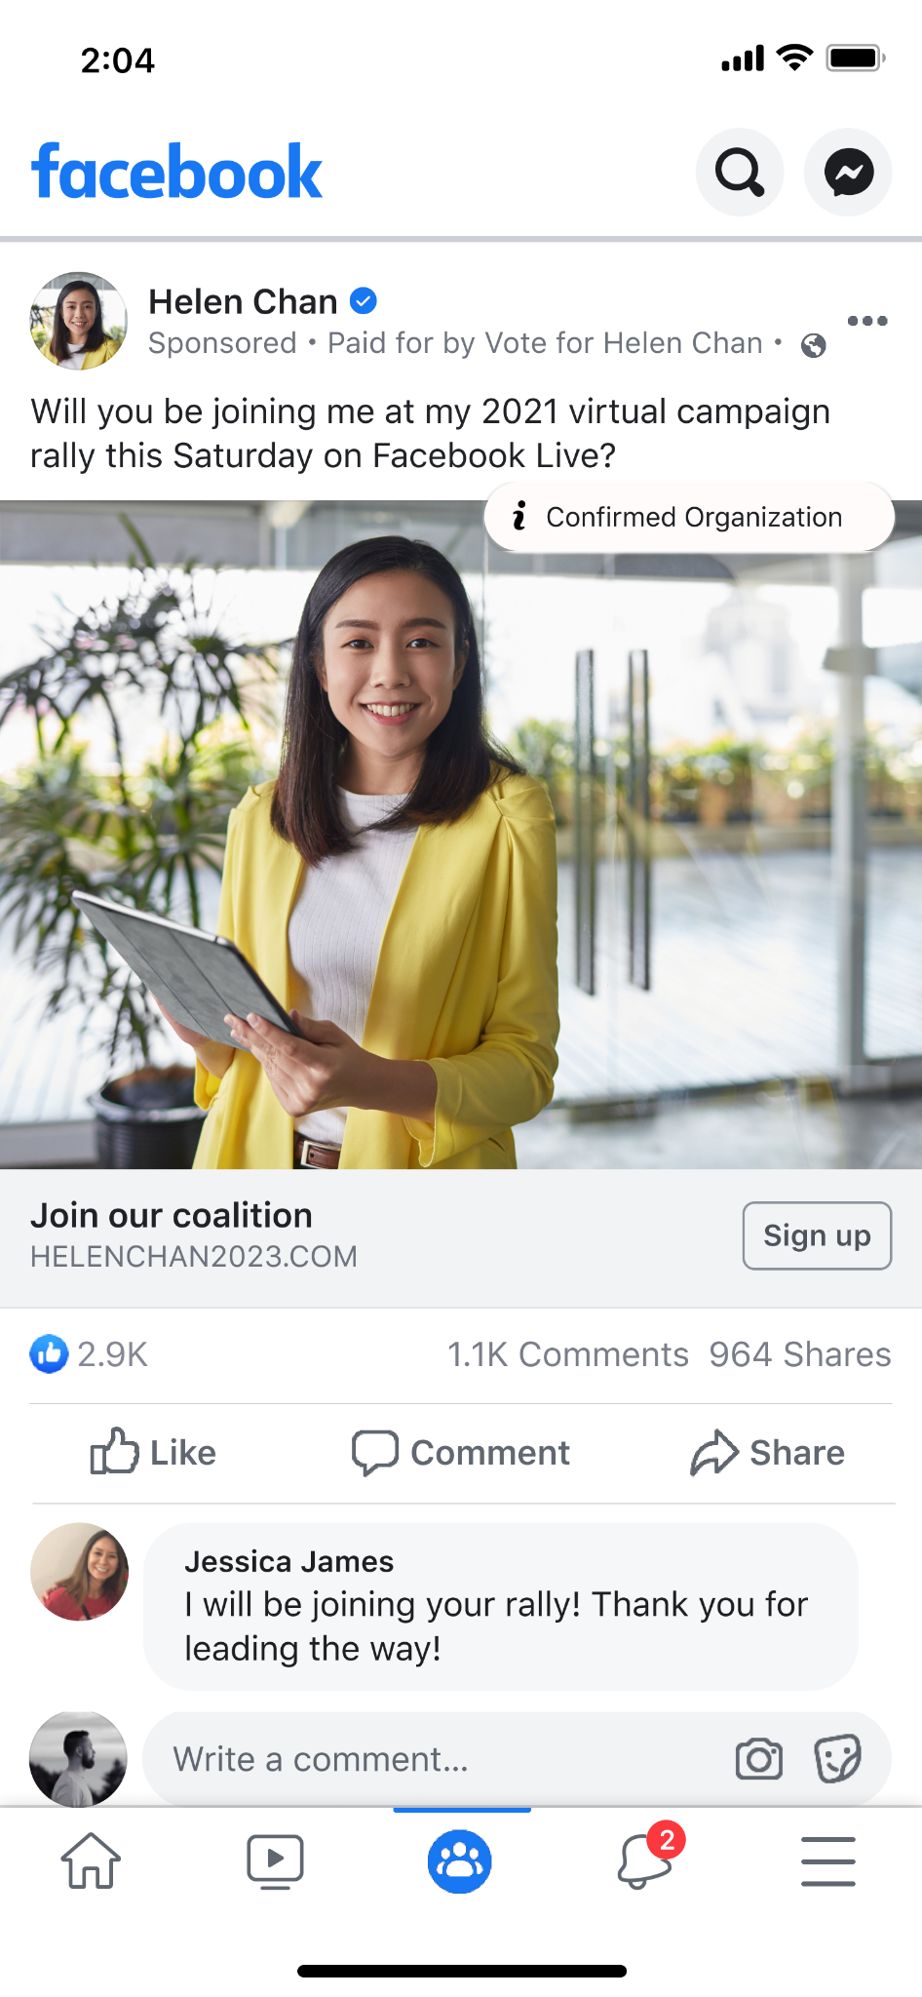
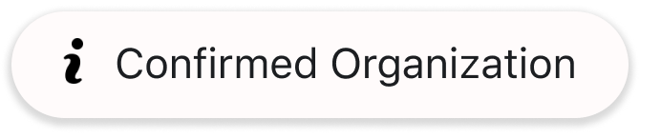
Remarque : Supprimez cette diapositive si vous n’êtes pas aux États-Unis
Transparence et sécurité des comptes
Pages de confirmation
Aux États-Unis, l’icône « Organisation confirmée » accompagnant les publicités portant sur un enjeu social, électoral ou politique permettra au public de savoir que nous avons vérifié que l’organisation à l’origine de la publicité est bien enregistrée auprès du gouvernement américain.
Ce que cela signifie
En un clic, les utilisateur·ices peuvent tenir les annonceurs pour responsables en consultant leurs coordonnées et les informations vérifiées hors Facebook. Ils peuvent notamment voir si les annonceurs ont soumis un numéro d’identification de la Commission électorale fédérale (FEC), un numéro d’identification d’organisation enregistrée ou une accréditation du gouvernement américain.
ICÔNE « ORGANISATION CONFIRMÉE » AUX ÉTATS-UNIS
Notes:
NOTE: This slide is for the US only
Ad “i” icon in the US: Ads about social issues, elections or politics in the US with a “Confirmed Organization” icon will give people confidence in knowing that the advertiser has verified the organization behind the ad is registered with the US government. Now, with one tap, people will not only see information about the ad, but they’ll be able to quickly hold advertisers accountable by seeing their contact details and the information verified off-Facebook, including if they submitted an FEC ID, Tax-Registered Organization, or US government credentials.

Slide 41
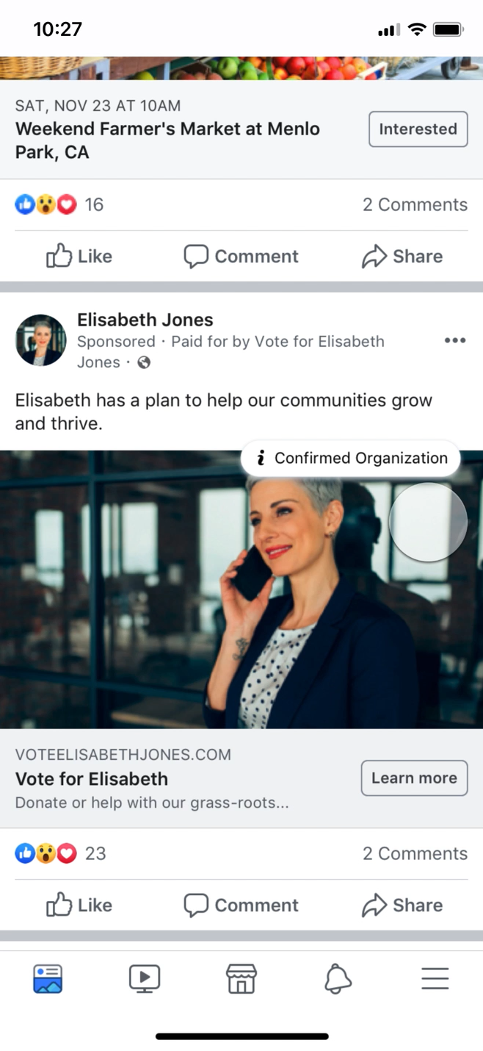
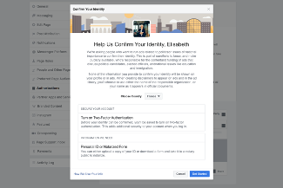
Transparence et sécurité des comptes
AUTHENTICITÉ
TRANSPARENCE ET RESPONSABILITÉ
Notes:
Elections are happening all over the world and we are committed to requiring authorizations and "Paid for by" disclaimers in more places, to help prevent interference in elections globally. We know that protecting the integrity of elections is never finished and we can’t do this alone — that’s why we continue to work with policymakers and experts to make sure we are constantly improving

Slide 42
Familiarisez-vous avec nos Standards publicitaires afin d’éviter tout rejet ultérieur.
Les publicités visant à intimider les internautes ou à les décourager de voter et les publicités qui enfreignent nos Standards de la communauté concernant la fraude électorale et l’interférence dans le vote.
Les publicités portant sur un enjeu social, électoral ou politique doivent faire l’objet d’une autorisation et mentionner des avertissements.
Comprendre nos Standards publicitaires
Si vous faites une présentation dans une juridiction où il n’y a pas de règles relatives aux publicités portant sur un enjeu social, modifiez cette diapositive en supprimant les mentions relatives aux enjeux sociaux
Transparence et sécurité des comptes
Notes:
Moving to our policies. I want to remind you of our Advertising Standards.
Our ad policies provide guidance on the types of content that is allowed on our platforms. Familiarizing yourself with the policies can help you adhere to them and avoid disapproval later.
Also, it’s important to note that you cannot post organic content or run ads that intimidate or discourage people from voting and also you cannot run ads that violate our Community Standards on voter fraud and voter interference.
For you and your organizations, it’s especially important to be aware and familiar with our ads about social issues, elections or politics. We will have a deep dive about our policies here in a bit but in the meantime, I want to flag that all ads about social issues, elections or politics will need a disclaimer and the process can take up to 72 hours to complete so we recommend that all relevant advertisers get started as soon as possible.

Slide 43
Politiques de lutte contre la violence et les irrégularités électorales
Contexte : Appels à une ingérence coordonnée qui affecterait la capacité d’un individu à prendre part à une élection.
Contexte : Appels militaristes ou intimidants à se rendre sur le lieu de l’élection, du vote ou du dépouillement pour surveiller les activités des électeur·ices ou des fonctionnaires.
Contexte : Menaces contre les agents électoraux.
Transparence et sécurité des comptes
Offres d’achat ou de vente de votes
Déclarations qui donnent l’instruction pour, ou montrent une intention explicite de participer illégalement à un vote.
Appels à la violence en raison du vote, de l’inscription des électeur·ices, de l’administration ou du résultat d’une élection.
Appels à apporter des armes sur les lieux de vote, de dépouillement ou dans les bureaux de l’administration électorale.

Slide 44
Transparence et sécurité des comptes
Nous n’acceptons pas de fausses déclarations sur :
les dates, lieux, horaires et méthodes de vote ou d’inscription sur les listes électorales.
les personnes autorisées à voter et les prérequis pour voter.
la prise en compte ou non d’un vote et les informations et/ou le matériel requis pour pouvoir voter.
la participation ou non d’un·e candidat·e.
Règles relatives à l’interférence dans le processus de vote

Slide 45

Comment les publicités sont examinées
Texte
Toutes les publicités sont examinées à la fois par des personnes et par un système automatisé (intelligence artificielle) avant d’être diffusées sur Facebook ou Instagram. Nous vérifions les images de la publicité, son texte et son emplacement, ainsi que le contenu de la page de destination vers laquelle elle renvoie conformément à nos Standards de la communauté et à nos Standards publicitaires.
Il peut parfois arriver qu’une publicité déjà diffusée soit marquée par notre système d’IA ou signalée par notre communauté. Dans ce cas, nous pouvons examiner la publicité à nouveau et s’il s’avère qu’elle enfreint nos règles et/ou qu’il manque des avertissements, nous la refuserons et nous demanderons que l’annonceur dispose d’une autorisation et qu’il accompagne sa publicité d’un avertissement de type « Financé par » pour continuer de la diffuser.
Image publicitaire
Page de destination
Call-to-action
Notes:
We hold advertisers to even stricter standard to protect people – in part because they receive paid distribution, as opposed to something organically surfacing in people's feed.
•All ads are subject to our ad review system before they're shown on Facebook or Instagram, which relies primarily on automated review (artificial intelligence) to check ads against our Advertising Policies.
•During ad review, we'll check your ad's images, text, and positioning, in addition to the content on your ad's landing page.
•We use manual review to improve and train our automated systems, and in some cases, have trained global teams review specific ads.
•Ads are also required to follow our Community Standards.
FLAGGED BY AI OR REPORTS BY PEOPLE
In certain cases, a post or ad that's already running can be flagged by AI or reported by our community. If this happens, the content may be reviewed again, and if found to be in violation of our policies and/or the ad is missing a “Paid for by” disclaimer, we disapprove it.
---
Source: https://www.facebook.com/business/help/313752069181919?id=288762101909005&helpref=uf_permalink

Slide 46
Supprimer le contenu qui enfreint nos règles
Notre approche face aux fausses informations
Réduire la diffusion de faux contenus évalués par des médias de vérification
À l’instar des grandes plateformes en ligne et la plupart des médias, Meta ne vérifie pas le discours direct des personnalités politiques.
Informer les personnes avec plus de contexte et d’étiquettes sur les fausses informations
Notes:
On Facebook and Instagram, we follow a three-part framework to help prevent the spread of misinformation and give people more context to make informed decisions:
•Remove accounts and content violating Community Standards or ad policies​
•Reduce the distribution of false news and inauthentic content, like clickbait, when independent third-party fact-checkers rate content as false
•Inform people by giving them more context and labels on false posts they see​
But like the other major internet platforms and most media, Meta doesn’t fact-check direct speech from politicians.
---
ADDITIONAL CONTEXT
Fighting misinformation and our approach to politicians
We've cut the amount of engagement with fake news on Facebook by more than half according to multiple independent studies so we know people are seeing much less of it. But misinformation is a complex and evolving problem, and we have much more work to do. On Facebook and Instagram, we follow a three-part framework to help prevent the spread of misinformation and provide additional context so people can make informed decisions.
•Remove: We especially focus on removing content that violates our Community Standards, including fake accounts and misinformation that may contribute to the risk of imminent violence or harm.
•Reduce: Since 2016, we have partnered with 80 organizations independent third-party fact-checkers around the world, to fact-check potentially false news and content in more than 60 languages. When third-party fact-checkers label content as false, we significantly reduce its distribution on Facebook and Instagram so fewer people see it.
•Inform: The answer to misinformation isn’t always less information - it’s more context. So, we have introduced more prominent warning labels on Facebook and Instagram which provide more context and information from fact-checkers on false or partly false content. We believe it’s important to inform people who have encountered false news or content, so they can decide for themselves what to read, trust, and share.
Protecting Your Vote: We’re committed to fighting harmful attempts to interfere with or suppress voting which undermine elections. That’s why our policies prohibit and remove content that includes incorrect voting information as well as ads that advise people not to vote.
---
Source:
https://about.fb.com/actions/preventing-election-interference/
https://about.fb.com/news/2019/04/protecting-eu-elections-from-misinformation/
https://about.fb.com/news/2018/05/hard-questions-false-news/

Slide 47
Notre démarche vis-à-vis des personnalités politiques
Liberté d’expression et responsabilité
Nous pensons que, dans les démocraties matures où la presse est libre, le discours politique est le discours le plus scruté qui soit.
Les populations doivent pouvoir entendre les personnes qui souhaitent les diriger. En limitant la liberté d’expression, nous priverions les personnes d’informations sur ce que disent leurs élu·es.
On ne peut assumer sa responsabilité que si l’on a accès au discours des personnes qui sollicitent nos suffrages, afin de l’analyser et d’en débattre ouvertement, , même si nous sommes viscéralement en désaccord avec leurs propos.
Exemption de la revendication politique directe
Une réclamation effectuée directement par une personnalité politique sur sa Page, dans une publicité ou sur son site web est considérée comme une revendication directe. Elle est donc inéligible pour notre programme de vérification des informations par des tiers.
Quelle est la limite pour les personnalités politiques ?
Les personnalités politiques ne peuvent pas enfreindre nos Règles publicitaires ou nos Standards de la communauté en incitant à la violence ou en tenant des propos haineux. Elles ne peuvent pas non plus diffuser des informations erronées sur le lieu, le moment ou la manière de voter.
Les publicités sont soumises à des critères de transparence plus stricts : elles doivent inclure des limitations de responsabilité et sont mises à la disposition du public dans la bibliothèque publicitaire pendant 7 ans. Cela permet de s’assurer que les personnalités politiques sont également tenues responsables de leurs propos lors du scrutin.
Nous pensons que dans une démocratie, le peuple de ce qui est crédible, et non les entreprises technologiques. Nous ne pensons pas qu’une entreprise privée doive censurer les personnalités politiques ou les informations.
Notre approche est fondée sur notre croyance fondamentale en la libre expression.
Notes:
We believe that in a democracy, people should decide what is credible, not technology companies. We don’t believe a private company should make decisions about political ads or censor politicians or the news, which is why we welcome regulation that would apply across the industry. In the absence of regulation, Meta and other companies are left to design their own policies.
As we stated earlier, our approach is grounded in our fundamental belief in free expression. We believe that, in mature democracies with a free press, political speech is the most scrutinized speech there is, and by limiting it, we would leave people less informed about what their elected officials are saying. People should be able to hear from those who wish to lead them, because ultimately, accountability only works if we can see what those in power seeking our votes are saying and it’s scrutinized and debated in public. Even if we viscerally disagree with what they say.
Exempting direct political speech
Per our policy, if a claim is made directly by a politician on their Page, in an ad or on their website, it is considered direct speech and ineligible for our third-party fact checking program.
What political entities are fact-checked?
Former candidates for office or former officials continue to be covered by our third-party fact-checking program. That remains true for organizations like Super PACs or advocacy organizations that are unaffiliated with candidates.
What can’t politicians say?
•Our policies don’t mean that politicians can say whatever they want on Facebook and Instagram.
•They can’t violate our Advertising Policies or Community Standards by posting content that may incite violence or is considered hate speech.
•They still can’t, for example, spread misinformation about where, when, or how to vote.
•There will be some instances where a false or partly false rating from our fact-checking partners will affect politicians. When anyone shares a specific piece of content that has been otherwise debunked, we will demote that content, display a warning and reject the ad. This is different from a politician’s own claim or statement.
---
Source:
https://www.facebook.com/business/help/182222309230722

Slide 48

SECTION 04
Bibliothèque publicitaire Meta

Slide 49
Bibliothèque publicitaire
La bibliothèque publicitaire est la surface de transparence des publicités la plus complète de Meta. Elle fournit un aperçu de toutes les publicités sur les technologies Meta. Elle améliore la transparence des publicités en donnant au public davantage d’informations sur les publicités qui s’affichent.
Ce que cela signifie
La bibliothèque publicitaire comprend toutes les publicités actives sur les produits Meta. La transparence est l’une de nos priorités pour lutter contre les interférences dans les élections. La bibliothèque publicitaire propose donc des informations supplémentaires sur les publicités portant sur un enjeu social, électoral ou politique. Il peut s’agir d’une fourchette du montant des dépenses, de la couverture ou du nom de l’entité ou de la personne responsable de la publicité. Toutes les publicités de cette nature, aussi bien actives qu’inactives, sont stockées pendant 7 ans à partir de la date de la première impression.
Notes:
The Ad Library is Meta’s comprehensive ads transparency hub, providing a searchable view of ads across Meta’s products.
It provides unprecedented transparency into advertising globally and gives people more information about the ads they see which especially helps journalists, regulators and researchers conduct analysis. The Ad Library constraints all active ads running across Meta’s platforms. To preserve the integrity of elections, the Ad Library offers more insights about ads about social issues, elections or politics including spend range, reach breakdown and more details about the organization or person responsible for funding the ad. We store these ads for seven years. Ads that run with disclaimers are made public in the Ad Library as soon as they receive their first impression. In countries with proactive and reactive enforcement, ads that we take down without disclaimers as also added to the Ad Library.
[Speaker note: If you get questions about the ad library, you can view the ad library deck for more in-depth information: https://docs.google.com/presentation/d/1RLw3p8MkMVPtjuIHshpH9VDOvyFd_6UVlKAG0_AdRzY/edit?usp=sharing

Slide 50
Présentation de la bibliothèque publicitaire
La bibliothèque publicitaire comprend toutes les publicités actives sur les produits Meta. La transparence est l’une de nos priorités pour lutter contre toute interférence dans les élections. La bibliothèque publicitaire propose ainsi des informations supplémentaires sur les publicités portant sur un enjeu social, électoral ou politique, par exemple :
le montant des dépenses
la couverture
le nom de l’entité responsable de la publicité
Toutes les publicités (actives ou non) signalées comme étant de nature sociale, électorale ou politique sont répertoriées dans la bibliothèque publicitaire pour une durée de sept ans à partir de la date de leur première impression. Toute publicité en cours de diffusion et signalée par notre système ou par l’audience comme portant sur ces sujets sera également rejetée et ajoutée à la bibliothèque publicitaire si elle ne dispose pas d’un avertissement. Les publicités signalées comme inactives dans la bibliothèque publicitaire concernent uniquement les publicités diffusées sur Facebook et Instagram.

Slide 51
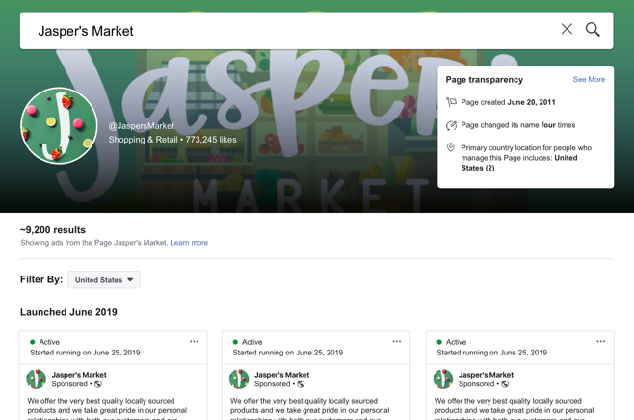
Recherches dans la bibliothèque publicitaire
Toutes les publicités actives diffusées par une Page sont visibles dans la bibliothèque publicitaire. Vous pouvez rechercher un annonceur pour voir les publicités actives diffusées depuis cette Page.
Lorsque vous consultez les publicités actives d’une Page, le contenu créatif publicitaire et le texte de la publicité seront affichés. Cliquer sur « Voir les détails de la publicité » permettra de voir des informations supplémentaires telles que la section « À propos » de la Page.
Si vous estimez qu’une publicité active devrait comporter un avertissement « Financé par » pour sa nature sociale ou politique, ou qu’elle enfreint d’autres règles publicitaires de Meta, vous pouvez la signaler.

Slide 52
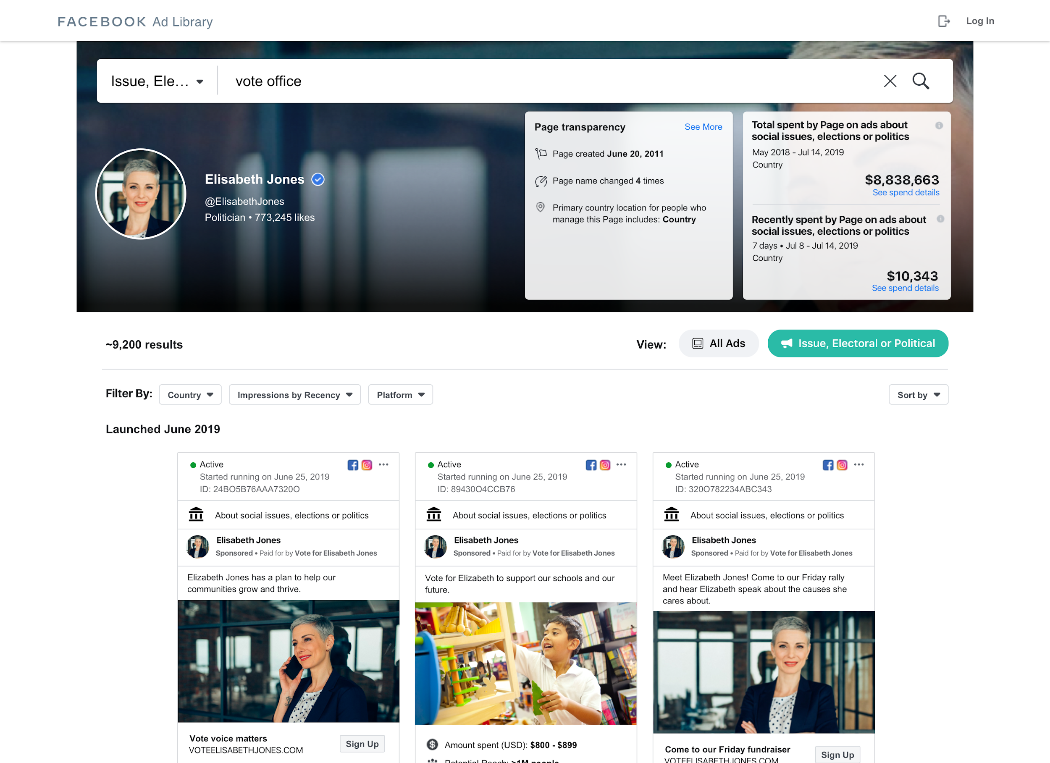
La bibliothèque publicitaire : une base de données consultable
Pour chaque Page et pour chaque publicité active, nous fournissons des informations relatives à la transparence de la Page, notamment :
La date de création de la Page
Les changements de nom de la Page
Le pays de résidence principal des personnes qui gèrent la Page
Pour les publicités portant sur un enjeu social, électoral ou politique, vous pouvez effectuer des recherches par nom de Page ou par mot-clé, puis trier les résultats obtenus par :
Pays
Nom de la Page
Statut (active et/ou inactive)
Pour ces publicités, nous affichons les résultats des publicités actives et inactives pendant sept ans. Elles incluent également un avertissement, pour que vous puissiez comprendre qui en est à l’origine.
En haut de la page, vous verrez également les dépenses globales de l’annonceur et les dépenses de la semaine précédente liées aux publicités de nature sociale, électorale ou politique.

Slide 53
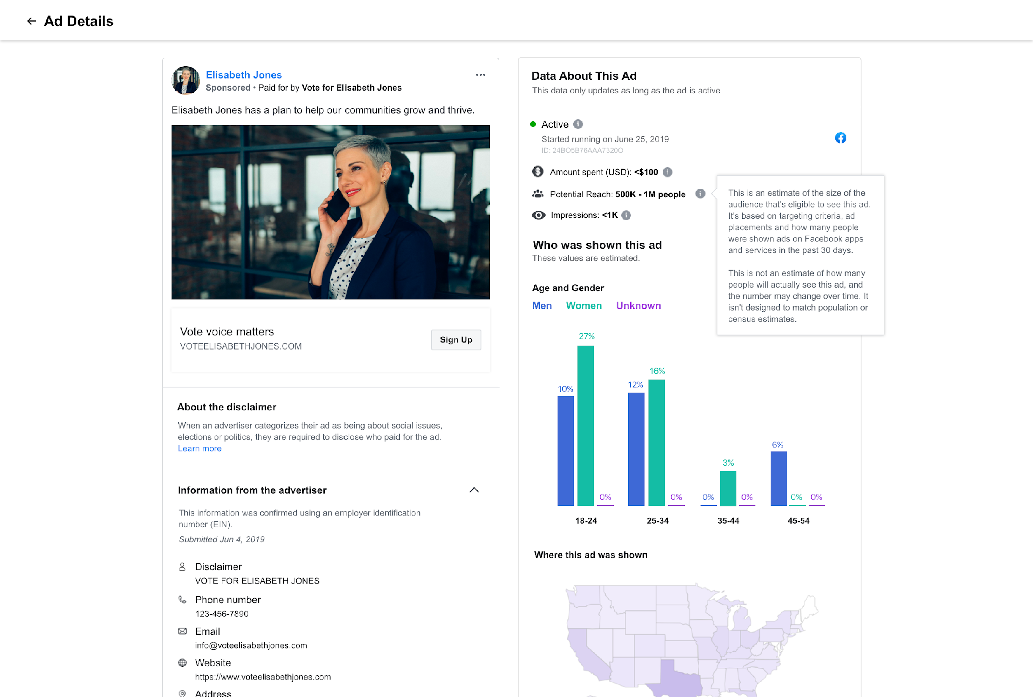
Afficher les détails de la publicité
Pour en savoir plus sur une publicité portant sur un enjeu social, électoral ou politique, cliquez sur « Voir les détails de la publicité ». Vous obtiendrez notamment des informations sur :
Le statut actif ou inactif
La fourchette d’impressions
La fourchette du montant dépensé
Les groupes démographiques touchés
Les lieux touchés
La couverture potentielle
Si un nom de Page ou un nom différent est envoyé pour un avertissement, nous demanderons une vérification hors plate-forme, à l’aide d’un numéro de téléphone, d’un e-mail, d’un site web ou d’une adresse professionnelle. Les informations fournies seront mises à la disposition du public dans la bibliothèque publicitaire pendant sept ans. Vous trouverez ces informations en cliquant sur le menu déroulant « Informations de l’annonceur » dans la section Détails de la publicité.
Notes:
Ads that run without a disclaimer and are later deemed to be political will also appear in the Ad Library. Page spend information is available for ads about social issues, elections or politics where the Ad Library Report is currently available.

Slide 54
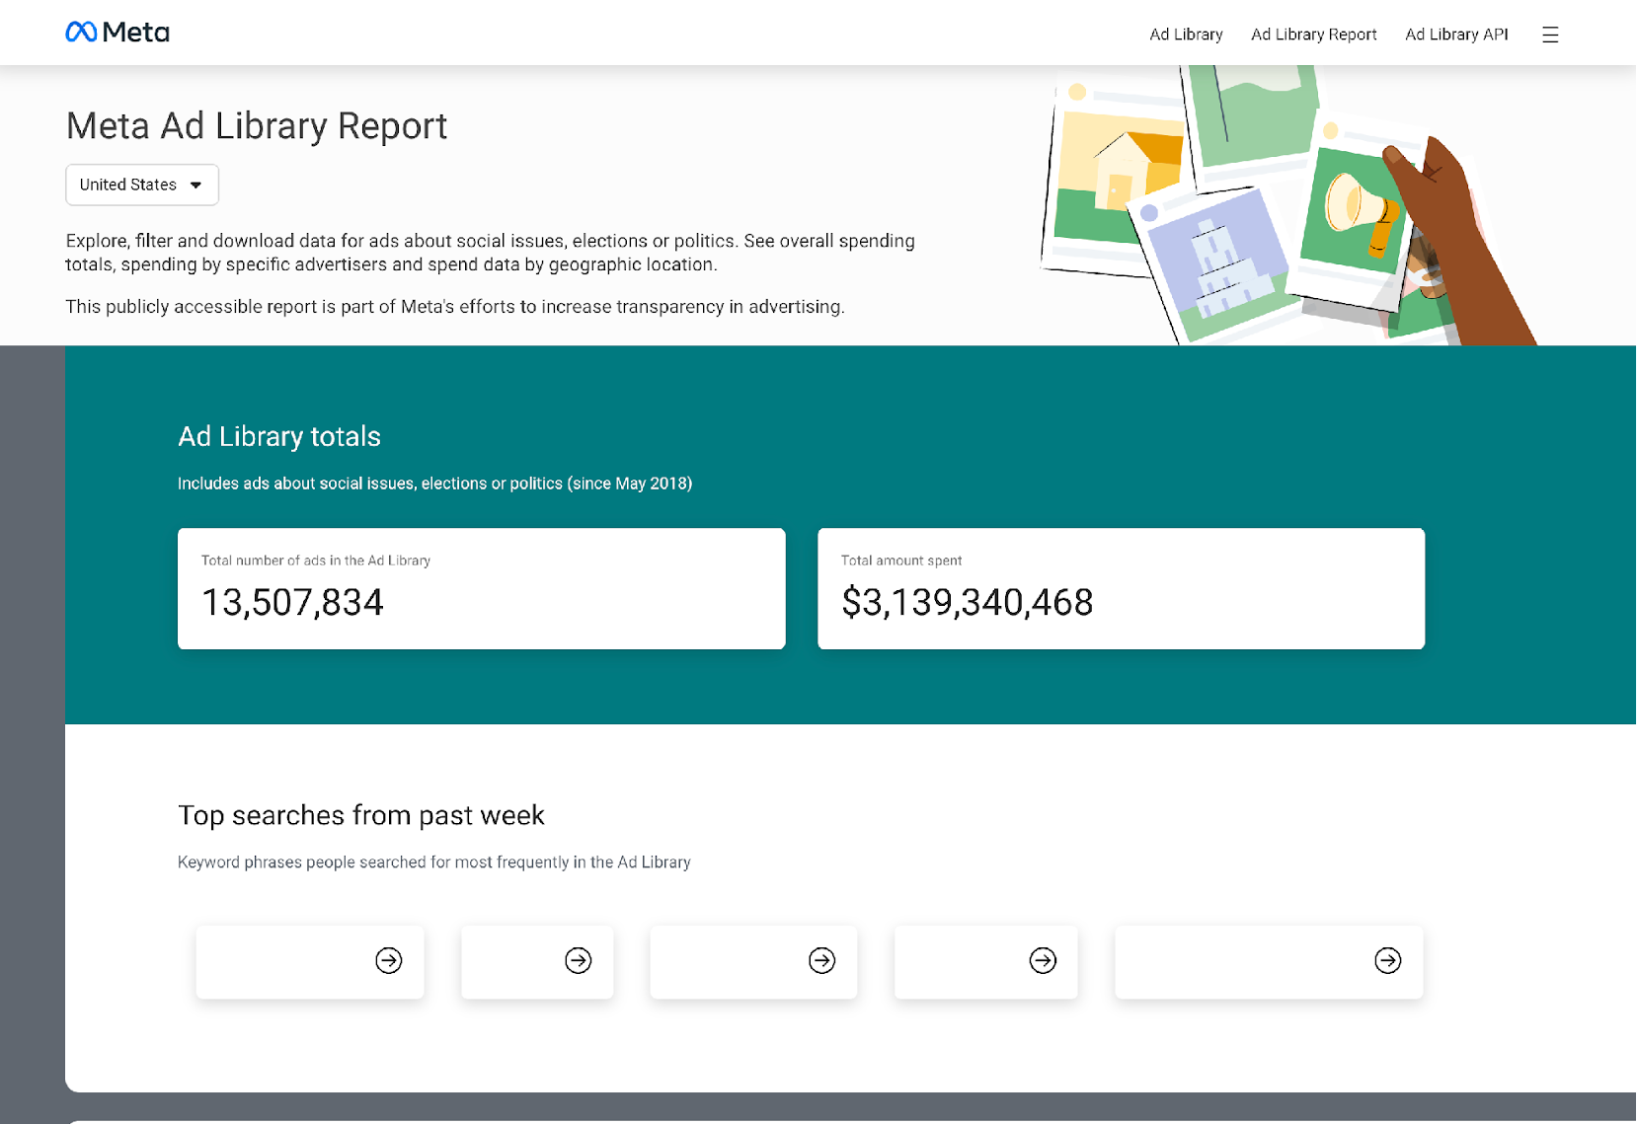
Rapport de la bibliothèque publicitaire
Le rapport de la bibliothèque publicitaire vous permet d’obtenir un aperçu agrégé et complet des publicités portant sur un enjeu social, électoral ou politique dans un pays donné, pour une période donnée. Vous verrez le montant dépensé par les annonceurs, les termes les plus recherchés et bien plus encore. Nous proposons également un suivi personnalisé des dépenses pour comparer les dépenses d’annonceurs qui diffusent des publicités portant sur un enjeu social, électoral ou politique.
Notes:
The Ad Library report allows you to get an aggregated, comprehensive view of ads about social issues, elections or politics in a given country, for a given time period. You’ll see how much advertisers are spending, popular search terms and more. We also offer a custom spend tracker to compare the spending of advertisers running ads about social issues, elections or politics.
Currently, the report is available in the EU, United Kingdom, Canada, Ukraine, Israel, US, India, SIngapore, Taiwan, Argentina and more.

Slide 55

L’API de la bibliothèque publicitaire Meta
Nous avons également ouvert notre API de la bibliothèque publicitaire au monde entier. Les organismes de réglementation, les journalistes, les groupes de surveillance et la communauté peuvent ainsi analyser les publicités portant sur un enjeu social, électoral ou politique et responsabiliser les annonceurs et Meta.
L’API de la bibliothèque publicitaire Meta permet une analyse efficace des publicités portant sur un enjeu social, électoral ou politique présentes dans la bibliothèque, ce qui permet d’acquérir une compréhension plus approfondie des actions des annonceurs sur la plateforme.
Pour accéder à l’API :
Effectuer la procédure de confirmation d’identité.
Créer un compte de développeur.
Accepter notre Politique de la plateforme.
Notes:
The Ad Library application programming interface (API) allows you to perform customized keyword searches of ads stored in the Ad Library. You can search data for all active and inactive ads about social issues, elections or politics.
https://www.facebook.com/id/hub/
https://developers.facebook.com/terms/
https://www.facebook.com/ads/library/api

Slide 56
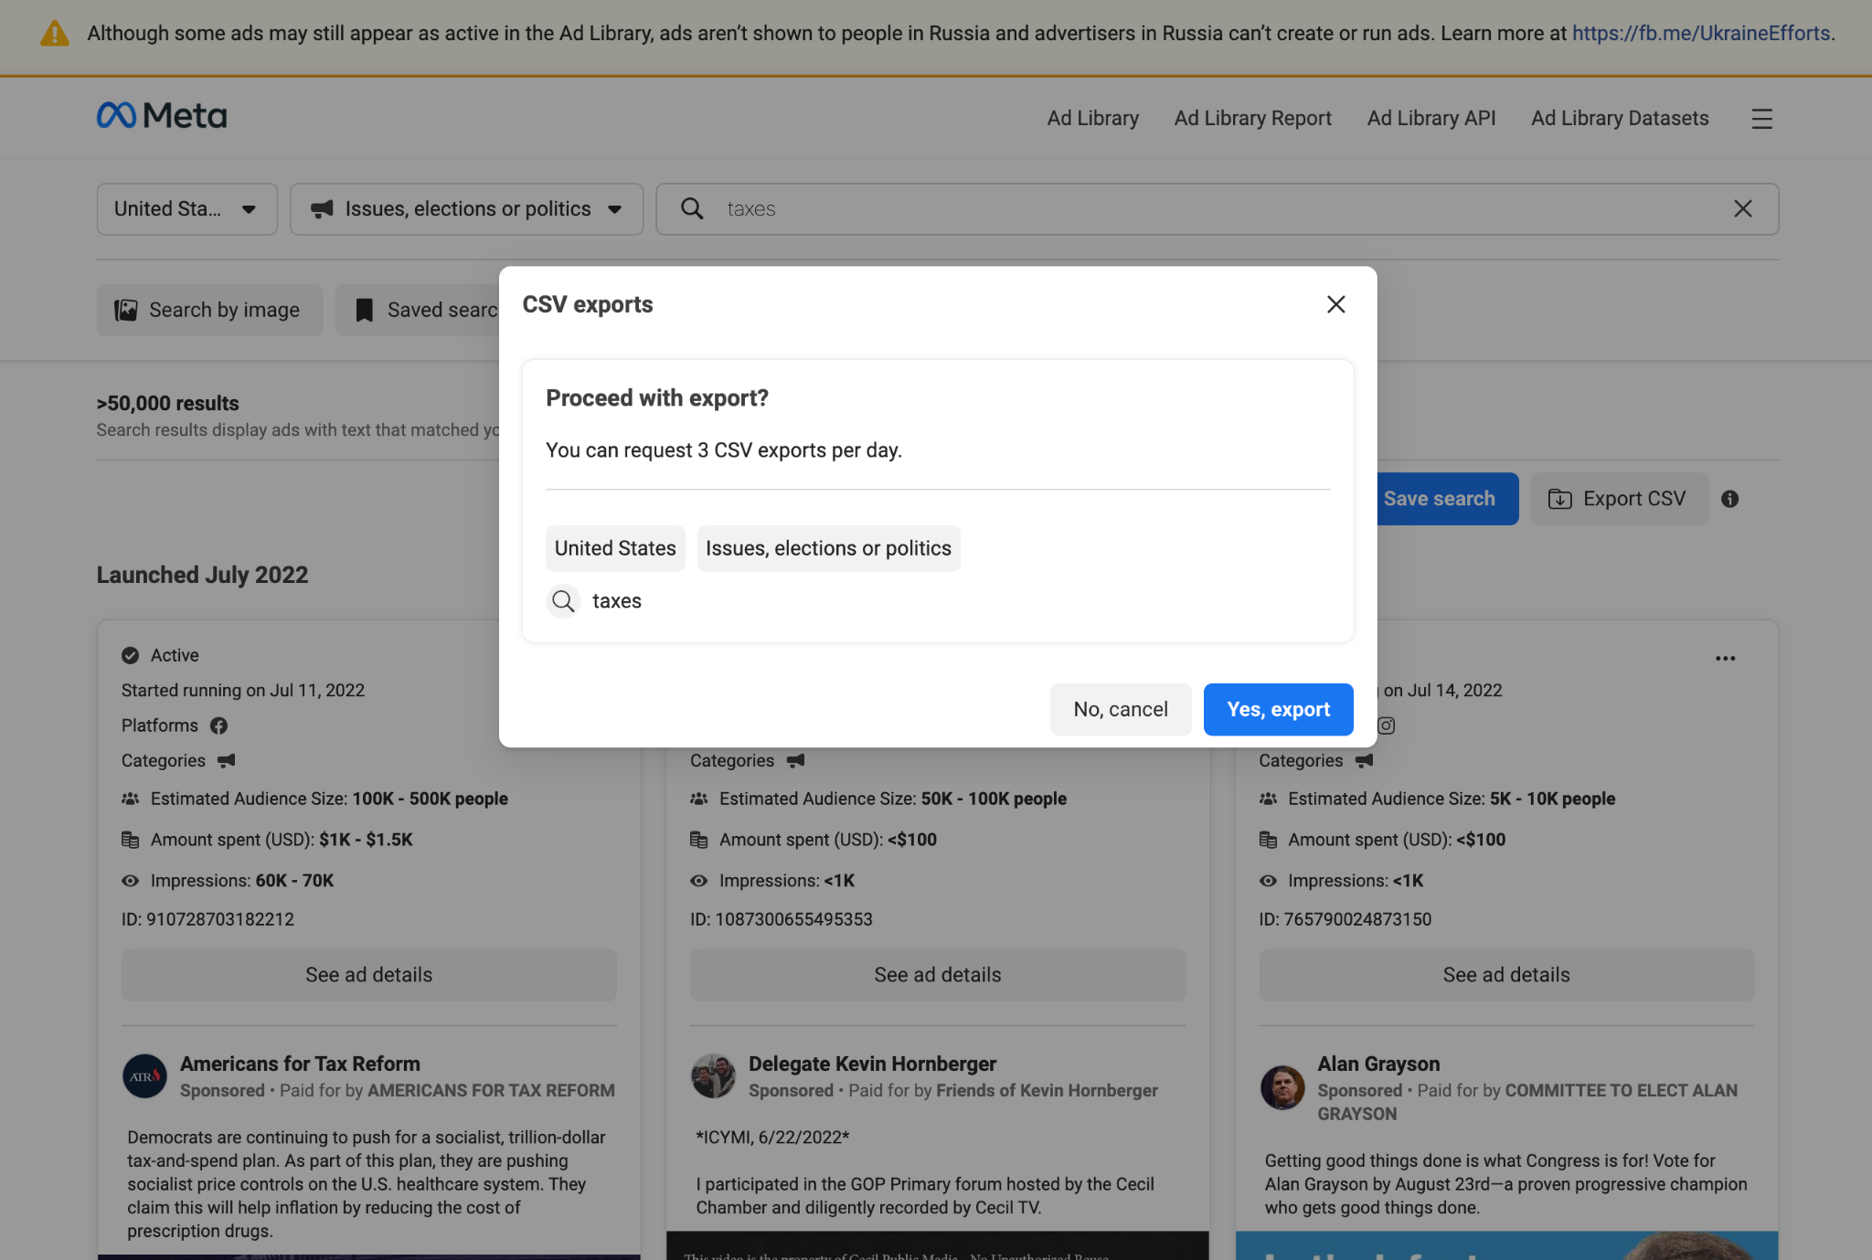
Exporter au format CSV
Bien que ces données soient déjà disponibles et téléchargeables via l’API de la bibliothèque publicitaire, l’exportation au format CSV offrira une nouvelle méthode d’accès plus simple. Cela évitera toute exigence de connaissance technique de l’API et permettra aux personnes d’analyser plus facilement les tendances et des tranches de temps spécifiques.

Slide 57
S’abonner aux résumés des annonceurs
La bibliothèque publicitaire propose actuellement des abonnements et des mises à jour par e-mail où vous pouvez vous inscrire pour recevoir des mises à jour de fonctionnalités ou obtenir des alertes sur l’état du système pour nos produits.
Vous pouvez désormais vous abonner pour recevoir des mises à jour sur le montant dépensé et le nombre de publicités provenant d’un maximum de 10 annonceurs ou de publicités portant sur un enjeu social, électoral ou politique.
Pour vous abonner à des résumés quotidiens ou hebdomadaires, consultez la bibliothèque publicitaire et modifiez votre abonnement.
Notes:
https://fb.workplace.com/groups/transparencyfyi/posts/2915275445440806/

Slide 58
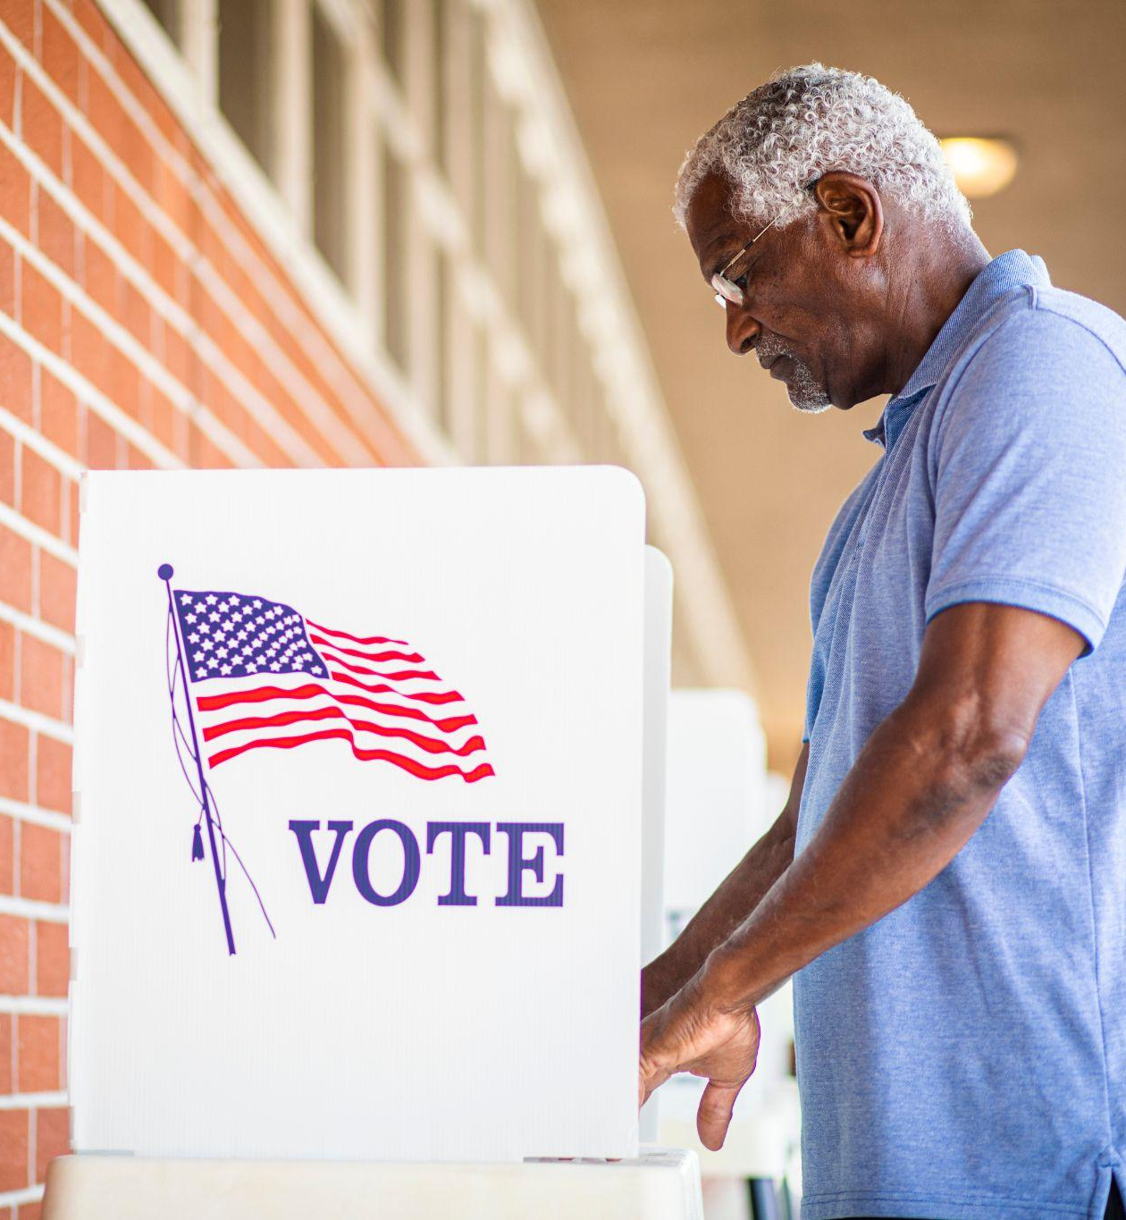
Ressources
Pour plus d’informations et de ressources, consultez facebook.com/gpa

