Slide 1
Build a Champion Program
Peer learning for AI adoption success
July 2026

Slide 2

People, not the technology they use, are your greatest competitive advantage.
#PeopleFirst

Slide 3
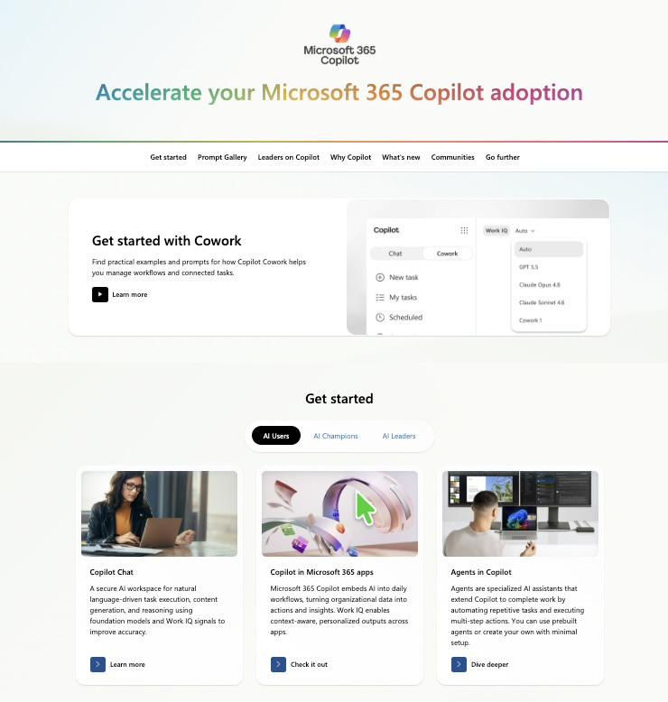

Copilot resources on Microsoft Adoption
One site for all your Copilot needs: adoption.microsoft.com/copilot
Resources by role
Interactive Prompt Gallery
Product announcements and news
Links to all other Microsoft sites
Extended links for Microsoft 365 applications, Copilot Cowork, Copilot Studio, AI Agents, and more
Take the class!
Earn your User Enablement badge & validate your skills with MS-4007 available today!
Notes:
Our one-stop shop for all Copilot enablement materials is adoption.microsoft.com/copilot.
This site provides resources by workstream, such as leader, user enablement, and technical readiness, to help deploy, use, and scale Copilot.
It showcases what’s new in Microsoft 365 Copilot and upcoming community events.
This site invites users to explore what’s possible with additional Copilot resource links, such as building prompt skills, creating content, joining the community, as well as other Copilot experiences.
The site content is continually updated as Copilot continues to develop, and additional functionality is added.

Slide 4

Make a difference
Become a Champion
Get more from Copilot and Microsoft 365
Help others do the same
Expand your knowledge and enhance your career
Join the free program at aka.ms/M365Champions
Notes:
Once your Champions have been identified, make sure they join the worldwide Microsoft 365 Champion program so that they can get continuously get skilled up and gain access to Microsoft subject matter experts and resources. Join here: https://aka.ms/M365Champions.

Slide 5


Who are Champions?
Champions provide peer learning, early feedback, and organizational support throughout the user enablement lifecycle. They are motivated by helping others rather than the technology itself and often are an ongoing source of high value scenarios. They build awareness, understanding, and engagement throughout the community as a trusted resource to their peers.
Champions will help to:
  Create the groundswell of enthusiasm that grows adoption.
  Build a circle of influence among their teams.
  Bring the new ways of working to life across teams.
  Identify business challenges and possible solutions.
  Provide feedback to the project team and sponsors.
  Reduce strain on core project team through active, ongoing engagement.
We connect with an adoption Champion in each business unit, who sends out weekly emails on Microsoft 365. Each Microsoft 365 tool has core benefits and by taking users on a smooth journey through them, we can unlock the value in each one.
Nick Lamshed
Change Consultant, Qantas
Notes:
Your Champions should consist of representation from all areas of the business that are able to feed directly back into your project or program. These are key individuals that really understand how each area in the business truly functions and can provide real-life scenarios and business challenges that they experience on a day to day basis.
Having a Champion that works directly in that functional area and the knowledge that they have is extremely valuable. As such, you must leverage their knowledge and expertise to help drive your broader deployment. As well as providing valuable insights and feedback from the business, they will typically also be advocates of Copilot and often will act as a first line support function for users within their functional area or department.

Slide 6

Five steps to developing a Champions community
1
  Set the context.
  Align the Champions community to organizational objectives and vision for your technology implementation.
2
3
  Identify Champions and get buy-in.
4
  Build a plan with Champions. Skill them first and often.
5
  Execute and share Champion feedback with leaders and through Service Health Reviews.
Notes:
There are five steps to developing your champions community.
Set the context, be clear on the project objectives on the role that the change champions will play in the launch.
Make sure that the Champions are aligned to the business objectives and outcomes the key success criteria and the business objectives for your copilot deployment.
When identifying your champions, a great way to do this is to contact your HR department and ask them to identify all the functional areas that exist within your business. In an ideal world it would be great to have representation as a change champion from each of those functional areas. This will ensure that you are gaining real world insight and true representation from the business as a whole. Ideally you are looking to recruit champions who are keen to be involved rather than an individual who has just been nominated but is not necessarily eager to be a part of the project.
We cannot emphasise enough the importance of Champions in helping you to be successful, so it is crucial that you are building a plan and taking on board their feedback. Make sure that they are upskilled before other colleagues, and they are receiving regular training as the technology develops. It is key that they are seen and respected by colleagues As true ambassadors.
Their feedback is critical as this will be coming directly from the business and ensure it is taken into consideration and fed back to senior leaders and sponsors. In some circumstances this might lead to adopting a new approach during the deployment, but if you are taking feedback directly from the business and acting upon it, this can only serve to be a positive outcome.

Slide 7
Build a sustainable
Champions community
  Champions:
1
  Should be formally trained to increase their depth and breadth of knowledge.
  Champions help build, grow, and sustain your Copilot implementation by gathering feedback, supporting the human change lifecycle, and providing peer to peer guidance.
2
  Should be encouraged and empowered to guide, teach, and train their peers.
3
  Need consistent positive reinforcement that affirms the impact of their efforts.
4
  Need a clear plan upon which to execute.
Notes:
Building a change champion community comprises of four key areas to consider.
It is important that Champions should be formally trained, usually by the project or program team, and ideally as a community of Champions. That way not only do they feel empowered as individuals, but they also become a community within themselves that promotes collaboration and a sense of togetherness. Often it is the case when working within a Champion community they will be sharing ideas and best practices with other colleagues which can only prove to be beneficial.
As part of their training, Champions should be encouraged and empowered to be supporting their colleagues and identifying business challenges and scenarios from within their functional areas.
When a Champion either volunteers or is nominated from within their department, the positive impact that they will have needs to be recognized formally. You must make it clear that these individuals will need dedicated time away from their day-to-day activities to undertake training and to support their colleagues during the launch.
This is why you need to make sure there is a structured plan and clarity around the role, the time implications, and a clearly defined set of activities that they will need to undertake.

Slide 8
The Champions program checklist
  Find enthusiastic Champions who can commit time and effort.
  Design a program to engage and recognize their effort, such as providing privileged access to relevant events or speaking engagements.
  Build a Viva Engage community or Microsoft Teams group for Champions to share updates and successes. (See Build your Community of Practice with Viva Engage.)
  Communicate to individuals about the Champions role and where they can be found – remember, they are not an IT support function but business representatives.
  Provide materials ready to support their work on the group with teams and individuals (e.g., lunch and learn sessions).
  Incorporate Microsoft 365 training resources into your own internal training site.
  Ensure a regular rhythm for discussions with the Champions on what’s working and what’s not.
  Create a contest (e.g., scavenger hunts and giveaways) between departments to encourage people to interact with Microsoft 365.
Notes:
The Champions checklist provides a starting list of actions and activities for when you start setting up your Champion program.

Slide 9
Branding your
Champion program
Copilot Champions may be referred to with terminology that is in alignment with your company culture.
Champions are professionally referred to as User Enablement Specialists.
Microsoft Partners can aid you in creating your internal user enablement function.
Champion recognition – in the form of badges for engagement, Praise via Viva Insights, or other forms – are essential to Champion morale.
As advocates for the employee experience, regular feedback, employee engagement, and communications are required for role success.
Champion duties are a part of the day-to-day duties of the employee alongside their core job function.
Representation from across the organization ensures balanced viewpoints and early identification of risks and issues.
Notes:
Your Champions play a key role in ensuring that your implementation plan is a success, so it’s important formally recognize them for their efforts. This doesn’t necessarily mean a monetary recognition. You can use our Champion Management Platform, a toolkit designed to help you manage, scale, and inspire your teamwork champions to achieve more: https://aka.ms/M365CMP.

Slide 10
Thank you

Slide 11
Understanding the user journey
Getting to “Aha!”
Feel
When can
I use it?
How can
I get help?
Why should
I care?
How will
WE use it?
How does this change my experience?
How can I do more?
What’s
next?
How will
I use it?
Act
Think
The Think-Act-Feel framework is grounded in decades of research showing a whole human understanding – including feelings – is critical to business outcomes.
Building on this framework we understand that delivering accelerated change is based on trust.
How can I share
my success?
How can I enhance my profession
with this?
An aha moment is defined as “a moment of sudden insight or discovery”.
Notes:
As mentioned before, Copilot is a bit different than the experiences we have driven enablement in the past. Many of us have launched large and small technology projects but we all have a failed technology project where the technology didn’t deliver what was promised, and that’s where the trust gets eroded. We have an opportunity now with Copilot to rebuild trust yet again. This means that we can rebuild the trust that the user has in that the system will help them to get the most of what’s been put in front of them. Our job is creating that trust and enthusiasm at scale and helping people get to what we refer to “aha” moments. This is the moment where an individual gets it, where they understand how the technology can help them.
This slide documents and charts, based on decades of research done at Microsoft and the collective 100 years of experiences of user enablement people around the world, the unarticulated questions that most users are asking when faced with new technology or change. We can talk about the benefits and value of new technology, but until someone has that personal experience that understands why it matters for them, frankly it’s all talk. They really want to know why should they care.
The interactive Copilot Scenario Library (https://aka.ms/Copilot/ScenarioLibrary) is critical to the user journey because you can use it to answer the “why should I care” question, to show users specific examples of how this new technology can help them be more productive in their role.

Slide 12
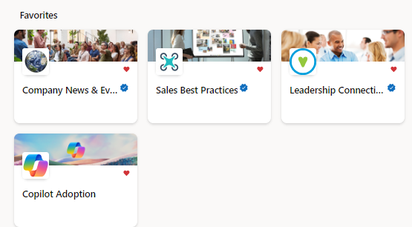
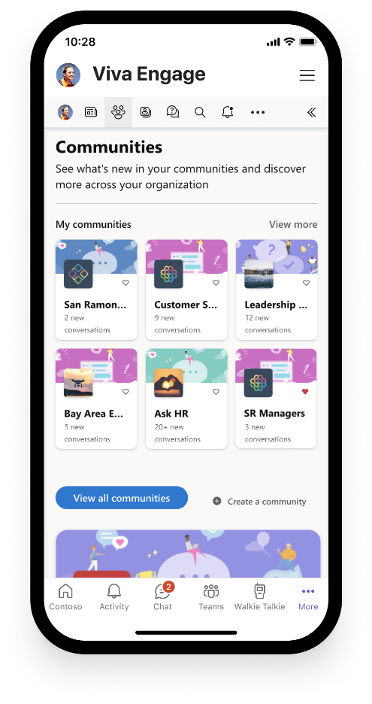
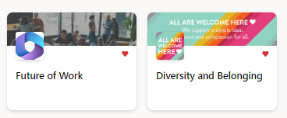
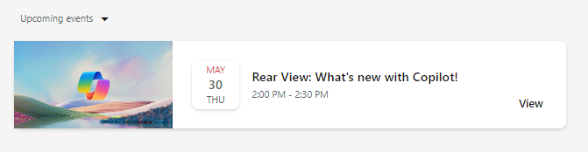
Copilot Communities
Communications
Out-of-the-box Community of Practice to drive Copilot awareness and user enablement
Use the new Copilot community template in Viva Engage to quickly generate excitement, share learning, and support future Copilot Champions and experts.
Give employees a place to:
Share best practices, such as prompts
Share success stories of Copilot saving time and driving productivity
Access company announcements on AI usage, adoption, direction, and mission
Seek support from peers and IT admins
Host virtual townhalls with Q&A in your community
Notes:
NOTE: Viva Engage is recommended for enterprise customers already utilizing Viva Engage in their environment. Small/medium businesses may opt to hold this essential employee engagement in Microsoft Teams or other community chat tools.

Slide 13
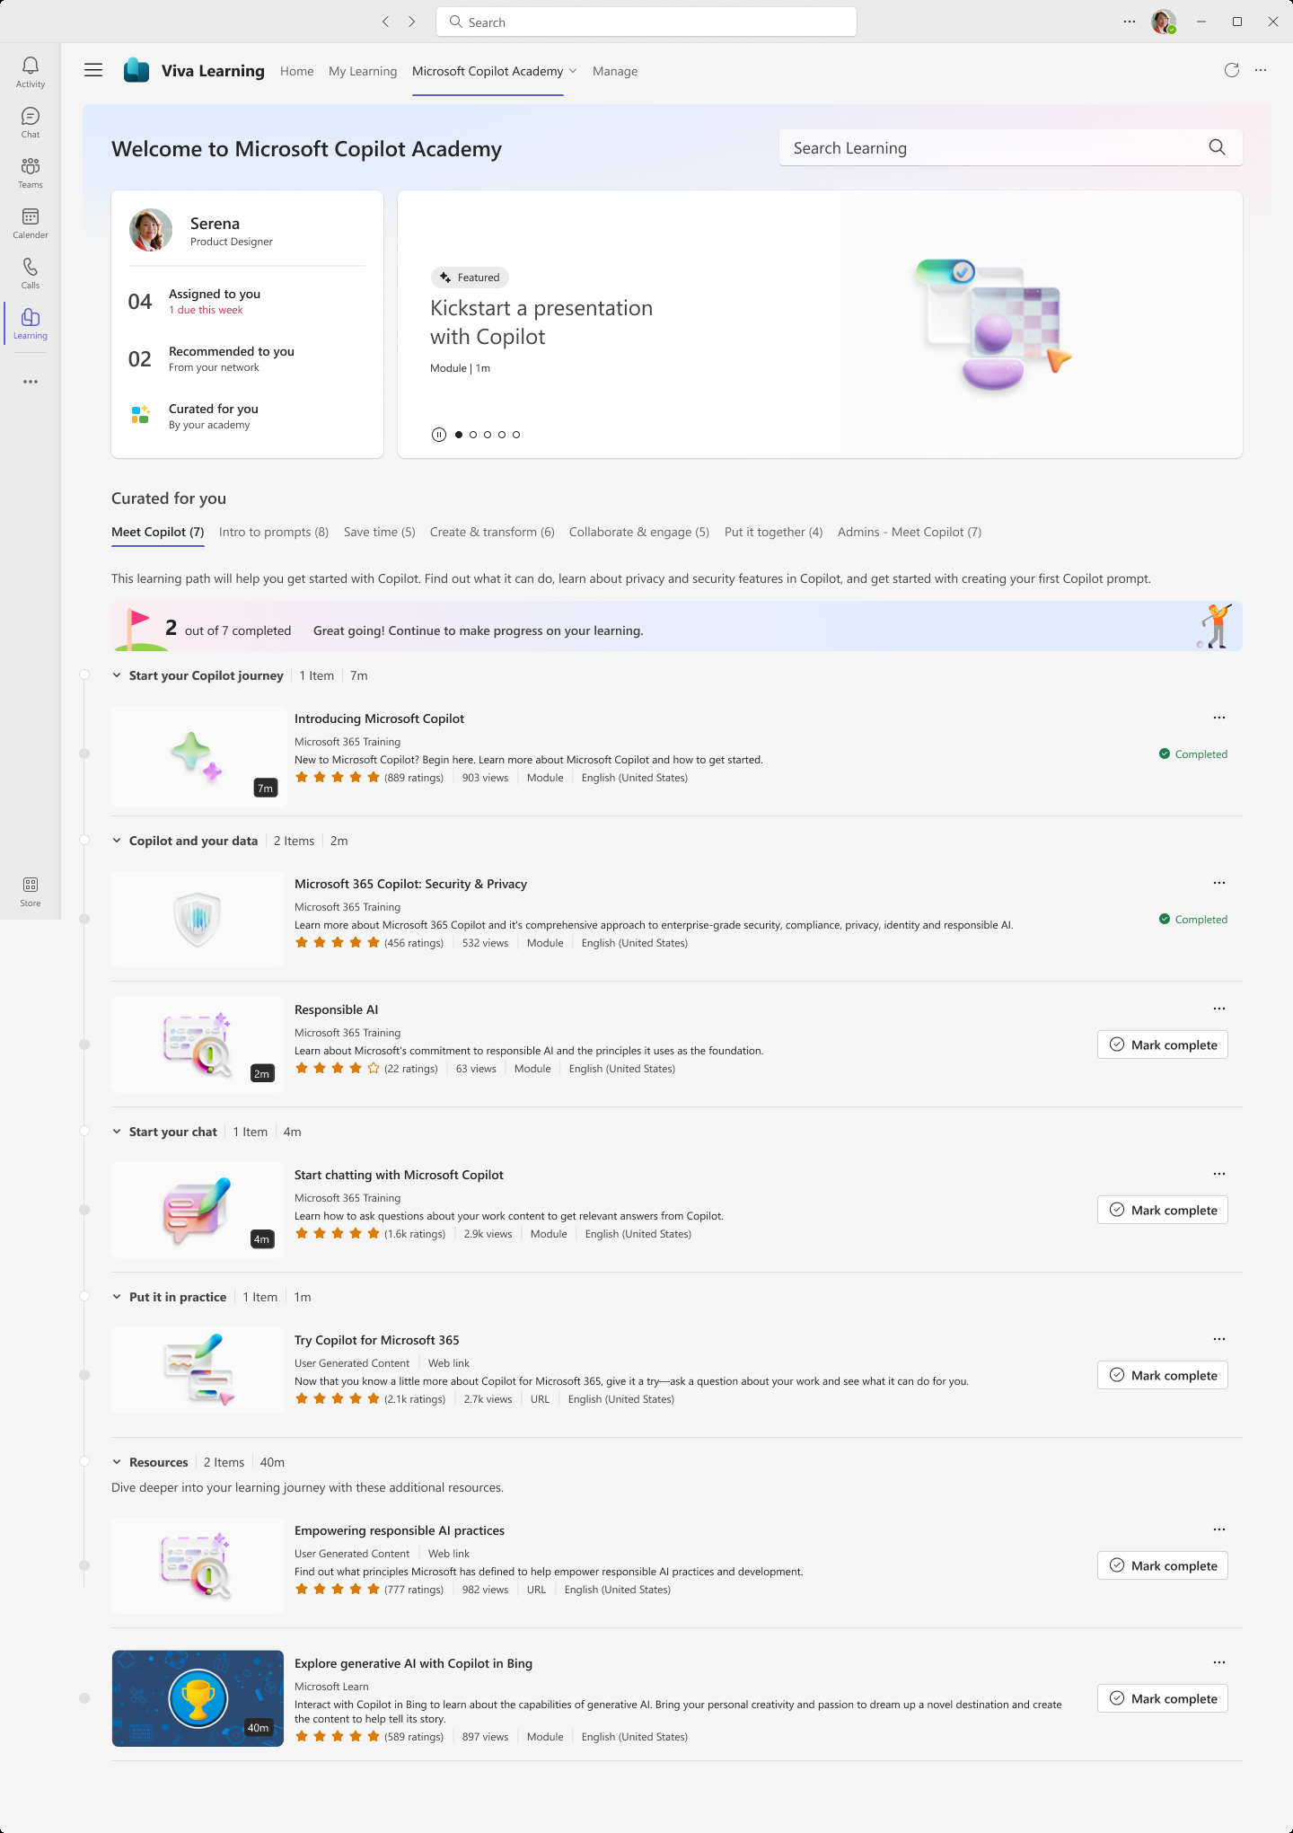
Copilot Academy
Skilling
Develop the skills to utilize Copilot experiences effectively
Curated learning paths designed by Microsoft experts to help you learn about, discover, and use Microsoft 365 Copilot
Access directly at aka.ms/CopilotAcademy
Surface free Copilot learning courses in the tools and platforms where users already spend their time
Includes hands-on prompt guidance from Copilot Prompt Gallery to develop prompt engineering skills
Out-of-the-box academy is preloaded in Viva Learning – no admin configuration required
Available in 8 languages

Slide 14
Skilling
Introducing AI Skills Navigator
An agentic learning space that helps individuals build career skills and organizations worldwide accelerate their business.
Rich, multimodal content
Skilling playlists
Curated content and credentials from Microsoft, LinkedIn and GitHub—all in a single place.
Personalized Al generated multimodal learning plans.
Skilling sessions
AI-generated podcasts
Live-like training available anytime with agentic support.
An engaging audio format that can be instantly generated from complex material.
AISkillsNavigator.microsoft.com
Notes:
The pace of change today is staggering. Every organization is asking the same question: How do we keep up and help our teams thrive in this new era? The challenge isn’t just learning—it’s evolving our skills as fast as business demands. And while there’s a flood of courses, articles, and videos out there, it can feel overwhelming. Leaders and employees want learning that is relevant, accessible, and that fits into their busy schedules.
We’re introducing the enhanced AI Skills Navigator—an agentic learning space that helps individuals and organizations worldwide build both the technical and uniquely human skills they need to stand out in an AI-driven workplace and accelerate their business.
Here’s what makes AI Skills Navigator unique:
Rich, multimodal content: A wide range of multimodal content and credentials from Microsoft, LinkedIn, GitHub, and other trusted sources, including videos, guides, labs, podcasts, and more to fit every learning style—all in one place.
Skilling playlists: Custom learning plans that anyone can create, assign to a team, and track to monitor progress and see how everyone is moving forward. You can select from curated, predefined skilling playlists by role, create your own, or use AI to help you create one.
Skilling sessions: Human-led, live-like training experiences that blend pre-recorded content with real-time AI coaching. The result is a dynamic, collaborative environment—so your teams get the energy of a classroom, but on their schedule, anytime and anywhere.​
AI-generated podcasts: With a single step, learners can transform complex training into short, natural-sounding audio bites and instant summaries in a format that fits their day, such as listening wherever it’s convenient or catching up between meetings.
AI Skills Navigator is now available worldwide as a public preview in English, with more features and languages coming soon. It’s time to empower yourself and your teams to grow—wherever you are.

Slide 15
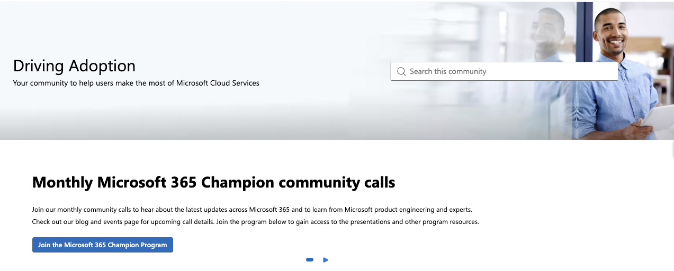
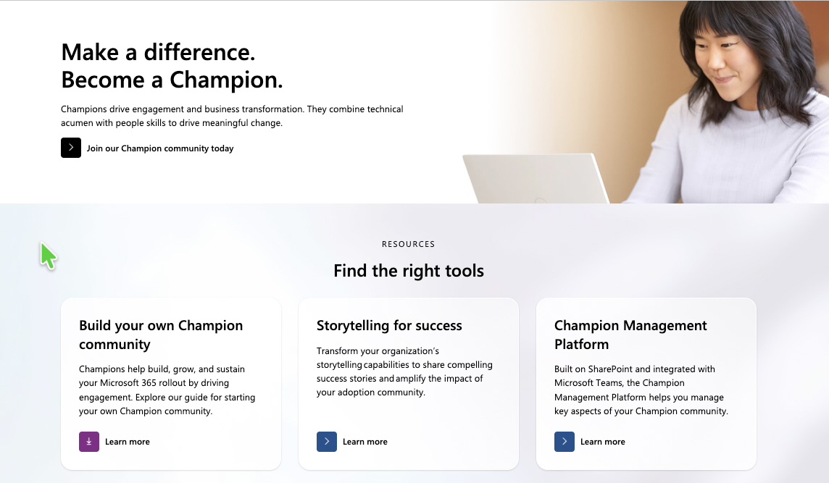
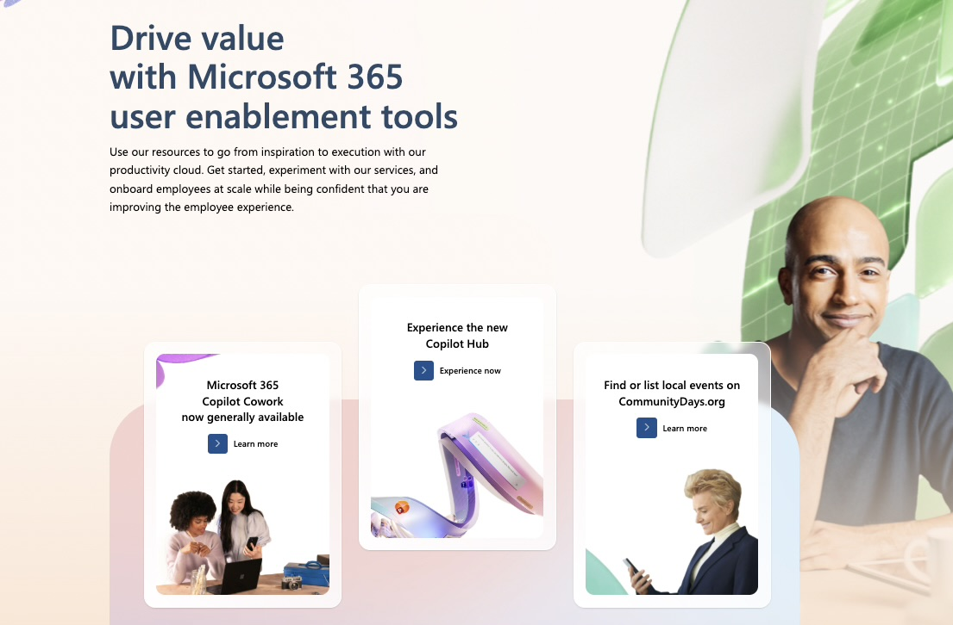
Bookmark Microsoft enablement resources
Join Driving Adoption Tech Community
Become a Champion
Microsoft Adoption Hub
aka.ms/DriveAdoption
Collaborate, share, and learn from experts
aka.ms/M365Champions
Monthly calls focused on adoption
adoption.microsoft.com
Resources to help you drive adoption
of Microsoft services
Join our communities
Utilize our resources
Achieve your goals
Notes:
Bookmark these helpful links to enablement resources and communities to help you achieve your goals.
Join the Driving Adoption Tech Community to collaborate and learn from other experts.
Join the Microsoft 365 Champions community to get access to Microsoft experts and slideware that you can easily reuse.
The Adoption Hub is a great resource for developers, IT professionals, and driving adoption.

Slide 16
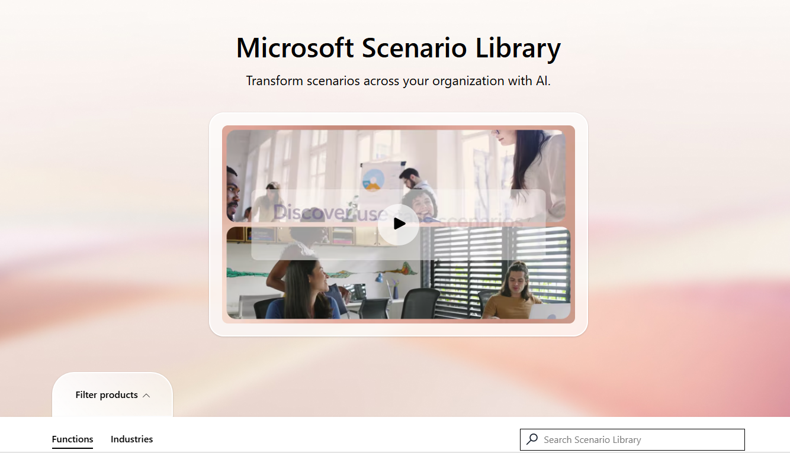
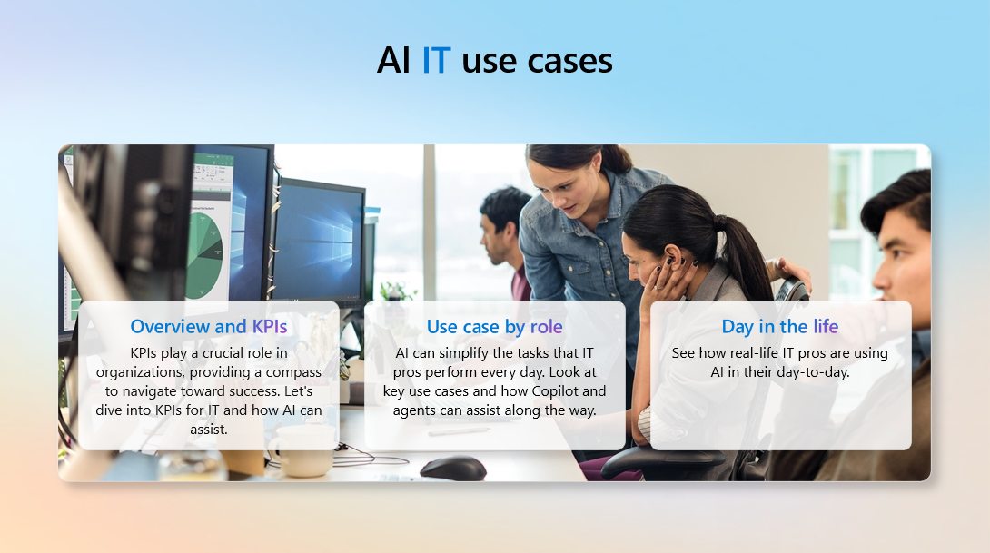
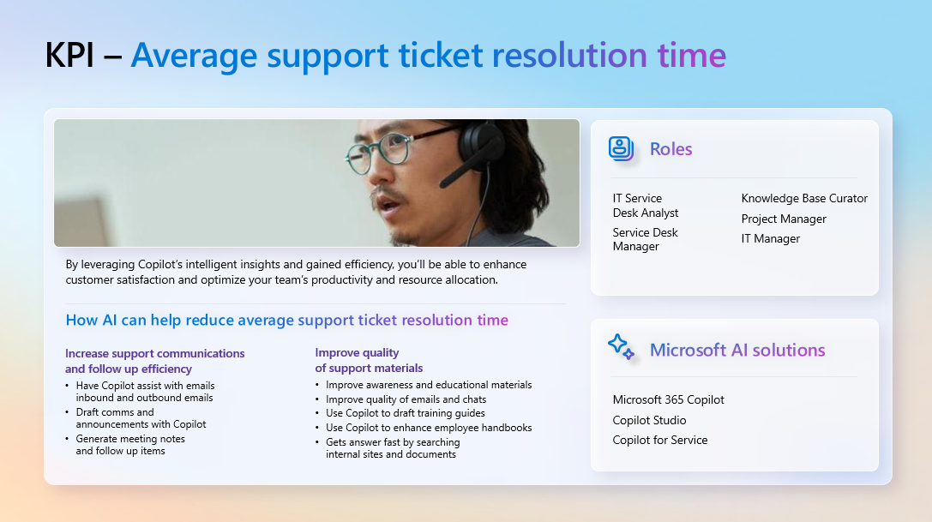
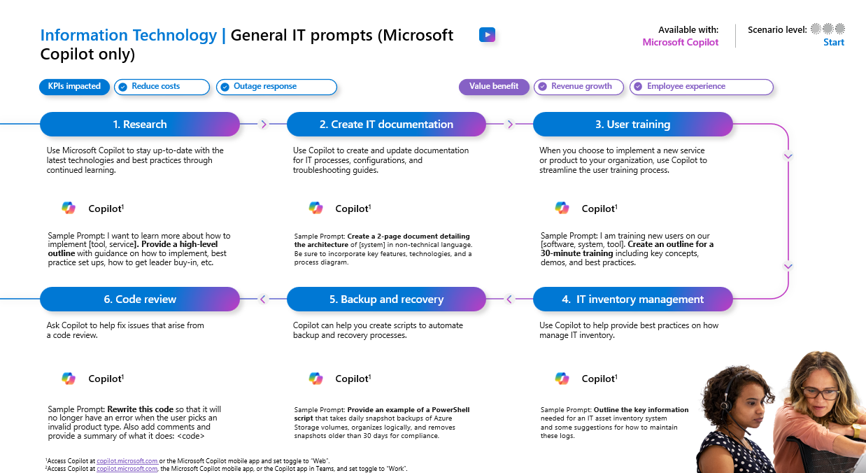
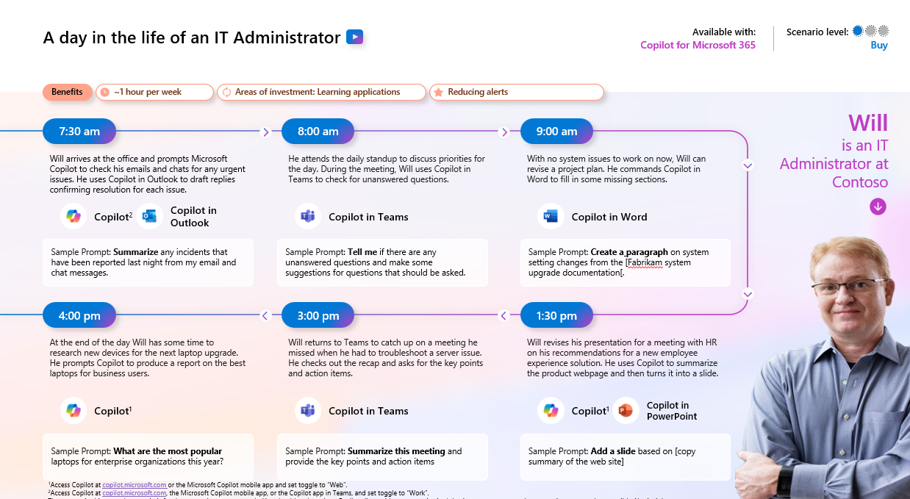
Functional scenario guidance
Utilize our interactive scenario library to start the conversation with business users about their pain points, opportunities, and ideas: aka.ms/ScenarioLibrary.
  Interactive library
  Downloadable guidance
Notes:
Leverage the interactive Copilot Scenario Library to help find and define specific user scenarios for your early adopters and organization.

Slide 17
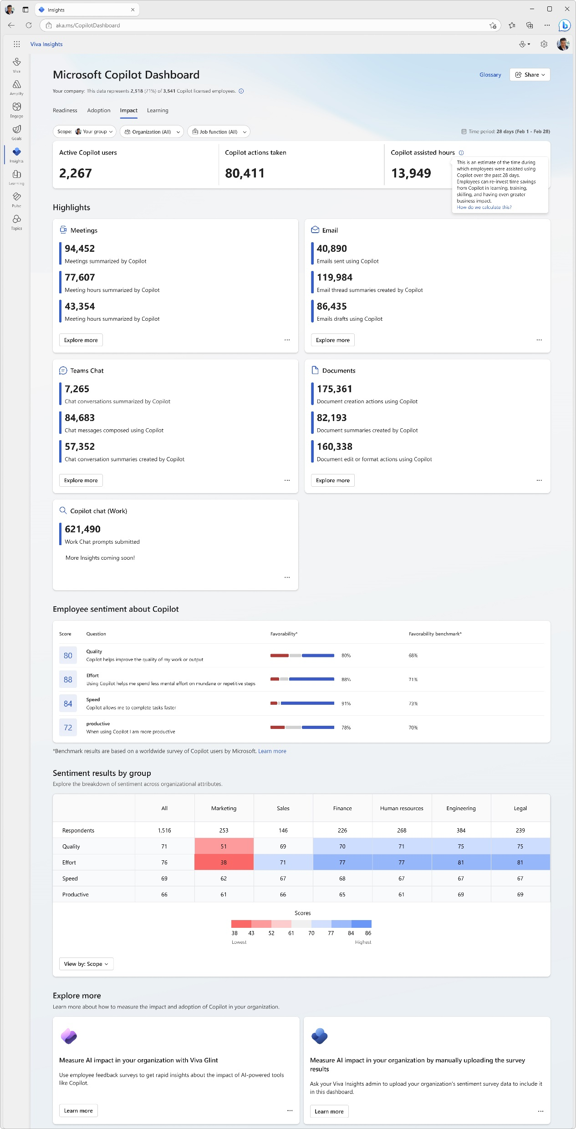
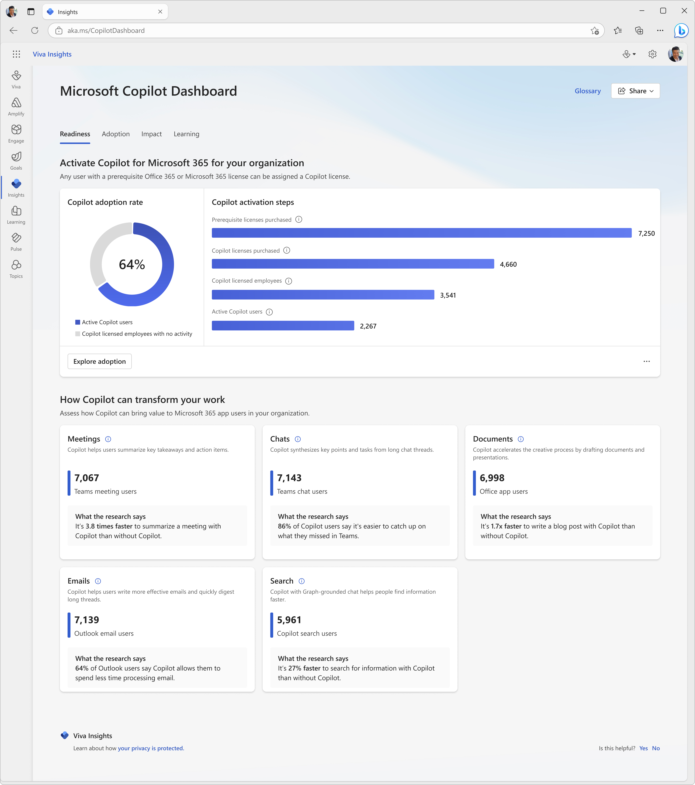
Copilot Dashboard
Measurement
Measure Copilot adoption and impact
Pre-built dashboard for business leaders to prepare for their Copilot rollout, understand and drive usage and adoption, and measure the impact of their investments.
Access directly at aka.ms/CopilotDashboard
Readiness tab to see licensing and copilot activation status across the tenant
Adoption tab to see Copilot trends and usage down to the app feature level, with filters to drill down by group, organization, and job function.
Impact tab to view Copilot actions by productivity categories, Copilot assisted hours and related value calculator and how Copilot usage is correlated with behavioral patterns in your business. Sentiment data from uploaded survey results is also available.
Learning tab for research and best practices to inform your AI journey
Use the Copilot Dashboard metrics eBook to help understand and interpret the data
Notes:
Use the Copilot Dashboard, powered by Viva Insights, to access usage reports and analyze data to understand trends and measure impact.

Slide 18
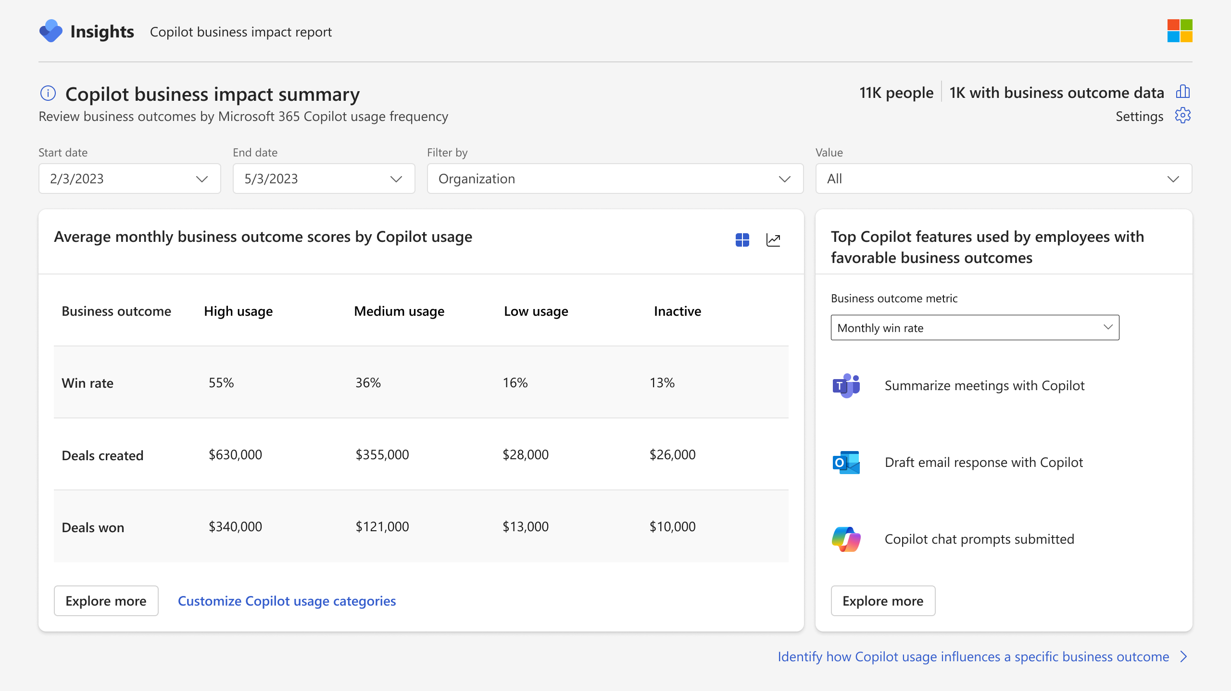
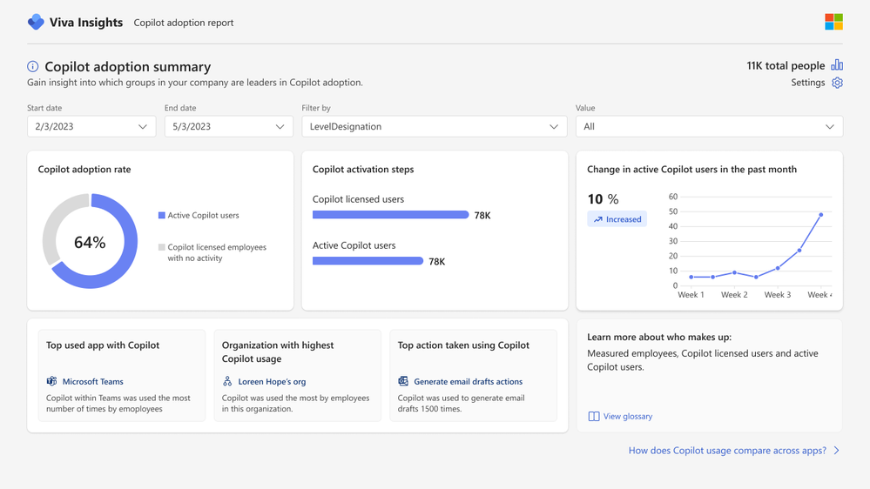
Viva Insights advanced impact reports
Measurement
  Included with Microsoft 365 Copilot
  Copilot business impact reports
Measure the value of Microsoft 365 Copilot with your key business metrics.
See setup details
  Advanced adoption and impact reports
Get a deeper look into Microsoft 365 Copilot adoption and impact trends with a customizable, prebuilt report.
Notes:
Viva Insights now comes included with your Microsoft 365 Copilot license.
Business impact reports:
Understand how Copilot usage relates to business outcomes in a Power BI report template
Customize your analysis for any function with your KPIs from your business data
Identify best practices based on what Copilot activities lead to successful business outcomes
Pinpoint opportunities to improve low Copilot usage to improve adoption and impact
Advanced M365 Copilot adoption report:
Understand how Copilot usage is trending across groups, apps and more.
Includes a dynamic date slicer, advanced filters and groups, trendlines, ability to customize active usage definitions and highlight section that calls out top Copilot actions.
Pull usage data older than 28 days with dynamic time ranges.
Advanced M365 Copilot impact report:
Tailor your Copilot impact report with advanced capabilities to get a deeper look into impact areas.
Compare collaboration patterns across groups or before and after Copilot usage.
Includes dynamic date slicer, Copilot assisted hours and value calculator, group comparisons, and the ability to customize active usage definitions.
Pull usage data older than 28 days with dynamic time ranges.

